Slide 1


Is there a Case for Community-Based Participation in Swiss Hydropower Projects?
September 4th 2017
IAEE European Conference: Session 1C
Pascal Vuichard
University of St.Gallen

Slide 2
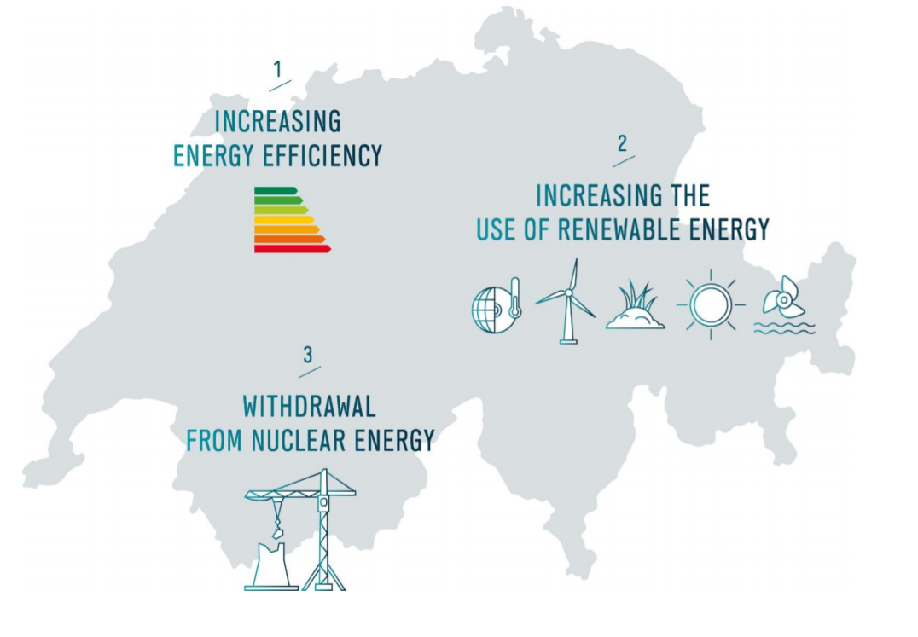
Research Context
Adoption of Energy Strategy 2050
Key Features of the ES2050
Increased Funding for Feed-in-Tariff
  But: Limited until 2022
  But: No more feed-in-tariff for small hydro (less than 1 MW)
Renewable Energy as a National Interest
Simpler and shorter approval procedures for RE-projects
Projected increase in production from hydropower
2
Source: BFE (2017)

Slide 3

Research Question
Research Question
Can Community-Hydro be a concept to support the increase in hydropower production within the context of the Energy Strategy 2050?
3

Slide 4



Agenda
Community-Hydro – a Visualization
Status Quo of Community Based Participation in Switzerland
Outlook and Conclusions
Methodology
Aspects of Community-Hydro in Switzerland
4

Slide 5
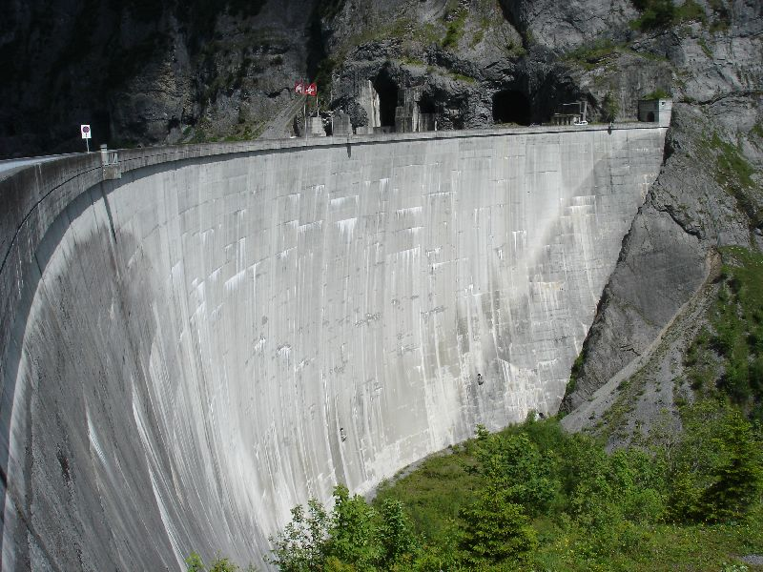



Community-Hydro in Switzerland
Process
Visualization
Produced hydropower gets fed into the grid
Hydropower plant
Utilities
Ms. Hampl
Ms. Broughel
Customers buys a part of the hydro power plant
Customers get compensated for their parts
Customers
5
Source: Adapted from Chwastyk & Sterling (2015)

Slide 6
Methodology
6

Slide 7

Methodological Approach
Methodology
Document Analysis
Review of Studies on Future Potential of Swiss Hydropower
Focus Group with Swiss Hydropower Practitioners
Expert Interviews with BFE
Comparison with Product Development Process for Swiss Community Solar Offering
7

Slide 8
Status Quo of Community Based Participation
8

Slide 9

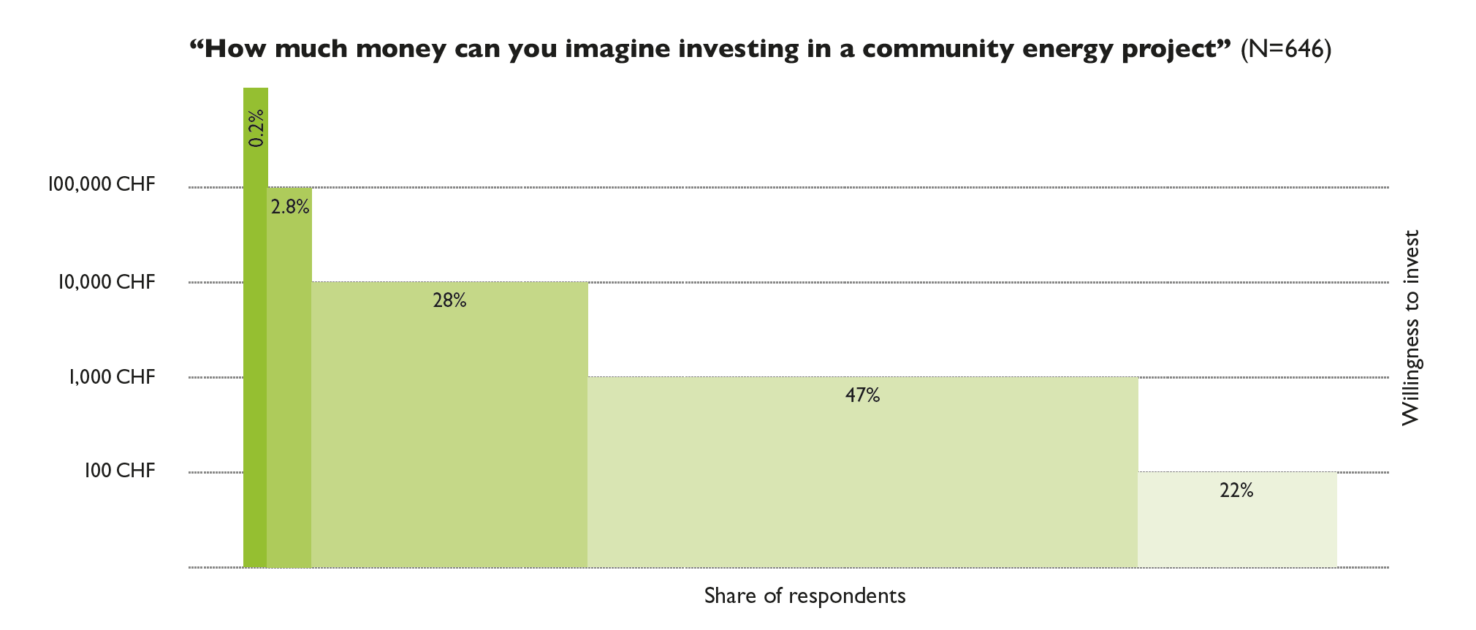
Status Quo Swiss Community Based Participation
3
Swiss Community Finance
61% of surveyed Swiss retail investors are interested in community finance
Of those, 69% can imagine investing up to 1‘000 CHF, another 28 % between 1‘000 and 10‘000 CHF
9
Source: Gamma, Stauch & Wüstenhagen (2017)

Slide 10

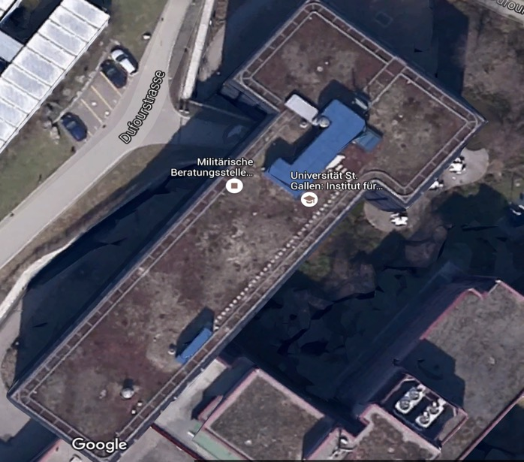
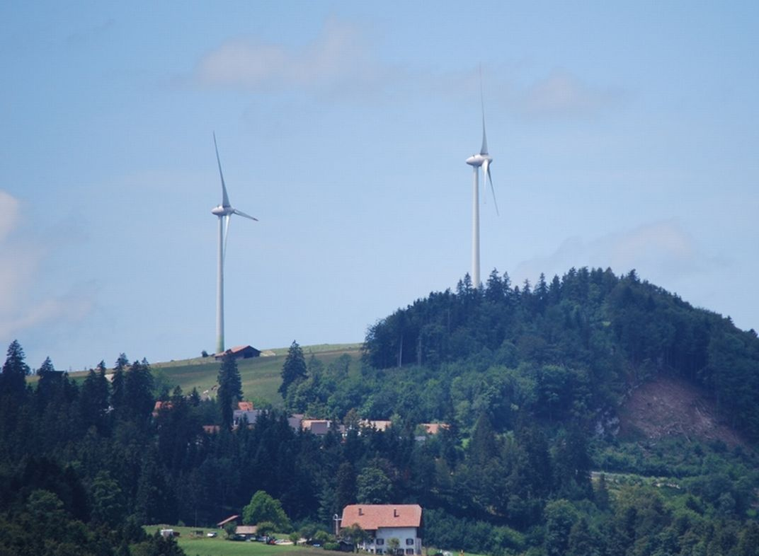
Status Quo Swiss Community Based Participation
Mr. Stauch
Ms. Läderach
Ms. Hoevel
Status Quo Switzerland
Community Solar
Community Wind
Source: Picture: Dufourstrasse 40a, St. Galllen (google maps), Wind Park Saint-Brais JU
10

Slide 11
Aspects of Community-Hydro in Switzerland
11

Slide 12
Potential Actors and Benefits
Potential Actors
Potential Benefits
Large Utilities
Customers
Customers
No (few) end customers
Large conglomerates
Typically owner of large hydro power
Every customer can take part
Pullout is possible at any time
Low financial barriers
Taking part in the Energy Transition
Small and Medium Utilities
Strong local position
Owner of small hydro (historical reasons)
End customers
Actors
Increased customer satisfaction
Increased customer retention
Creation of jobs
Addressing a new customer segment
Image of a local company
Contributing to the implementation of the Energy Strategy 2050
Cooperatives
Strong local focus
Challenge: Acquiring hydro power plants
Partnership with utility needed
12

Slide 13
Potential Investment Objects
Large Hydropower (>10 MW)
Small Hydropower (<10 MW)
Ownership Structure
Ownership Structure
Mostly large Swiss Utilities
Partner-Plant-Structure
Conglomerate of state-owned / semi-state-owned utilities
Option to buy first by partners
Interested in keeping complexity as low as possible
Owned by small and medium sized utilities
Strong connection to the local population – contact to end customers
Mostly owned directly by utility – not many different stakeholders
Large number of power plants
Project Structure
Project Structure
Large project sizes
Many stakeholders involved
Very long planning phases
Community Finance friendly project sizes
Planning phases shorter – national interest
13

Slide 14


What does that mean for Community-Hydro in Switzerland?
Focus on Small Hydropower
Local Utilities
Using the potential of the existing small hydro power plants
Restoration of old hydropower plants – in harmony with nature and adhering to ecological standards
Producing hydropower where it is used – decentral and close to the people
Local utilities with end customers compared to large utilities (energy producer)
Direct contact with customers
Local utilities often times own small hydropower plants
Need for increased production in hydropower sector obvious
Project Size
Tangibility
Small hydro with community-friendly project size
Duration for projects should be reduced given the ES2050
Small hydro a lot more visible
Local attachment to small hydro
Number of projects available
14

Slide 15
Outlook on further Research
15

Slide 16
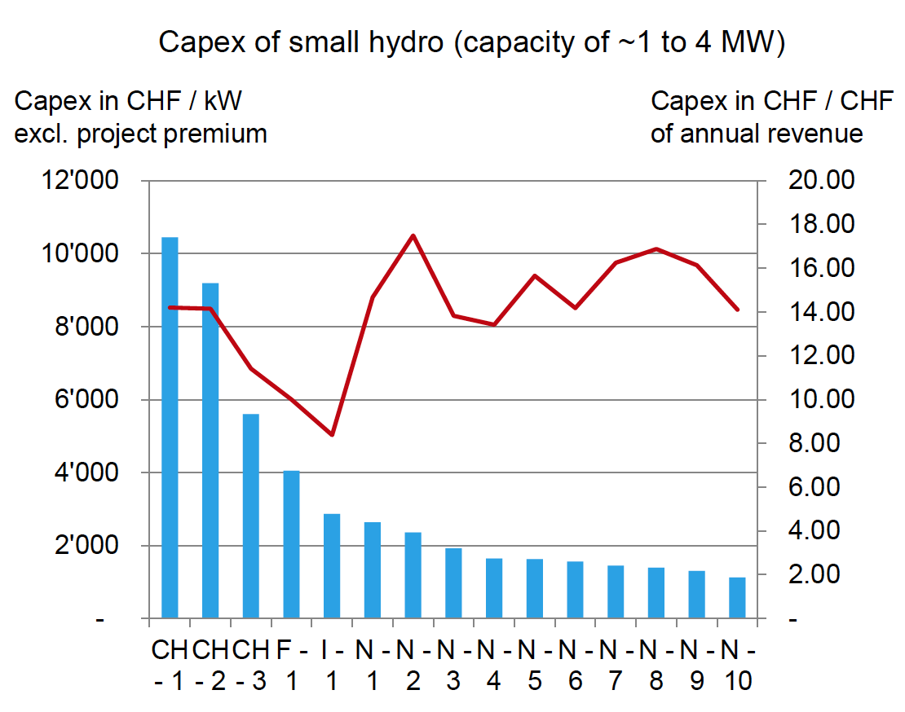

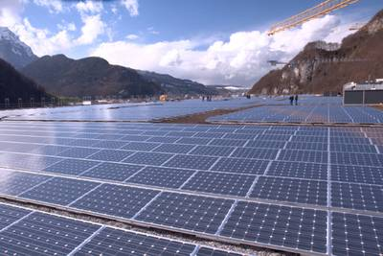
Outlook on Further Research
Role of New Regulation
Improving Profitability
Community Storage + Solar
Further reducing policy hurdles – Designing other policy instruments in a community-friendly way
For example: reduced grid costs for community projects
Reducing Gold-plating in construction in order to address high capex
Especially given the exclusion of small hydro from the feed-in-tariff system
Combining Community Solar with Community Storage
Acquiring your personal storage capacity
16

Slide 17
Conclusions
17

Slide 18
Can Community-Hydro be a concept to support the increase in hydropower production within the context of the Energy Strategy 2050?
Hypothesis: Yes, BUT
Potential Actor
Potential Object
Potential Customer
Small and Medium Utility
Strong contact to end customers
Interest in customer retention and satisfaction
Small hydropower plant
High visibility and tangibility
Producing hydropower where it is used
Large number of projects
Low financial barriers
Locally attached
Pullout option at any time
Being part of the Energy Transition
Challenges
Profitability of small hydro
Consequences of regulation changes due to ES2050
18

Slide 19
Thank you very much for your attention!
19

Slide 20
Sources
Bundesamt für Energie (BFE). (2013). Perspektiven für die Grosswasserkraft in der Schweiz: Wirtschaftlichkeit von Projekten für grosse Laufwasser- und Speicherkraftwerke und mögliche Instrumente zur Förderung der Grosswasserkraft. Bundesamt für
Bundesamt für Energie (BFE). (2015a) Bestehende Wasserkraft: Unterstützungsvarianten und ihre Wirkung.
Bundesamt für Energie (BFE). (2015b). Wasserkraft.
Bundesamt für Energie (BFE). (2016a). Energiestrategie 2050.
Bundesamt für Energie (BFE). (2016b). Energiestrategie 2050 – Erstes Massnahmenpaket - Massnahmen zum Ausbau der erneuerbaren Energien.
Chwastyk, D. & Sterling, J. (2015). Community Solar – Program Design Models. Solar Electric Power Association, November 2015.
Focus Group – Workshop: How to make capital costs of hydropower plants in Switzerland work for investors. REMforum, May 12th 2017.
20

