Slide 1

THE EFFECTS OF URBANIZATION ON ENERGY CONSUMPTION AND GREENHOUSE GAS EMISSIONS IN ASEAN COUNTRIES: A DECOMPOSITION ANALYSIS
Phuong Khuong Minh, Russell McKenna, Wolf Fichtner
15th IAEE European Conference 2017, Vienna, Austria.
Notes:
Thank you so much for your introduction. I am glad to be here and give you my presentation about

Slide 2
Contents
Introduction to ASEAN
Motivation & Objectives
Methodology
Results
Conclusion and Outlook

Slide 3
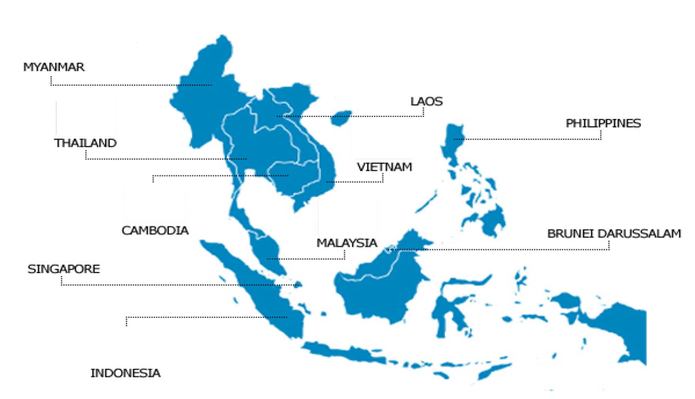

1. Introduction to ASEAN
ASEAN – Association of Southeast Asian Nations consists of 10 countries
 | ASEAN | EU | World
Area million km2 | 4.4 | 4.4
Population million people | 625 | 508
GDP annual growth rate % | 4.9 | 1.9 | 3.5
% Urban population | 52.2 | 71.3 | 60.2
Urban population annual growth rate % | 3.0 | 0.9 | 2.1
Energy intensity koe/$ | 0.174 | 0.111 | 0.157
CO2 emission annual growth rate % | 6.1 | -5.6 | 0.8
Resources: World Bank database – 2016, IEA - 2016
Notes:
ASEAN or The Association of Southeast Asian Nations – 10 countries is a regional intergovernmental organisation

Slide 4
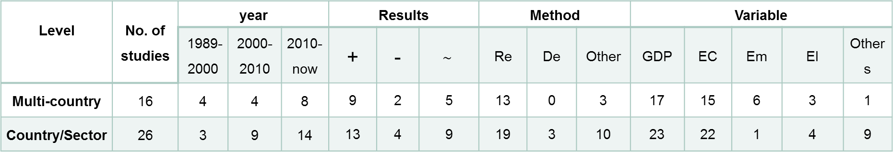
2. Motivation & Objectives
Literature review of the studies for relationship between Energy Consumption, Emission & Urbanization
Level | No. of studies | year |  |  | Results |  |  | Method |  |  | Variable
 |  | 1989-2000 | 2000-2010 | 2010-now | + | - | $$\sim$$ | Re | De | Other | GDP | EC | Em | EI | Others
Multi-country | 16 | 4 | 4 | 8 | 9 | 2 | 5 | 13 | 0 | 3 | 17 | 15 | 6 | 3 | 1
Country/Sector | 26 | 3 | 9 | 14 | 13 | 4 | 9 | 19 | 3 | 10 | 23 | 22 | 1 | 4 | 9
Acronyms:
“+”: increase effect, “-”: decrease effect, “$\sim$”: unclear effect.
Re: Regression; De: Decomposition; EC: Energy consumption; Em: Emission, EI: Energy Intensity
Issues:
Comparison between countries & sectors
Partly conflicting results
Methodology limitations
Variable selection : Urbanization definition, Emission & Energy intensity
Objectives:
Estimate the urbanization effect and other contributions effects on energy consumption & emission by new approach
Compare the effects in multi-level in ASEAN
Propose some suggestions for policy makers
Notes:
Limitation
Regression
Data
Require large data sets
Difficult to deal with unbalanced data (missing data & different criterial)
Method
Complex in defining & considering the relationship between dependent and independent variables
Not a strong tool in comparison
Overlooks the effect of structure (i.e. energy structure & economic structure)

Slide 5
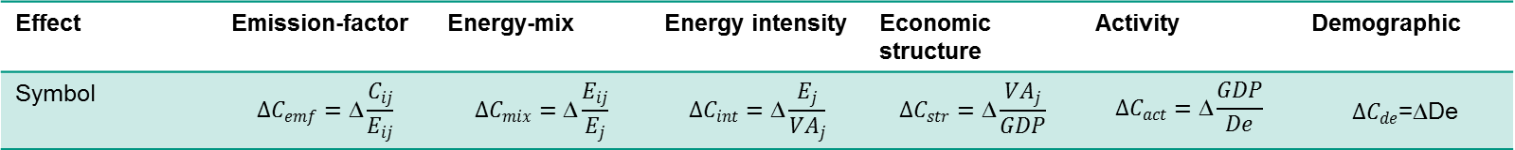
3. Methodology
IDA – Index Decomposition Analysis
Effect | Emission-factor | Energy-mix | Energy intensity | Economic structure | Activity | Demographic
Symbol | $$∆C_{emf}=\text{∆}\frac{C_{ij}}{E_{ij}}$$ | $$∆C_{mix}=\text{∆}\frac{E_{ij}}{E_{j}}$$ | $$∆C_{int}=\text{∆}\frac{E_{j}}{{VA}_{j}}$$ | $$∆C_{str}=\text{∆}\frac{{VA}_{j}}{GDP}$$ | $$∆C_{act}=\text{∆}\frac{GDP}{De}$$ | $∆C_{de}$=∆De
C: Emission
E: energy consumption
VA: Value added
De: Demographic
i: fuel (oil, gas, coal)
j: sector (commercial, industrial, transportation, residential
1st - Population
2nd - Urban 1 –
Population in urban areas
3rd - Urban 2 –
No. of non-agriculture employees
Notes:
First examine
Multi-level comparison
Different effects – 6 effects
Consider different demographic indicators
Singapore:
Mention about data resources
Explain activity effect

Slide 6
4. Results: different effects
Different effects on CO2 emission from 1995-2013
 | Emission-factor | Energy-mix | Energy intensity | Economic structure | Activity | Demographic
Brunei | - | - | - | - | + | +
Cambodia | + | + | + | + | + | +
Malaysia | +/- | +/- | + | -/+ | + | +
Myanmar | - | - | - | + | + | +
Philippines | - | - | + | + | + | -
Thailand | - | +/- | + | -/+ | + | +
Vietnam | - | + | - | + | + | +
“+”: increasing effect, “-”: decreasing effect,
“+/-”: change from increasing to decreasing
“-/+”: change from decreasing to increasing
Notes:
Results:
All 7 countries:
activity effect increases CO2 emission
Except for Philippines: demographic factors (population, urban population & no. of non agriculture employee) increase CO2 emission
Emission factor effect or the changes of emission from each type of consumed energy decreased CO2 emission in 6 of 7 countries
Energy mix effect or the changes of energy consumption from fossil fuel to alternative energy resources contributed some positive effect on reducing CO2 emissions in Brunei, Myanmar, Philippines during the considered period and recent in Malaysia and Thailand.
After many efforts in enhancing energy efficiency, only 3 countries showed the satisfactory results
Except for Brunei, because of the industrial bias in economic growth, the economic structure changes make CO2 emission increasing in the region

Slide 7
4. Results: different effects by sector
Different effects on CO₂ emission by sectorial in Philippines from 1995-2013
 | Emission-factor | Energy-mix | Energy intensity | Economic structure | Activity | Demographic
Commercial | + | + | - | + | + | -
Industrial | - | - | +/- | + | + | -
Transportation | - |  | + | + | + | -
Residential | + | - | + |  | + | -
“+”: increasing “-”: decreasing “+/-”: change from increasing to decreasing “-/+”: change from decreasing to increasing
Notes:
Other advantages of decomposition methods – not only compare multi-countries but also multi-sectors.
For example, look deeper into sectors at the special case of Philippines, the only countries has demographic effect drive CO2 emission decrease
Increasing production is the main reason increasing CO2 emission.
However the good control in demographic issues reduce the pressure on emission issues which is getting worse in Philippines year by year.

Slide 8
4. Results: Normalized effect of Urban 1 on Energy Consumption
EC | Brunei | Cambodia | Malaysia | Myanmar | Philippines | Thailand | Vietnam
Commercial | + | + | + | + | + | + | ++
Industrial | ++ | ++ | +++ | ++ | ++++ | ++ | +++
Residential | ++++ | ++++ | ++++ | ++++ | ++ | +++ | ++++
Transportation | +++ | +++ | ++ | +++ | +++ | ++++ | +
Notes:
Also, looking into the multi-level comparison, which means compare sectors by sector between different countries. We have the results like that. However, because of limited time, I would like to skip this slide and turn to the results of analysis or compare different effect from different demographic factors. That are quite interesting

Slide 9
4. Results: demographic effects
Average demographic effect on Energy Consumption
from 1995-2013
 | Population | Urban 1 | Urban 2
Brunei | 1.00 | 1.33 | 1.40
Cam | 1.00 | 1.48 | 3.53
Malay | 1.00 | 1.81 | 1.55
Myan | 1.00 | 2.24 | 3.41
Phil | 1.00 | 0.82 | 1.86
Thai | 1.00 | 3.49 | 3.25
Viet | 1.00 | 2.57 | 4.66
Multi-country comparison
Urban 1 & 2 effect more than Population
Sectorial comparison across countries
On Energy consumption
Strongest effect in residential sector
Weakest effect in commercial sector
On CO2 Emission
Strongest effect in transportation
Weakest effect in residential sector
Notable effect in Cambodia & Philippines
Constant effect in Vietnam & Malaysia
Urban 1 & 2 increase their effects in the first phrase and decrease gradually after that
Urban factors co-variate with energy consumption

Slide 10
4. Critique of the methodology
Sensitivity analysis
Every 1% variation in the input could change
Activity effect: about -5.5%
Demographic effect: 5.5%
Energy intensity effect: 0%
Pros & Con of the method
Advantages of decomposition:
Deal with non-linear relationship
Comparison in multi-level across countries
Assess the hidden effects as energy structure & economic structure
Disadvantages of decomposition:
Collecting & synchronizing data
Choosing appropriate decomposition analysis
Problem with 0 value in datasets
Regression example

Slide 11
5. Conclusion & Outlook
Demographic effect:
The effects on Energy Consumption & Emissions: Urban 2 > Urban 1 > population
Urbanization increases Energy Consumption & Emissions
Urbanization has the greatest impact on
Transportation emission
Residential energy consumption
Other effects on Energy & Emissions:
Increasing factors: Activity, Economic Structure
Decreasing factors: Energy intensity: most progress in industrial
Suggestions for Policy-makers:
Consider urbanization instead of population as a energy consumption & emission problem
Focus efforts on finding an optimal solution to decentralized, efficient energy system for urban cities
Focus efforts on decreasing transportation emission
Outlook:
Consider different urbanization indicators (population and/or urban density)
Improve database by applying bottom-up approaches
Using decomposition combined with regression to forecast energy demand

Slide 12
1. Introduction to ASEAN
ASEAN – Association of Southeast Asian Nations consists of 10 countries
 | ASEAN | EU | World
Area million km2 | 4.4 | 4.4
Population million people | 625 | 508
GDP annual growth rate % | 4.9 | 1.9 | 3.5
% Urban population | 52.2 | 71.3 | 60.2
Urban population annual growth rate % | 3.0 | 0.9 | 2.1
Energy intensity koe/$ | 0.174 | 0.111 | 0.157
CO2 emission annual growth rate % | 6.1 | -5.6 | 0.8
Resources: World Bank database – 2016, IEA - 2016
Notes:
the last messages also my motivation and also my pleasure to stand here to tell you about the CO2 emission issue in ASEAN is that
The CO2 emission problem could increase year by year in the region due to the rapidly economic growth. And the rapidly economic growth that I could tell you here is mainly come from their striving to have a better life. It will along with more machines and much more use of energy. All of these add to one of the great threats in the future: severe climate change
However, these 10 countries are working hard to get away from it and if they could get the right help from their government as well as from the world at large with things we are discussing here these 3 days. Then they could be ability to manage it but of course mainly by their own hard work.

Slide 13
Thank you for attention Feedback & Questions
Phuong, Khuong Minh. IIP - KIT
Contact:
Email: Khuong.phuong@partner.kit.edu
Tel: +49 721 608 – 44400

Slide 15
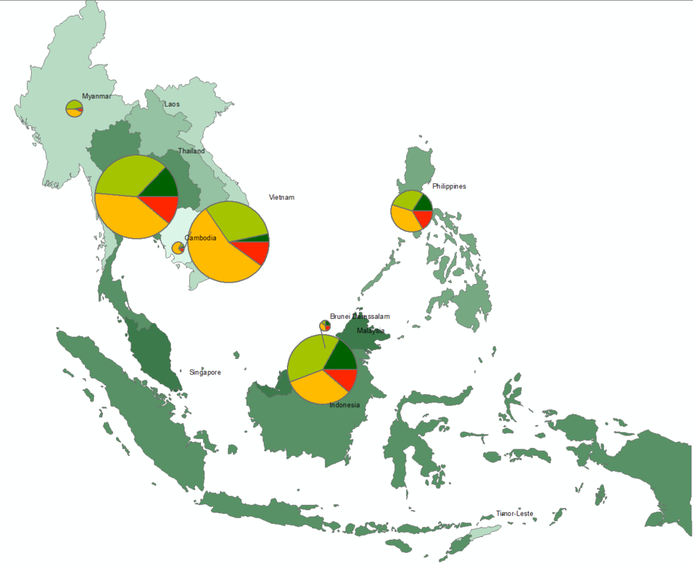


1. Introduction to ASEAN
CO2 emission from 1995 to 2013.
Unit: million ton CO2
CO2 – Commercial
CO2 – Industrial
CO2 – Transportation
CO2 - Residential
Urban percentage
21
22-34
35-38
39-44
45-54
55-77
78-100

Slide 16
3. Methodology & Database
Database: 7 countries from 1995 - 2013
Sector | Activity | Energy data | Emission data | Demographic
Residential | Number of households – National population censuses report | Fuel, renewable, electricity - IEA 2015 | CO2 emission from fuel combustion - IEA, 2016 | Population, Urban 1, Urban 2 – World Bank 2015
Commercial | Added Value, GDP – World Bank 2015 & ADB database 2015
Industrial
Transportation |  | Fuel – IEA 2015

Slide 17
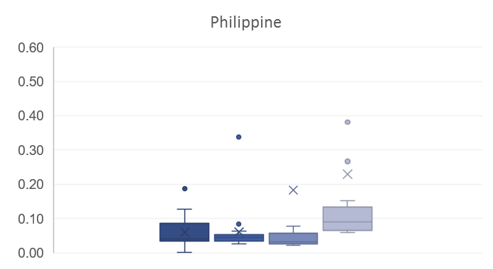
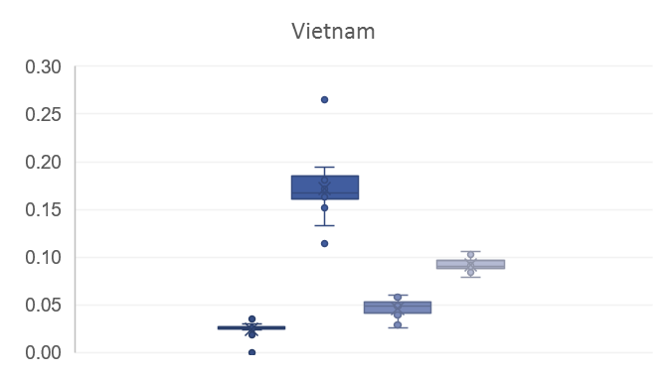
4. Results: Normalized effect of Urban 1 on Emissions
 | Brunei | Cambodia | Malaysia | Myanmar | Philippines | Thailand | Vietnam
Commercial | +++ | ++ | ++ | + | +++ | ++ | +
Industrial | ++++ | + | ++++ | +++ | + | +++ | ++++
Residential | ++ | +++ | + | ++ | ++ | + | ++
Transportation | + | ++++ | +++ | ++++ | ++++ | ++++ | +++

Slide 18
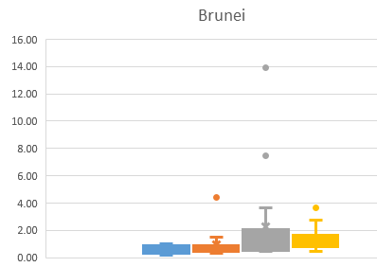
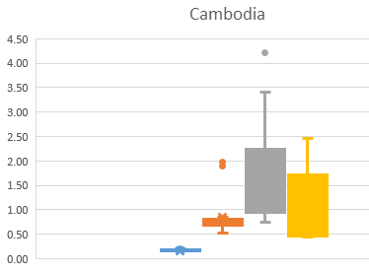
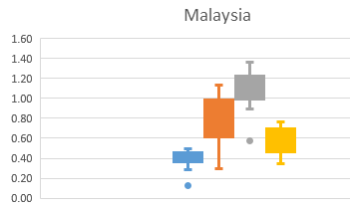
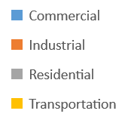
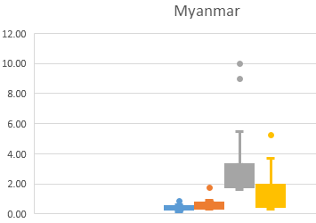
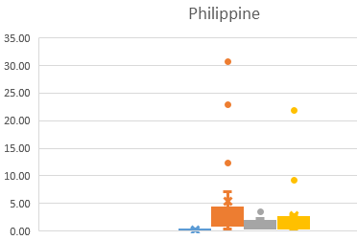
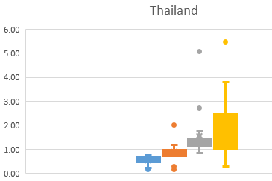
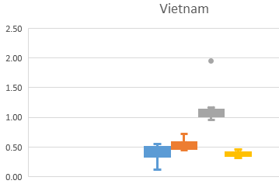
Energy consumption
EC | Brunei | Cambodia | Malaysia | Myanmar | Philippines | Thailand | Vietnam
Commercial | + | + | + | + | + | + | ++
Industrial | ++ | ++ | +++ | ++ | ++++ | ++ | +++
Residential | ++++ | ++++ | ++++ | ++++ | ++ | +++ | ++++
Transportation | +++ | +++ | ++ | +++ | +++ | ++++ | +

Slide 19
ASEAN status
World Bank, 2015
World Bank, 2015

Slide 20
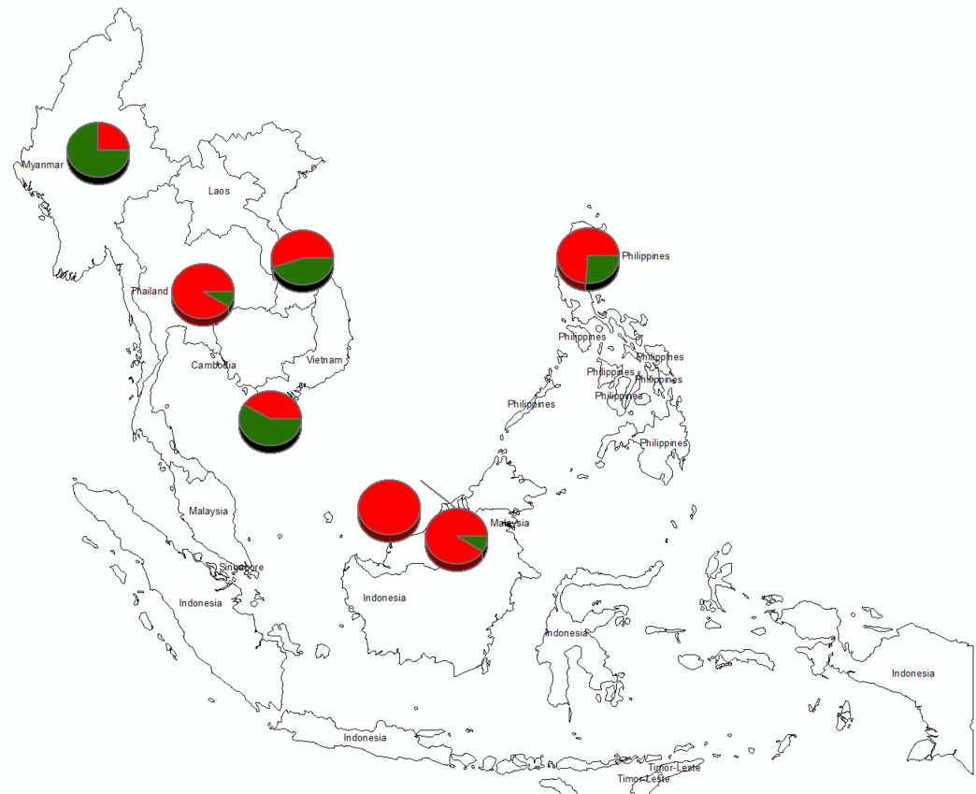
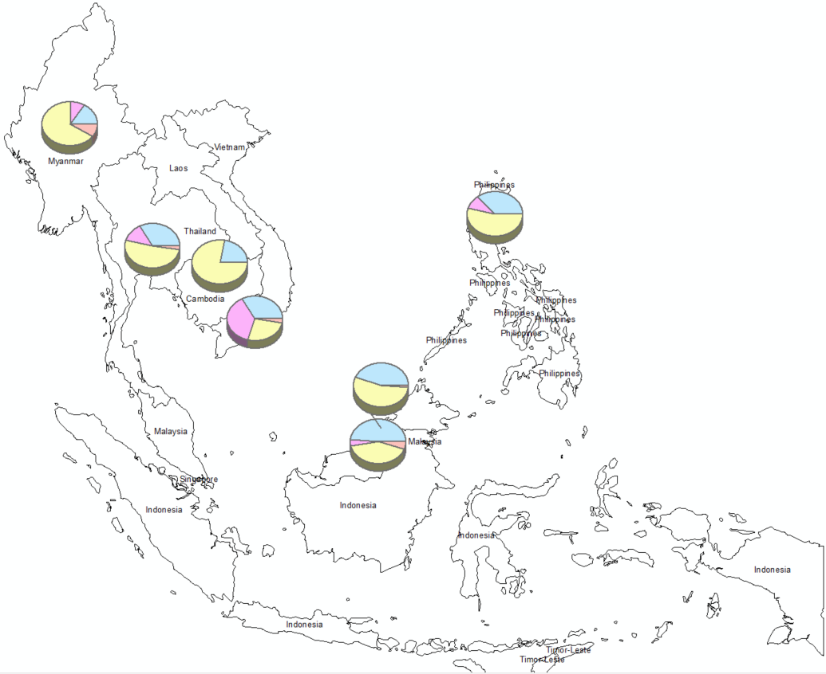



Slide 22
CO2 intensity 1995-2013.
Unit: kgCo2/Toe
- IEA -

Slide 23
Urbanization effect on Energy Consumption
 | Population | Urban 1 | Urban 2
Brunei | 1.00 | 1.33 | 1.40
Cam | 1.00 | 1.48 | 3.53
Malay | 1.00 | 1.81 | 1.55
Myan | 1.00 | 2.24 | 3.41
Phil | 1.00 | 0.82 | 1.86
Thai | 1.00 | 3.49 | 3.25
Viet | 1.00 | 2.57 | 4.66

Slide 24
3. Methodology selection
Limitation | Regression
Data | Require large data sets
 | Difficult to deal with unbalanced data (missing data & different criterial)
Method | Complex in defining & considering the relationship between dependent and independent variables
 | Not a strong tool in comparison
 | Overlooks the effect of structure (i.e. energy structure & economic structure)
IDA – Index Decomposition Analysis
Effect | Emission intensity | Energy mix | Energy intensity | Economic structure | Activity | Demographic
Symbol

