Slide 1



Impact of electricity market reform on CO₂ emissions by states and its implication in the U.S
Takako Wakiyama^{1,2}, Eric Zusman¹, James E. Monogan III³
1. Institute for Global Environmental Strategies (IGES), Japan
2. University of Sydney, Australia
3. University of Georgia, U.S
This study was supported by JSPS KAKENHI, Grant Number JP 16K21703

Slide 2
Outline
Purpose of the paper
Background and Trends of the U.S CO2 and electricity market
Methodology and model to assess the impacts of electricity market reform
Results and conclusion

Slide 3
Purpose of the paper
This paper aims to assess the impacts of electricity market reform and state policy to CO₂ emissions. We consider electricity market reform and policy are variables that impact to a shift of energy and carbon intensity, and indirectly affect to CO₂ emissions.
Basic assumption
To improve carbon and energy intensity and for further reductions of CO₂ emissions, restructure of electricity market could be one of key measures.
Electricity market system in the U.S. differs by states and regions. The impacts of restructuring electricity market and state policy on energy efficiency and energy mix in electricity, which contribute to reductions of CO₂ emissions at the state level, will be different. So it can help to understand the impact of electricity market reform in different conditions.
Notes:
As a global momentum of climate change, in 2015 the world agreed to make efforts to reduce GHG emissions to limit rising temperatures below 2 degrees Celsius in Paris Agreement under the international climate change negotiation of the United Nations Framework Convention on Climate Change (UNFCCC). To achieve the goal, nations are required to effectively reduce CO₂ emissions.
Examining the impacts of electricity market reform in U.S. to CO₂ emissions would be useful for countries that are currently planning the electricity market reform to understand the impact of electricity market reform and effective system that can promote renewable energy, energy efficiency and reduction of CO₂ emissions.

Slide 4
Background and Trends of the U.S CO2 emissions and electricity market

Slide 5
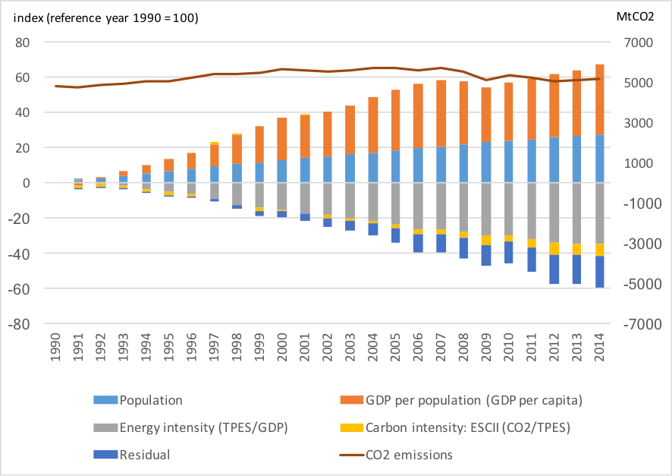
Emission contributions since 1990 to 2014
Source: Created by Authors from IEA (2016)
Research question:
Can electricity market reform improve carbon and energy intensity?
Notes:
The U.S is the second largest emitters of CO₂ (IEA 2016). CO₂ emissions accounts for 82% of the U.S GHG emissions and electricity contributes to 29% of the total GHG emissions in 2015
According to the IEA data of kaya identity (IEA, 2016), the main contributions to CO₂ emissions is population and GDP per capita (Fig. 1).
CO₂ emissions in 2014 increased 7.6% from 1990, where GDP per capita has increased 40%.
On the other hand, energy intensity (total primary energy supply/GDP) with 35% reduction from 1990 in 2014 has a great contribution to the reductions in CO₂ emissions since 1990, which also contributed to the reduction of CO₂ emissions. "CO2 emissions and drivers: CO2 = P (GDP/P) (TPES/GDP) (CO2/TPES)
where: C = CO2 emissions; P = population; GDP/P = GDP/population; TPES/GDP = Total primary energy consumption per GDP; CO2/TPES = CO2 emissions per unit TPES

Slide 6
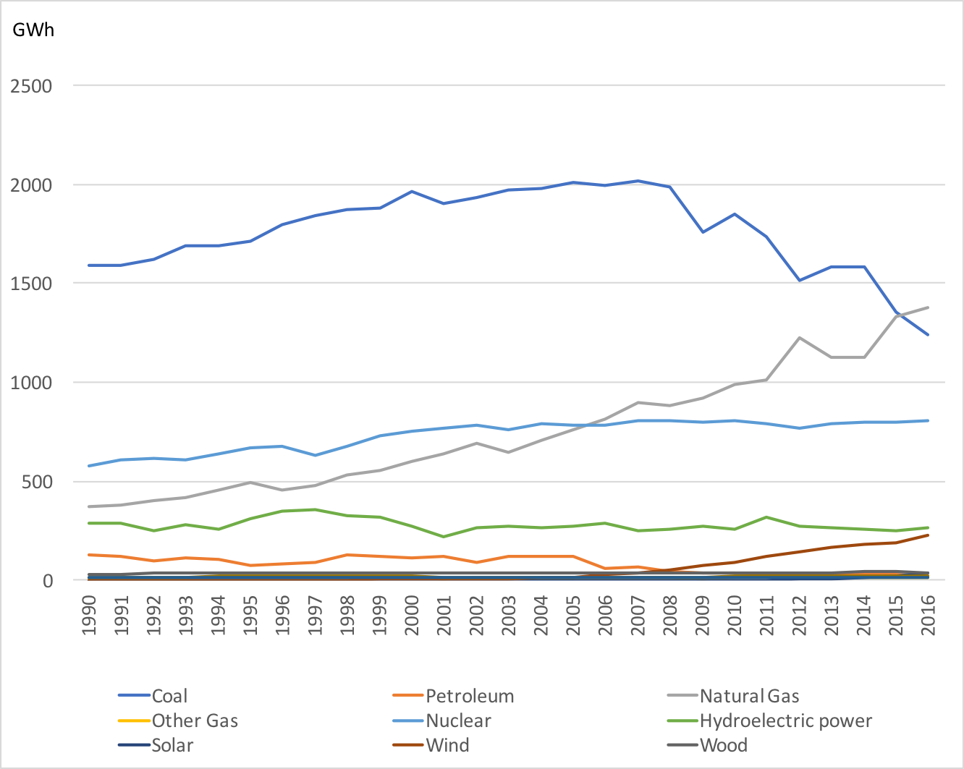
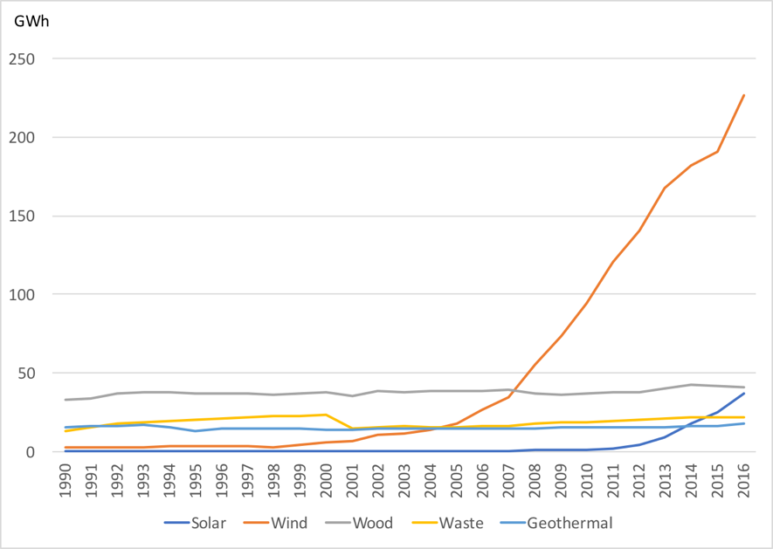
Improvement of carbon intensity:
Electricity net generation by different energy sources
Source: Created by Authors from
EIA 2016
Notes:
The U.S. has improved carbon intensity with increase in natural gas and renewables.
Electricity net generation from natural gas has increased three times more from 1990 to 2016 while that of coal has declined (Shearer et al 2014).
The carbon intensity of natural gas is 0.40MtCO2/GWh while that of coal is 1.00MtCO2/GWh (Fig. 3).
Renewables have also contributed to the improvement of carbon intensity.
As of 2016, renewable energy sources provide 15% of U.S electricity generation.
Most of the renewable sources come from hydropower generation (about 44%) and wind power (about 37%)

Slide 7
The U.S electricity market reform
Liberalization of wholesale market
In 1992, the U.S established a new class of electricity generators as one of the initiation of electricity market restructuring. With this, utilities and non-utilities are encouraged to invest in Independent Power Producers (IPPs) and to enhance the competition of wholesale markets
In 1996, FERC issued order 888 and 889 to unbundle their generation functions and provide open access to their transmission facilities. These orders also encouraged the establishment of Independent System Operators (ISOs) and Regional Transmission Organizations (RTOs) that manage the power transfers in the interconnection across states
Liberalization of retail market
Retail restructuring implemented in some states allows non-utility companies to purchase electricity in a wholesale market and offer retail consumers variety of pricing structures and choices.
Energy consumers in such states have choices to select energy suppliers offering different price structures

Slide 8
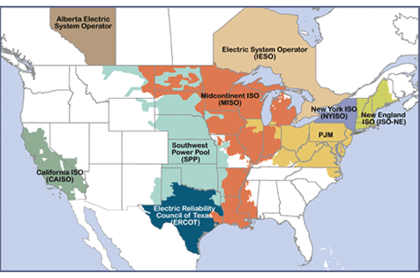
Electricity market reform in the U.S
Map of ISOs and RTOs
Source: FERC

Slide 9
 | Regulated market: Resource mix | Regulation: Timeframe | Regulation: Settlement | Demand Response | Energy Markets | Ancillary Services
California ISO | Conventional generators, storage, demand response | Day-ahead market. Regulation up and down are 15 minute products | Real-time price and historical performance | demand response in California consists of programs for managing peak summer demands operated by the state’s electric utilities. | In day-ahead market, From the offers and bids, CAISO constructs aggregate supply and demand curves for each location. | CAISO procures four ancillary services in the day-ahead and real-time markets: Regulation up: Regulation down: Spinning reserve: Nonspinning reserve
New York ISO (NYISO) | Conventional generators, storage, demand response | Day-ahead and real-time markets | Real-time price and historical performance | For demand-response (DR) programs | Hour ahead and Real time market | NYISO administers competitive markets for ancillary services that are required to support the power system. Operating reserves and regulation.
Electric Reliability Council of Texas (ERCOT) | Conventional generators, mostly made up of CC for both regulation up and down | Cleared in day ahead market | Real-time price
PJM interconnection | Conventional generators, storage, demand response | Cleared hourly in real-time market | Real-time price and historical performance | PJM’s DR programs can be grouped into emergency or economic programs. | In Real-Time Market, PJM must coordinate the dispatch of generation and demand resources to meet the instantaneous demand for electricity. | Regulation: Synchronized reserves: Day-ahead scheduling reserves (DASR):
ISO New England (ISO-NE) | Generators only | Real-time. Approximately hourly | Real-time price and historical performance | ISO-NE administers the following demand-response programs for the New England wholesale electricity market | In real time market, ISO-NE must coordinate the dispatch of generation and demand resources to meet the instantaneous demand for electricity. | ISO-NE procures ancillary services via the forward reserve market and its regulation market.
Midwest ISO (MISO) | Mostly conventional generators. Very small percentage from one battery and one demand response | Day-ahead and real-time market | Real-time price and historical performance | MISO recognizes the value of Demand Response as a mechanism for improving market efficiency | MISO must coordinate the dispatch of generation and demand resources to meet the instantaneous demand for electricity. | MISO procures ancillary services via the co-optimized energy and ancillary services market and includes the following services: Spinning Reserves, Supplemental Reserves, Regulation
Southwestern Power Pool (SSP) | Mostly conventional generation, dispatchable wind occasionally participates in providing regulation down | Day-ahead and real-time markets. Regulation up and down are five minute products | Real-time price and historical performance |  | SPP must coordinate the dispatch of generation and demand resources to meet the instantaneous demand for electricity | SPP procures ancillary services via the co-optimized energy and ancillary services market and includes the following services: Regulation Up reserves, Regulation Down reserves. Spinning Reserves, Supplemental Reserves

Slide 10
Electricity market reform and improvement of energy intensity
Reducing electricity consumption (in this paper we look at electricity sales) per GDP at the state level.
To reduce electricity from demand side.
To reduce energy use per generation in energy supply.
In deregulated competitive market
Electricity suppliers seek to reduce their total cost of supply by pursuing better cost-performance.
Incentive to pursue more energy efficiency of electricity power generation plants and to shift from conventional power plant to less emission technologies.
Some of electricity markets has introduced energy demand response
It gives opportunities for electricity users to manage their electricity use in a cost benefit way
energy supplier can reduce and shift the operation of the electric grid during peak period by providing various time-based rates and financial incentives

Slide 11
Electricity market reform and improvement of carbon intensity
To shift the energy sources from high carbon intensity to lower carbon intensity by increasing renewable energy
Renewable portfolio standards (RPS)
One of the significant drivers for the growth of investment in renewable generation.
In deregulated wholesale electricity market
IPP and non-utility generators such as wind farms can participate in the market-based competitive system.
In regulated retail states
If a state implements RPS, utilities might include more renewables in their energy mix to control the costs and maintain the cap rate regulated by public utility commissions.
Notes:
Currently 29 states and Washington DC have a RPS while eight sates set up renewable goals without any financial penalties for non-achievement.

Slide 12
Methodology and model to assess the impacts of
electricity market reform

Slide 13
Methodology
To assess impacts of different variables to carbon and energy intensity, and CO₂ emissions in 50 states, use fixed panel analysis.
Panel data is analysis of pooled cross-sectional time series data.
Panel data analysis can control heterogeneity of individuals such as cities and states. Each state in the U.S. has heterogeneous features, which cannot be controlled by time-series and cross-section studies and resulted in biased results.
In our model, the interesting treatment is when a state introduces a new market reform, how does state's electricity supply and demand eventually changes the energy and carbon intensity.
Notes:
CO₂ emissions is modeled as a function of carbon and energy intensity. These variables vary with states and time. However, if there are other variables that could be invariant in states and time or measures that are difficult to measure or hard to obtain data, it affects CO₂ emissions, but it cannot include it in the equation. By omitting these variables, the estimated result would have bias. Panel data analysis can control these invariant variables in states and time by effectively control all states specific characteristics.

Slide 14
A path diagram to assess variables to impact to CO₂ emissions

Slide 15
Assumptions
Assumption 1: Electricity market reform in term of both wholesale and retail market can reduce the price of electricity by creating competition in markets and pursuing efficiency and better cost performance electricity sources to consumers
Assumption 2: State policy of RPS increases a proportion of renewable energy in energy mix of electricity power generation, which lead to the reduction of carbon intensity. If the usage of renewables increases in energy mix of electricity generation in a state, then the elevated renewable usage will diminish the level of per capita CO₂ emissions, which leads to reductions of carbon intensity.
Assumption 3: Deregulation of electricity market is expected to increase renewable which contribute to the reduction of carbon intensity, by encouraging energy suppliers to pursue efficiency and offer various options.
Assumption 4: Deregulation of retail market, and establishing ISOs/RTOs where create deregulated wholesale market, can contribute to increase in renewable which leads to the reduction of carbon intensity.
Assumption 5: Deregulation of electricity market by opening up wholesale market gives options for IPP and non-utility to enter the market and increase the competitions. Thus the competition encourage to reduce energy intensity and carbon intensity.

Slide 16
Assumptions
Assumption 6: Deregulation of electricity market both in wholesale and retail market is expected to improve energy intensity, and increase renewable which contribute to the reduction of energy intensity, by encouraging energy suppliers to pursue efficiency and offer various options.
Assumption 7: From energy consumers perspective, price changes promote them to reduce energy use, which lead to the reduction of energy intensity (electricity production per GDP) because the decline of consumption can contribute to the reduction of energy production. If price of electricity increases, the consumers are likely to reduce electricity use. Deregulated markets offer the consumers different price options.
Assumption 8: Energy and carbon intensity contribute to the reduction of CO₂ emissions.

Slide 17
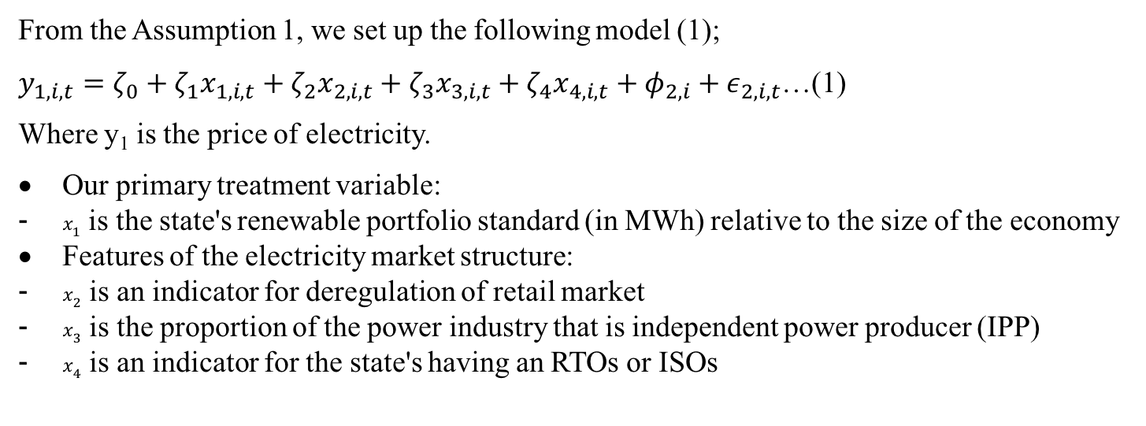
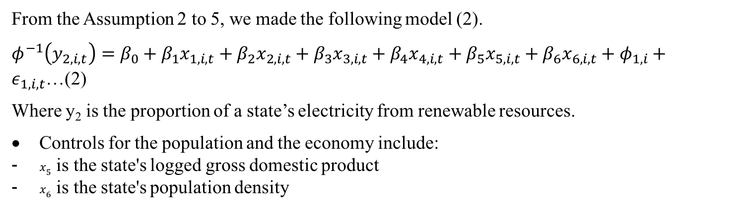
Model 1 & 2
From the Assumption 1, we set up the following model (1);
$y_{1,i,t}=ζ_{0}+ζ_{1}x_{1,i,t}+ζ_{2}x_{2,i,t}+ζ_{3}x_{3,i,t}+ζ_{4}x_{4,i,t}+φ_{2,i}+ε_{2,i,t}$…(1)
Where y₁ is the price of electricity.
Our primary treatment variable:
$x_{1}$ is the state's renewable portfolio standard (in MWh) relative to the size of the economy
Features of the electricity market structure:
$x_{2}$ is an indicator for deregulation of retail market
$x_{3}$ is the proportion of the power industry that is independent power producer (IPP)
$x_{4}$ is an indicator for the state's having an RTOs or ISOs
From the Assumption 2 to 5, we made the following model (2).
$φ^{−1}\left(y_{2,i,t}\right)=β_{0}+β_{1}x_{1,i,t}+β_{2}x_{2,i,t}+β_{3}x_{3,i,t}+β_{4}x_{4,i,t}+β_{5}x_{5,i,t}+β_{6}x_{6,i,t}+φ_{1,i}+ε_{1,i,t}$…(2)
Where y₂ is the proportion of a state’s electricity from renewable resources.
Controls for the population and the economy include:
$x_{5}$ is the state's logged gross domestic product
$x_{6}$ is the state's population density

Slide 18
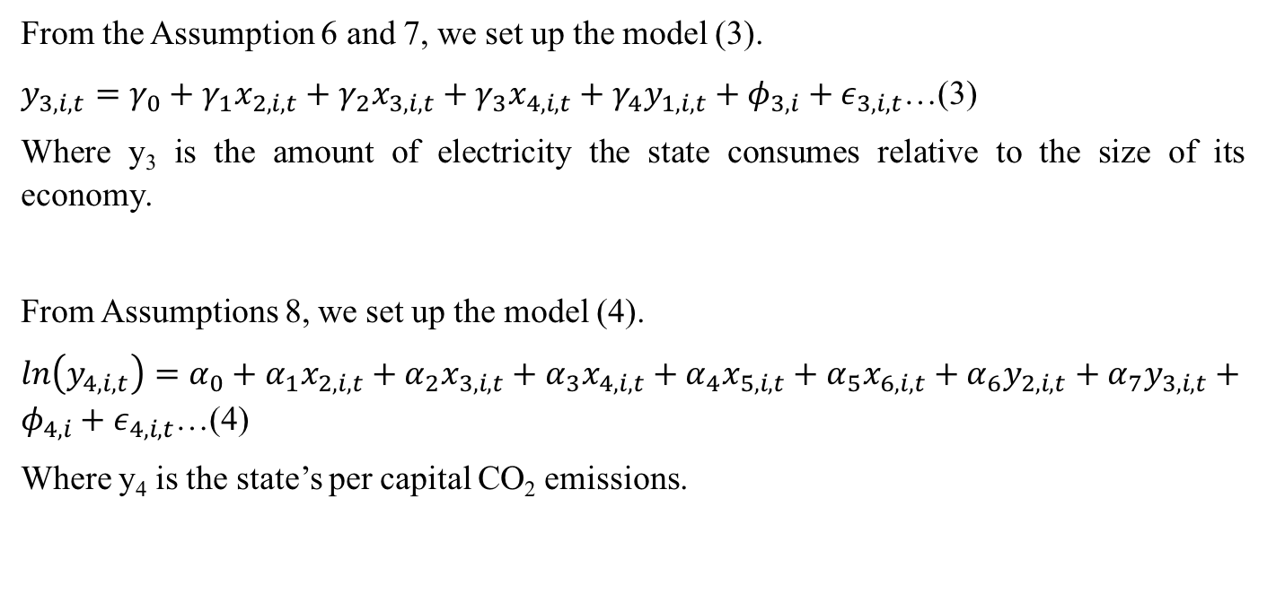
Model 3 & 4
From the Assumption 6 and 7, we set up the model (3).
$y_{3,i,t}=γ_{0}+γ_{1}x_{2,i,t}+γ_{2}x_{3,i,t}+γ_{3}x_{4,i,t}+γ_{4}y_{1,i,t}+φ_{3,i}+ε_{3,i,t}$…(3)
Where y₃ is the amount of electricity the state consumes relative to the size of its economy.
From Assumptions 8, we set up the model (4).
$ln\left(y_{4,i,t}\right)=α_{0}+α_{1}x_{2,i,t}+α_{2}x_{3,i,t}+α_{3}x_{4,i,t}+α_{4}x_{5,i,t}+α_{5}x_{6,i,t}+α_{6}y_{2,i,t}+α_{7}y_{3,i,t}+φ_{4,i}+ε_{4,i,t}$…(4)
Where y₄ is the state’s per capital CO₂ emissions.

Slide 19
Results and conclusion

Slide 20
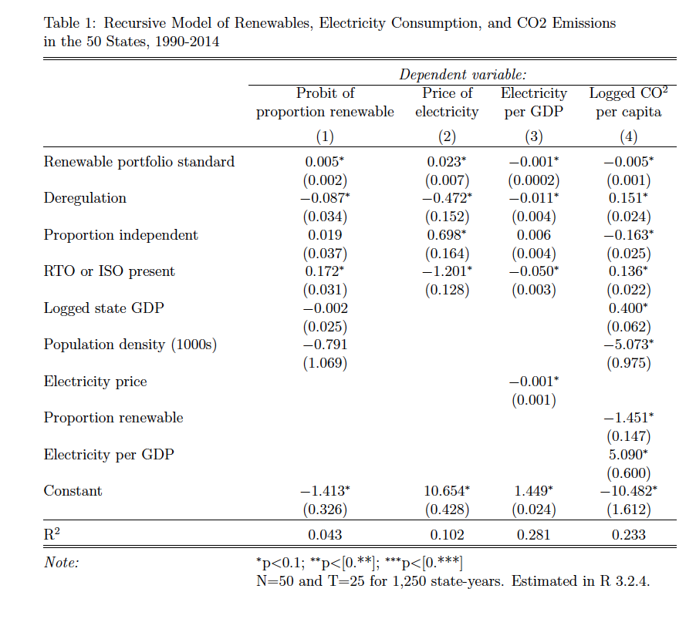
Recursive Model of Renewables, Electricity Consumption, and CO2 Emissions in the 50 States, 1990-2014

Slide 21
Results
Model 1: Electricity price
Year that a state had a deregulated retail electricity market significantly impact to price of electricity by reducing the price by 4.7%.
Electricity market reform in wholesale have also a significant impact to drop electricity price by 12% in year when states joined ISOs/RTOs.
Year that a state had a deregulated retail electricity market significantly increases in the price of electricity by around 7%.
The state’s Renewable Portfolio Standard (RPS) significantly influence the electricity price by 2.3%.
Model 2: Renewables
The state’s RPS has significant impact on the increase in the proportion of renewables in electricity production in a state with 0.5% increases as the targeted amount of RPS increases.
Year that a state had a deregulated retail electricity market has 8.7% drop in a proportion of renewables.
Year when a state joined ISOs/RTOs have significant impacts to increase in renewables
The increase in the proportion of IPP in the electricity generators does not have significance in increase in renewables

Slide 22
Results
Model 3: Energy intensity
The increase in proportion of renewables in the electricity productions in a state also significant impact on the reduction of energy intensity .
he price increase reflects to the reduction of energy intensity.
ISOs/ RTOs does not have significant to influence in the change of energy intensity.
Model 4: CO₂ emissions
An increase in proportion of IPP and proportion of renewables significantly impact on the reduction of CO₂ emissions by 1.6% and 1.45% respectively.
The most influential factor to the reduction of CO₂ emission per capita is the population density with 5.07. The higher population density, the less CO₂ emission per capita.
Electricity market reform in both deregulation of wholesale and retail markets have an negative impact on CO₂ emissions per capita.
Notes:
if we combine direct and indirect effects, the effect is negative. The reason for this is that this is the effect of electricity market reform after controlling for a lot of variables that were affected by the reforms.

Slide 23
Conclusions
Electricity market reform contributed to reduction of electricity price
Electricity market reform has great contributions to efficiency of the market by reducing electricity price and energy intensity, which could result from the increasing competition of a market.
Although carbon and energy intensity significantly contributed to the reduction of CO₂ emissions per capital at the state level, electricity market reform in both wholesale and retail did not directly impact on reducing CO₂ emissions.

Slide 24

Thank you

