Slide 1


Evaluating the EU’s Energy Innovation System
15th IAEE European Conference 2017
6th Sept. 2017
Yeong Jae Kim
Charlie Wilson

Slide 2
Objective
  To evaluate the balancedness and consistency of directed innovation activity in the EU with the priority areas set out in the Strategic Energy Technology (SET) Plan
No. | SET Plan 6 Priorities | SET Plan 10 Action Plan
1 | No.1 in Renewables (RE) | Performant renewable technologies integrated into the system)
 |  | Reduce costs of technologies
2 | Smart EU Energy System with consumers at the centre (SG) | New technologies & services for consumers
 |  | Resilience & security of energy system
3 | Efficient Energy System (EE) | New materials & technologies for buildings
 |  | Energy efficiency for industry
4 | Sustainable Transport (EV, Biofuels) | Competitive in global battery sector (e-mobility)
 |  | Renewable fuels
5 | Carbon Capture and Storage (CCS) | Carbon Capture and Storage
6 | Nuclear Safety (NS) | Nuclear Safety

Slide 3
Use indicators to analyse balance in SET Plan portfolio
  Strategic Energy Technology (SET) Plan (EC, 2008)
      SET Plan was launched to provide strategic energy planning and coordination of energy research & innovation activities within the EU.
  Achieving these targets requires the following changes (EC, 2015)
      SET Plan management firmly rooted in the Energy Union
      Strengthened cooperation: opening and widening to new actors
      More joint actions
      Transparency, indicators and periodic reporting
      Monitoring and knowledge sharing
‘Integrated’ SET Plan reboot in Oct 2015
Notes:
In 2008, the Strategic Energy Technology (SET) Plan was launched to provide strategic planning and coordination of energy research & innovation activities within the EU. The SET Plan was designed to support EU policy objectives on climate change, energy efficiency, and renewable energy, as well as energy security, energy union, growth, jobs, and global competitiveness Both 'SET Plan' and 'SET-Plan' are used as abbreviations in official documents and the SETIS website. We have used the non-hyphenated 'SET Plan' throughout as this is the form used in the EC Communication on the revised integrated strategy (Communication from the Commission C(2015) 6317 final).
In 2015 the Commission proposed a revised SET Plan that was more targeted, and that used a whole systems approach to ensure better integration across sectors and technologies (EC 2015). The revised Integrated SET Plan set out four priority areas (renewable energy and storage, smart systems and consumers, energy efficiency, sustainable transport) and two additional areas (carbon capture and storage, nuclear). These six areas were articulated in a set of ten actions. The next steps for the Integrated SET Plan are to detail the level of ambition, implementation, timing and deliverables for each of these ten actions.
The SET Plan Steering Group is the central governance structure of the SET Plan, coordinating extensive stakeholder networks within each action (Joliff-Botrel 2015). The Strategic Energy Technologies Information System (SETIS) hosts the data collection and monitoring function, helping to assess the impact of policy and identify adaptive responses if needed (Corsatea et al. 2015). The SET Plan also articulates links to available EU funding mechanisms for energy research and innovation (Strachinescu 2015).

Slide 4
Literature
  Economics of Energy Innovation
      Well-designed environmental regulations can induce innovations that help improve firm’s competitiveness (Porter and van der Linde, 1991).
      Market-based regulation creates incentives for dynamic improvement (Popp, 2003).
      Both energy prices and the quality of existing knowledge have strongly significant positive effects on innovation (Popp, 1999).
      An inverted-U relationship exists between competition and innovation (Aghion et al., 2005).
      Policy uncertainty negatively affects innovation activity.

Slide 5
Literature
  Systemic Perspective on Energy Innovation
      National Innovation System (NIS): “ .. the network of institutions in the public and private sectors whose activities and interactions initiate, import, modify and diffuse new technologies.” (Freeman, 1987).
      Technology Innovation System (TIS): structural elements of innovation system and analyse actors, institutions, and networks that affect a specific technological development (Hudson, Winskel, & Allen, 2011).
      Functional Innovation System (FIS): “functions” of innovation system as a critical determinant of analysing processes of energy technology innovation (Hekkert & Negro, 2009; Bergek, Jacobsson, Carlsson, Lindmark, & Rickne, 2008).

Slide 6
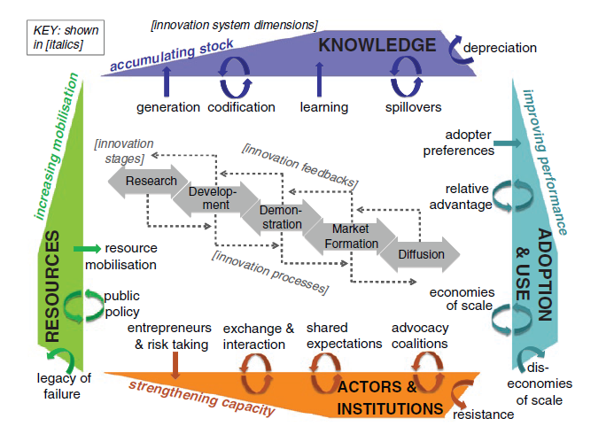

a systems perspective on energy innovation
Grubler & Wilson (2014). Energy Technology Innovation: Learning from Historical Successes & Failures. CUP
Notes:
The hardware and software of technology are created and used in particular contexts: institutional, infrastructural, or organisational, giving rise to the term ‘orgware’ as coined originally by IIASA scholars.
Innovation processes contextualise and link stages and drivers, relating:
to knowledge, and its generation and use,
to actors and institutions, with their risk appetites and expectations,
to the mobilisation of resources, both financial capital and human capital,
and to the adoption and use of technologies.
Partial (non-systemic analysis)
Partial analysis may focus on some or all of the stages in the innovation lifecycle, from research, development and demonstration, through the so-called valley-of-death to niche market and then widespread commercial deployment, and ultimately senescence and decline.
Partial analysis and resulting innovation policies may also focus on some or all supply-side drivers to reduce the costs of innovation and so ‘push’ technologies into the market, or on some or all demand-side drivers which increase the payoffs for innovation and so ‘pull’ technologies into the market.
The innovation system includes all these innovation stages and processes, but crucially, it situates them within a broader conceptualisation of an innovation system.
This framework provides a comprehensive, consistent basis for analysing innovation activity.

Slide 7
Methodology
  Select the most appropriate indicators from the wide variety of literature (Borup et al., 2013; Klitkou et al., 2012; Grubler & Wilson, 2014; Cornell University, INSEAD, & WIPO, 2015; Truffer, Markard, Binz, & Jacobsson, 2012; Speirs, Pearson, & Foxon, 2008; Park, Han, Jang, Choi, & Joo, 2016; Miremadi, Saboohi, & Jacobsson, 2016; Borup, Andersen, Jacobsson, & Midttun, 2008).
  1. Usefulness: indicators should be relevant and a strong predictor of the ETIS processes.
  2. Availability: data should be available.

Slide 8
Characterise the EU’s energy innovation system
ETIS process | Technology-specific indicators [and metrics] at the EU level | Units
Knowledge
Generation | Public energy RD&D expenditure | €m at 2015 prices & exchange rates
 | Demonstration budgets | €m at 2015 prices & exchange rates
Depreciation | Volatility in energy RD&D expenditure | index: coefficient of variation (COV)
Spillover | Knowledge spillover benefit from trade | €m: energy technology imports
Codification | Scientific publications | # articles
 | Patents | # patents
Learning | Learning-by-doing | index: learning rate (LR)

Slide 9
Characterise the EU’s energy innovation system
ETIS process | Technology-specific indicators [and metrics] at the EU level | Units
Resources
Policy Support | Innovation policy density | sum: cumulative years of all instruments
 | Market-based policy density
 | Regulatory policy density
 | Innovation policy durability | average: cumulative years of all instruments
 | Market-based policy durability
 | Regulatory policy durability
Policy Diversity | Diversity of policy mix | Shannon index: three types of policy instrument
Policy Stability | Stability of policy mix | average: cumulative years of all instruments adjusted by revisions
Legacy of Failure | Decline in public interest following failures, using Google search frequency as proxy | index: exponent fitted to decline function

Slide 10
Characterise the EU’s energy innovation system(preliminary)
ETIS process | Technology-specific indicators [and metrics] at the EU level | Units
Actors & Institutions
Capacity | Eco-innovation R&D organisations | # organisations
 | Top 100 clean-tech funds | sum: cumulative funds €
Heterogeneity | Diversity in energy actors | Shannon index: type of organisation in European Energy Research Alliance
Quality Control | EU testing centres & state labs | index
Exchange & Interaction | European Energy Research Alliance activities involving different actors | numbers
Shared Expectations | Strategic goals inc. targets, roadmaps, action plans | sum: cumulative years of all goals
 | Strategic goals inc. targets, roadmaps, action plans | average: cumulative years of all goals

Slide 11
Characterise the EU’s energy innovation system
ETIS process | Technology-specific indicators [and metrics] at the EU level | Units
Adoption & Use
Relative Advantage | Market share | %: actual market as % of potential market
Market Size | Potential market size | €m: estimated as # of vehicles * €/vehicle, MW capacity * €/MW, etc.

Slide 12
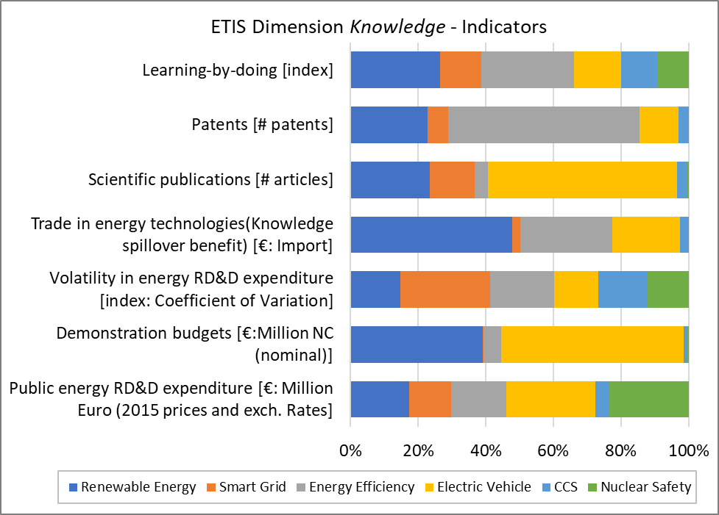
Results(Knowledge)
Imbalance
Imbalance
      Strong imbalance
      Renewable Energy, Energy Efficiency, Smart Grid have the largest share

Slide 13
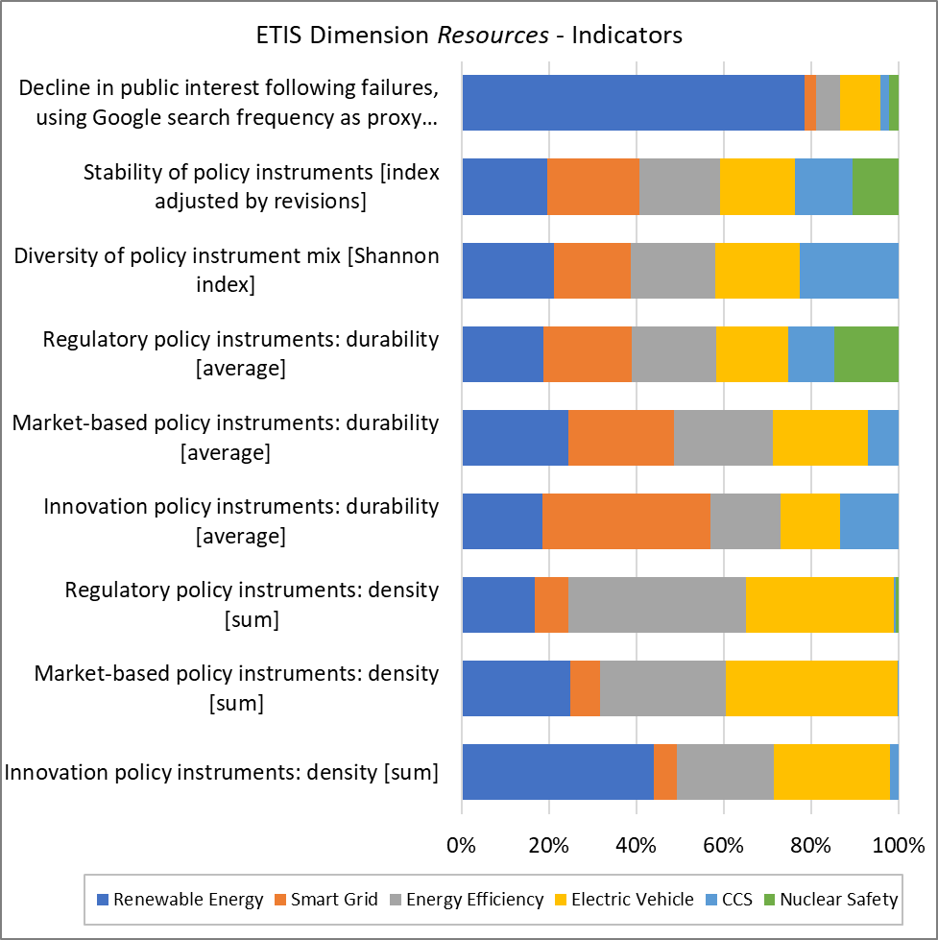
Results(Resources)
Solyndra bankruptcy
in 2011

Slide 14
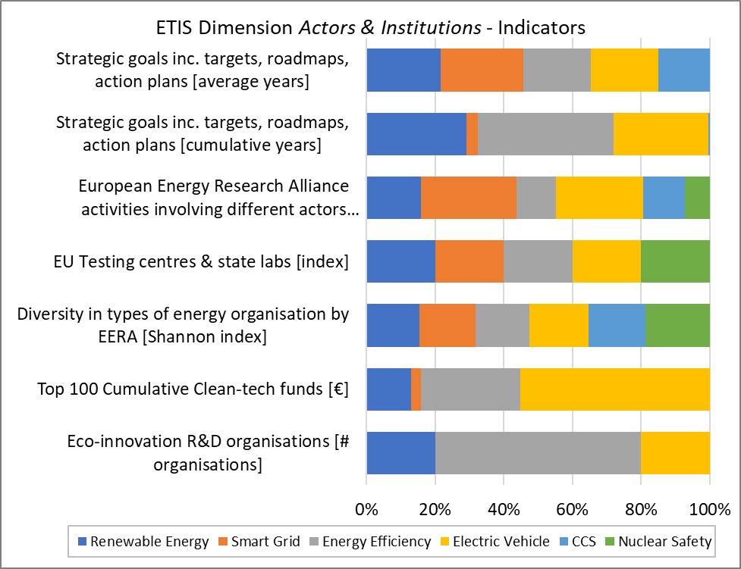
Results(Actors & Institutions)
(Preliminary)

Slide 15
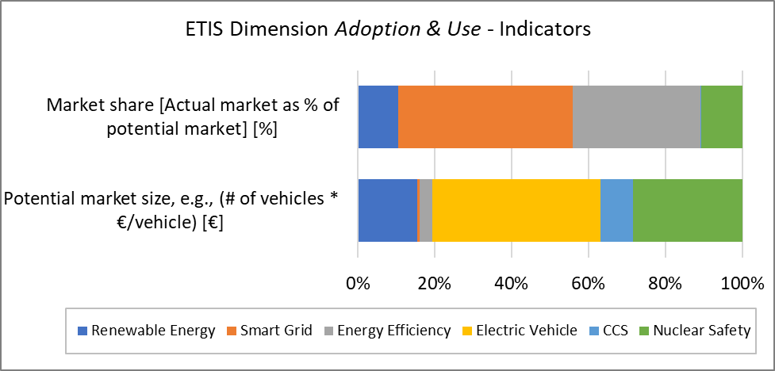
Results(Adoption & Use)
Imbalance
      Market share (Mature technologies): smart grid, energy efficiency)
      Potential market share: electric vehicles, renewable energy, and nuclear safety(already matured field)

Slide 16
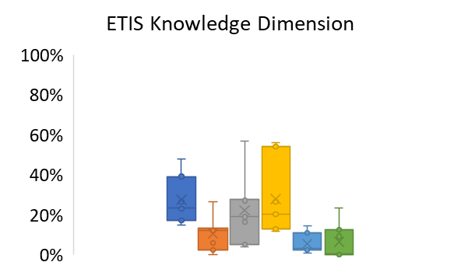
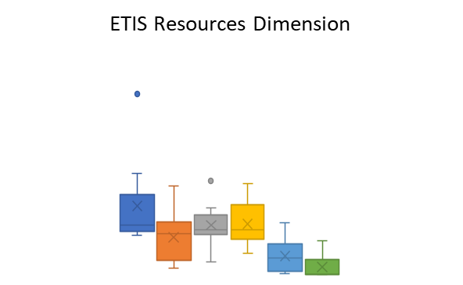
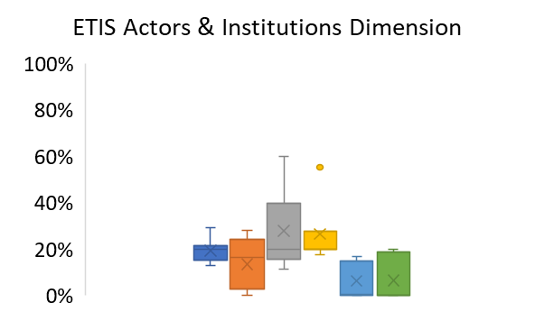
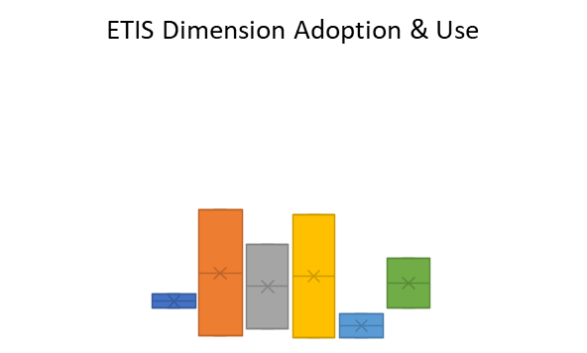
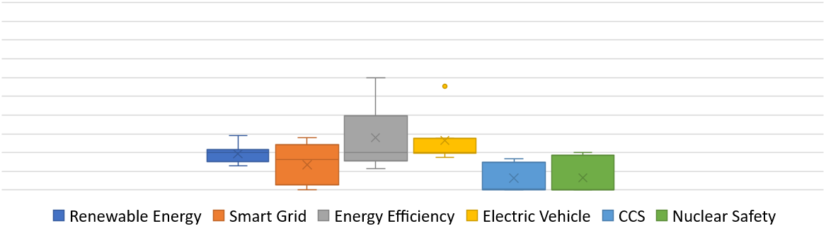
Results(All ETIS dimensions)
Inconsistency
Electric Vehicles
Inconsistency

Slide 17
Conclusions
  Overall Findings
      We found relatively strong progress and evidence of innovation system functioning in renewable, electric vehicles and energy efficiency.
      We found that nuclear safety and CCS are less emphasised.
      We also found relatively diverse actors and organisations in the EU energy innovation system (preliminary).
      An indicator describing early stage innovation processes would be expected to favor electric vehicles. However, indicators describing the late stage of innovation processes would be expected to favor nuclear safety and energy efficiency.
  Future Works
      A dynamic analysis of the time series is the area of the future research.
      A more rigorous approach would be required to test a causal relationship between EU-level innovation system activity on innovation outcomes.

Slide 18
Dr. Yeong Jae Kim
(y.kim@uea.ac.uk)
Dr. Charlie Wilson
(Charlie.Wilson@uea.ac.uk)

Slide 19
appendix
Knowledge Generation. Public energy RD&D expenditure including demonstration budgets (International Energy Agency (IEA) RD&D database).
Knowledge Depreciation
Knowledge Spillover. Knowledge spillover benefit was measured by the total import in energy technologies (EU trade data since 1988 by Harmonised System (HS)).
Knowledge Codification. Publication(Web of Science Core Collection), Patents(USPTO)
Learning (Nilsson & Nykvist, 2016; Rubin, Azevedo, Jaramillo, & Yeh, 2015; Weiss, Junginger, Patel, & Blok, 2010).
With i as a country, t as a year, and k=0-4 (lagged year).

Slide 20
appendix
Policy Support. (International Energy Agency (IEA)’s policies and measures databases).
With i as one policy instrument (i=1,…..,n) , p as types of policy instrument (p=innovation, market-based and regulatory) and s as SET Plan priority area (s=1,…,6).
With i as one policy instrument (i=1,…..,n) , p as types of policy instrument (p=innovation, market-based and regulatory) and s as SET Plan priority area (s=1,…,6).

Slide 21
appendix
Policy Support. (International Energy Agency (IEA)’s policies and measures databases).
Policy Stability. (International Energy Agency (IEA)’s policies and measures databases).
With as share of a type of policy instrument in the SET Plan priority area.
The higher the value of H, the more diverse the mix of policy instruments.
With i as one policy instrument (i=1,…..,n) and s as SET Plan priority area (s=1,…,6).

Slide 22
appendix
Legacy of Failure (Google Search Data)
With t as year and s SET Plan priority area (s=1,…,6) .

Slide 23
appendix
Capacity of Actors & Institutions. (a survey of the top 100 clean-tech R&D organisations, the European Commission).
Heterogeneity of Actors & Institutions
Quality Control (European Commission’s science and knowledge service)
Exchange & Interaction (European Energy Research Alliance)
Shared Expectations (Policy database)
With as the share of SET Plans in the entire SET Plan.
Higher scores on E indicate a more heterogeneous mix of actors in the energy innovation system.

Slide 24
appendix
Market size and share
 | SET Plan | Potential Market Size (physical units) | Actual Market Size (physical units) | Market Share | Unit Cost | Potential Market Size (economic value)
[1] | Renewable Energy (RE) | 1,144,025 MW | 120,716 MW | 10.55% | 1,995,123 €/MW | 2,282 € billion
[2] | Smart Grid (SG) | 241,662,532 homes | 110,000,000 homes | 46% | 422 €/home | 102 € billion
[3] | Energy Efficiency (EE) |  |  | 33.34% |  | 492 € billion
 | Energy Efficiency- Buildings | 241,662,532 homes | 16,898 homes | 0.01% | 3,800 €/home | 918 € billion
 | Energy Efficiency Appliances | 535,587,700 appliances | 357,076,320 appliances | 66.67% | 121 €/appliance | 65 € billion
[4] | Electric Vehicle (EV) | 198,376,808 numbers | 149,500 numbers | 0.08% | 32,500 €/numbers | 6,447 € billion
[5] | Carbon Capture & Storage (CCS) | 481,916 MW | 600 MW | 0.12% | 2,561,875 €/MW | 1,235 € billion
[6] | Nuclear Safety (NS) | 1,144,025 MW | 121,957 MW | 10.66% | 3,653,490 €/MW | 4,180 € billion

