Slide 1
Consumer preferences and the energy transition
Alessandra Motz
Rico Maggi
Vienna, 06.09.2017

Slide 2
Background
After the Fukushima accident (2011), Switzerland decided to phase out nuclear generation
Swiss Energy Strategy 2050 (2013): low-carbon generation should replace nuclear – currently accounting for ∿40% of national demand
Sun and wind should play the main role
Electricity grids strategy to ensure security and efficiency
Three referenda have been called since 2013 on topics related to the national Energy Strategy:
“Green economy” – September 2016, rejected by 64% of voters
“Nuclear withdrawal” - November 2016, rejected by 54% of voters
“Energy Strategy 2050 first implementation package” - May 2017, approved by 54% of voters

Slide 3
Aim & Method
National and local referenda can hinder the implementation of new energy policies in Switzerland
→ Assessing the preferences of Swiss household consumers toward:
Different primary energy sources used for generating electricity
Socio-economic drivers
Behavioural drivers
Psychological drivers: literacy, awareness, risk attitudes, …
The risk of experiencing a blackout / the possibility of providing demand response
Method: a discrete choice experiment

Slide 4
What drives the choice of green electricity?
Several analyses have investigated consumers’ preferences toward attributes of electricity supplies and “green” features of energy-related goods and services. The results suggest:
A positive willingness-to-pay (WTP) for green energy supplies
Conflicting evidence as regards the impact of demographic variables: age, gender, education level, income, rural vs urban location, …
Suggest a stronger impact of behavioural and attitudinal variables
(Green attributes of electricity supplies in OECD countries: Goett & Hudson & Train 2000, Wuestenhagen & Markard & Truffer 2003, Burkhalter & Kaenzig & Wuestenhagen 2009, Zoric & Hrovatin 2012, Kaenzig & Heinzle & Wuestenhagen 2013, Tabi & Hille & Wuestenhagen 2014, Bauwens 2016, Salm & Hille & Wuestenhagen 2016, Yang & Solgaard & Haiderb 2016,…)

Slide 5
Behavioural and attitudinal drivers
Environmental awareness and concerns - Perceived effectiveness of coping behaviour
(Ward et al., 2011, Zoric & Hrovatin 2012, Bauwens 2016, Tabi & Hille & Wuestenhagen 2014,...)
Generosity, fairness, altruism, “warm glow”
(Fischbacher et al. 2015, Blasch & Ohndorf 2016, …)
Identification with groups of peers, preference for local producers or investment
(Goett & Hudson & Train 2000, Salm & Hille & Wuestenhagen 2016…)
Energy and investment literacy
(Blasch, Boogen, Filippini & Kumar 2017, …)

Slide 6
Discrete Choice Analysis
Discrete Choice (DC) Analysis: operational theory of human behaviour:
Assumes that the decision maker, when faced with a set of mutually exclusive and collectively exhaustive alternatives (goods/services), selects the one providing the highest utility
Is based on the Random Utility Theory: the agent’s utility is made up of an observable, systematic component and an unobservable, probabilistic component
If applied to stated preferences, allows the evaluation of characteristics of the good/services that are not yet observable – e.g. new attributes or new levels for the existing attributes

Slide 7
Choice tasks – An example
Choose, out of 5 electricity supply contracts, the one you would sign for your own place:

Slide 8
Attribute levels
Attribute levels reflect average 2014 values (in red) and extremes we could expect in the future

Slide 9
Data collection: survey
Web-based survey:
February 2015
Stratified sample of 1’006 Swiss residents
Response rate: 37%
The survey covered:
8 choice tasks, obtained by means of efficient design with blocking
Demographic variables
Energy-related behaviour
Behaviour, equipment, literacy
Agreement / disagreement with a set of statements related to energy and environmental issues
Climate change, pollution, nuclear, coal, gas, wind, RES in general, risk of blackouts, increasing prices

Slide 10
PCA on attitudinal indicators

Slide 11
The discrete choice model
I think the risk of a nuclear accident in CH is low
It is dangerous to live close to a nuclear plant
It is dangerous to live close to a gas-fired plant
I am worried about pollution
Generating electricity via RES is important
I am worried about climate change
Primary energy source
LV1 Environmentalist
LV 4 - Not afraid of conventional generation
Price
City
Higher % RES in “Mix”
Blackout experience
Lower % RES in “Mix”
Green behaviour
More short blackouts
Energy illiteracy
Utility
More long blackouts
University
German
Less short blackouts
Swiss nationality
Choice
Less long blackouts
Male
Age

Slide 12
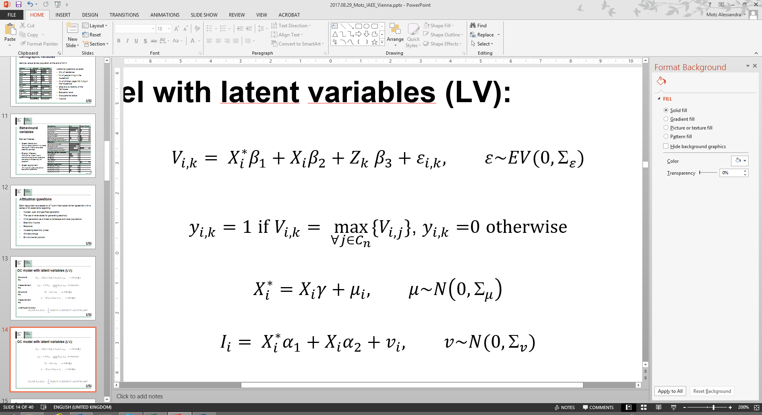

DC model with latent variables (LV):
Structural eq.
DC model
Measurement eq.
Structural eq.
LV model
Measurement eq.
Likelihood function:

Slide 13
DC model: Results (1)
In the MNL model respondents show ceteris paribus preference toward Sun and dislike toward Sun. This disappears when we add LVs
Price coefficients are significant and coherent in both models. They create an ordering of alternatives: Sun and Hydro rank first, Wind and Nuclear last

Slide 14
DC model: Results (2)
In the MNL respondents place a positive value on having a higher share of RES in the Mix alternative; this disappears when we include LVs
The coefficients for a decreased frequency of short and long blackouts are not significant in both models
But the coefficients for a higher frequency of short and long blackouts are negative, significant and of comparable relative magnitude in both MNL and hybrid model

Slide 15
DC model: Results (3)
Older respondents are less interested in the primary energy sources used
Men are more likely than women to choose Nuclear
«Environmentalists» (LV1) do not care about the primary energy source used, but they place a strongly positive value on having a larger share of RES in the Mix alternative
Those who are «Not afraid of conventional generation» (LV4) place a positive value on the Nuclear alternative

Slide 16
DC model: Results (recap)

Slide 17
LV1 model: Results
Positive correlation with the probability of having a higher score in LV1 «Environmentalist»:
Shows a green behaviour – perceived effectiveness of coping behaviour?
Has a university title
Lives in a city
Has experienced a blackout
Has a higher score in the energy illiteracy index – Warm glow effect? Importance of clear labels?

Slide 18
LV4 model: Results
Negative correlation with the probability of having a higher score in LV4 «Not afraid of conventional generation»:
Does not show a green behaviour
Is energy literate
Speaks German
Has Swiss citizenship
Has a university title (weak)

Slide 19
Goodness of fit
A significant improvement in goodness of fit is obtained by taking into account taste heterogeneity and its drivers

Slide 20
Conclusions (1)
There is significant heterogeneity in consumers’ preferences toward alternative energy sources
Consumers’ preferences toward alternative technologies are mainly driven by three factors:
A pro-environmental attitude (LV1)
A positive stance toward nuclear and thermal generation (LV4)
A varying sensitivity to price increases, with generally lower values for RES than for “grey” and nuclear energy, with the exception of wind
Gender and age also play a role:
Men are less likely than women to oppose nuclear generation
Older respondents are less sensitive to the kind of energy source used

Slide 21
Conclusions (2)
LV1
Pro-environmental attitude:
A stronger LV1 does not imply a specific preference for a single renewable energy source, but rather for a greener supply irrespective of the RES used
The policy maker (or electricity suppliers) can exploit this for greening the economy (or their own supply portfolio) in the most sensible or cheapest way
Positive attitude toward nuclear and thermal generation:
A higher energy literacy is generally associated to a higher LV4
Providing accurate information may help minimizing or managing opposition to generation technologies that are usually perceived as undesirable for environmental or safety reasons
LV4

Slide 22
Thanks for your attention!

Slide 23
Demographic variables
Sample versus Swiss population at the end of 2014:
Additional questions covered:
City of residence
Nr of people living in the household
Nr of children (age<15) living in the household
Size and ownership of the flat/house
Education level
Occupational status
Income

Slide 24
Behavioural variables
Derived indexes:
Green behaviour
(0-3; switches lights off + switches heating off + has a renewable electricity contract)
Energy illiteracy
(0-8; sum of «I don’t know» answers to equipment questions and amount of electricity bill question)
Green equipment
(0-7; sum of «yes» answers to equipment questions)

Slide 25
Attitudinal questions
Each respondent expressed on a 7-point likert scale his/her agreement with a series of 30 statements regarding:
Nuclear, coal- and gas-fired generation
The use of renewables for generating electricity
Wind generation as a threat to landscape and local populations
Electricity imports
Blackouts
Increasing electricity prices
Climate change
Environmental pollution

Slide 26
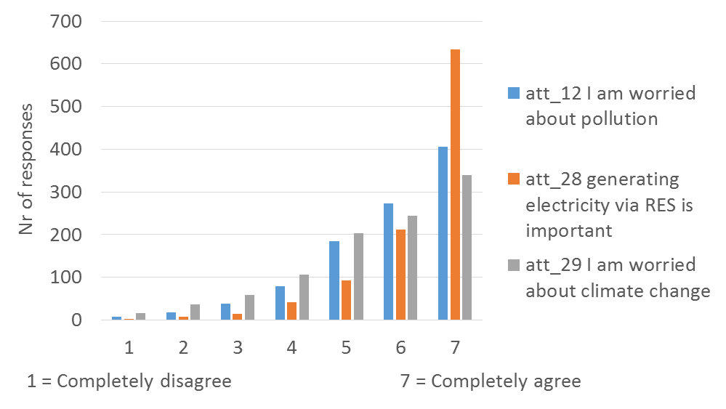
LV 1 «Environmentalist»
Good internal consistency
Definite stance towards climate change, pollution and RES

Slide 27
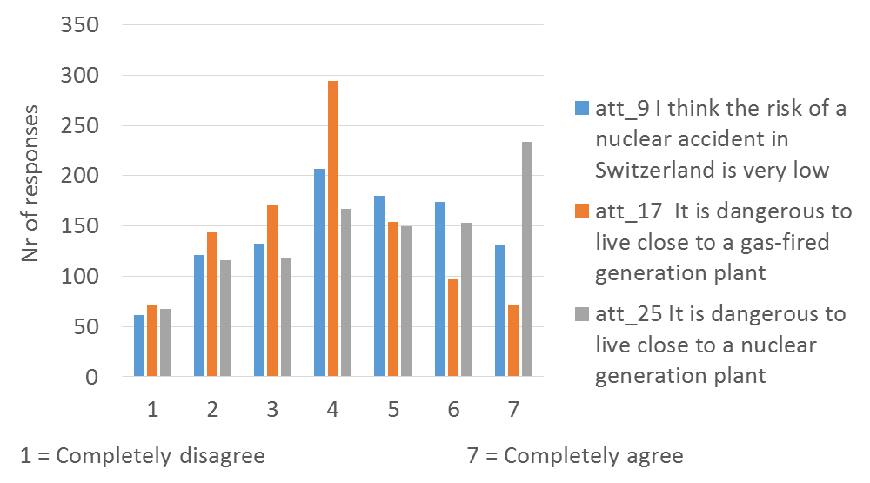
LV 4 «Not afraid of conventional generation»
More balanced distribution of responses
Good internal consistency
Definite stance toward two generation technologies

Slide 28
Composition of the sample

Slide 29
Composition of the sample

Slide 30
Composition of the sample

Slide 32
Definition of the choice experiment: hints from the literature
Risk of strategic behaviour: choice of a green supply as a voluntary contribution to a public good / addition of a public good feature to a private good
Limited trust in / limited understanding of green options: the choice framework should be easily understood by respondents
Landlord / tenant problem

