Slide 1
THE TRANSITION OF THE AUSTRIAN ENERGY SYSTEM TO A HIGH PENETRATION OF WIND ENERGY: VISIONS, VALUES AND COSTS 4. September 2017 IAEE, TU Vienna Patrick Scherhaufer Stefan Höltinger Boris Salak Thomas Schauppenlehner Johannes Schmidt www.transwind.boku.ac.at
Notes:
Core of our analysis is based on the transdisciplinary project TransWind, conducted on behalf of the climate and energy fund Austria from 2013-2015.
In the first part of the presentation I will refer to already published material and in the second part I will present work in progress.
For Oslo: What does social acceptance has to do with love, peace and harmony (the title of our panel). I would say nothing or everything.

Slide 2
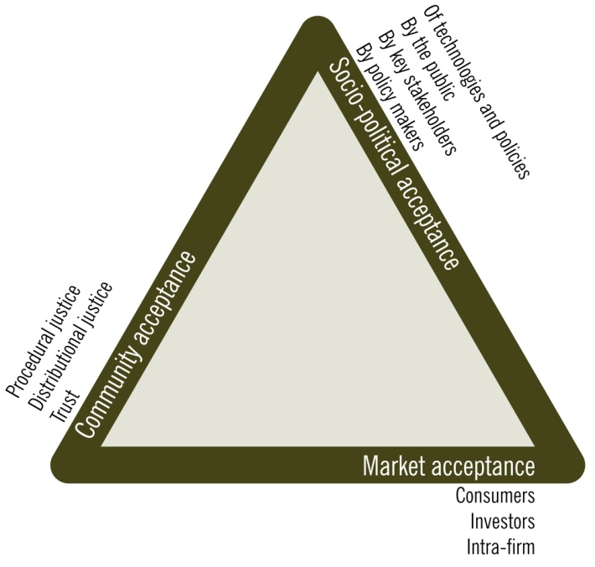

What is the problem?
The acceptance or non-acceptance of a particular renewable energy technology is depended on complex set of
economical incentives,
costs,
social norms,
individual values, preferences,
and beliefs
at various levels of decision-making.
Wüstenhagen et al. 2007
Notes:
One precondition for a succesful transition of the energy system is the social acceptance of the particular renewable technology, which corresponds with attributed policies, the impacts and negative effects and what people think and feel about it. A deep unterstanding of the parameters of social acceptance will help us to reduce future conflicts in regard to the developement of RET.
Rolf Wüstenhagen and others were the first who try to conceptionalise social acceptance by suggesting the following triangle: They investigated consumer and investor behaviors at the level of market acceptance, the policy incentives and the stakeholder and public opinions at the level of socio-political acceptance and procedural and distribuational justice at the level of community acceptance.
In our project we tried to better link the three different levels of acceptance in an integrated assessment, because as Wüstenhagen and others already justified, the three levels certainly influence each other.

Slide 3



Research Questions of TransWind
What is the techno-economical potential for wind energy in Austria?
What are the decisive patterns of acceptance and non-acceptance?
How are interests, rationales and beliefs embedded in different narratives (stories) about renewable energy?
Market & Socio-political Acceptance
Community & Socio-political Acceptance
Notes:
We first tried to investigate the techno-economical potential of wind energy in Austria. For the assessment we used a participatory modelling approach, where we included the views of the most important stakeholders in the field (proponents and opponents of wind energy). We wanted to show that not only the market incentives (feed in tariffs, investor behavior, etc.) are important, but the suitability and availability of land for the use of wind energy.
Then we tried to assess the patterns of acceptence and non-acceptance together with a group of citizens and local decision makers, but at the same time compared these answers with the perceptions of a group of national wide stakeholders. Our conclusion is that although very different patterns of acceptance exist, there is a chance to appeal to overarching targets like the claims of environmental justice to solve the conflicts. Hence, we linked elements of community acceptance with decisive features of socio-political acceptance.
And third we are interested in how different narratives are used legitimizing pathways of the energy transition.
If you think these issues are too much for one presentation, you are defenitely right, hence I would like to concentrate on: TU Vienna: taking into account the theme of the conference and the interests of the audience I will focus on the techno-economical potential
Oslo: the patterns of acceptance and non-acceptance and the work in pogress
However, there is not ONE WAY of investigating social acceptance, there exists many ways, but all are very costly and time-consuming. This is one reason, why the question of social acceptance is not the most prominent issue in real-world planning and siting processes of wind energy.

Slide 4

Materials & Methods: A participatory integrated assessment
1 WorldCafé
28 semi structured interviews
1 questionnaire
3 participatory workshops
with experts from the stakeholder group
6 case studies
4 visualisation courses
8 focus group discussions
8 semi structured interviews with local stakeholders
Participatory modelling: Techno-economical wind energy potential
Triangle based on Wüstenhagen et al. 2007
Notes:
How did we operationalize our research questions?
This research approach reflects a participatory integrated assessment. We used modelling tools, visualisation efforts, qualitative methods of social sciences – like semi-structured interviews and focus groups – and the integration of stakeholder knowledge in our transdisciplinary research project.

Slide 5
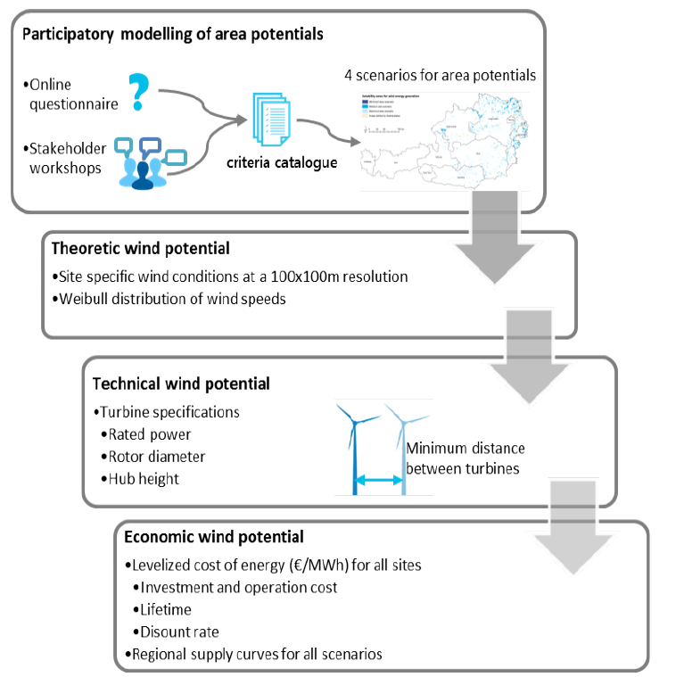
The techno-economical potential: Overview of the modelling steps
Notes:
As I said before, we focused in particular on socio-political and market acceptance. The first category, i.e. socio political acceptance, is addressed by deriving land availability scenarios incooperation with stakeholders. Acceptance of the public and important stakeholders is reflected in those scenarios. The second category, the market acceptance, also relies on those scenarios as important market actors defined the availability of land for new projects as fundamental. In addition we calculated the levelized costs of electricity (LCOE). Hence we are able to derive total costs of wind power deployment from our modeling approach.
First, four scenarios (min, med, max and the already existing federal suitability zones) were defined in the participatory modeling process. On the basis of online questionnaire and stakeholder workshops we identified areas that are suitable and acceptable for wind energy.
Second, the theoretical wind energy potential was simulated based on mean hourly wind speeds from the Weibull distributions that were provided by the Austrian windatlas.
In the third step, the technical potential was derived by transforming hourly wind speeds to power production using the performance coefficient of the most common wind turbine in Austria.
In the last step, the LCOE was calculated for all of the wind sites by including a range of estimates from the literature for investment and operation costs, discount rate and windturbine lifetime.

Slide 6
The techno-economical potential: Criteria catalogue for the 3 participatory scenarios
 | scenarios of potential wind turbine sites |  |  | GIS data-set
 | min | med | max
topological restrictions
Areas above alpine forest line | excluded | excluded | excluded | Kilian et al. (1994)
maximum slope (degrees) | 5.7 | 8.5 | 11.3 | SRTM DEM 90m
water bodies | excluded | excluded | excluded | Corine LC 5
offset distance to settlements and infrastructure
settlement areas (m) ª | 2000 | 1200 | 1000 | IACS
buildings outside of settlement areas (m) ^{b} | 1000 | 750 | 750 | OSM buildings
building land outside of settlement areas (m) | 1000 | 750 | 750 | federal land use plans
built-up areas ^{c} | 300 | 300 | 300 | federal land use plans
railways | 300 | 300 | 300 | OSM
motorways, primary and secondary roads | 300 | 300 | 300 | OSM
airport public safety zones ^{d} | 5100 | 5100 | 5100 | AustroControl
power grid (>110kV) | 250 | 250 | 250 | OSM
suitability of protected areas and offset distances
national parks (m) | no (3000) | no (2000) | no (1000) | CDDA
Natura 2000 -habitats directive sites (m) | no (2000) | no | potentially^{f} | Natura 2000
Natura 2000 - birds directive sites (m) | no (2000) | no | no | Natura 2000
other protected areas (m) ^{e} | no (2000) | no | no | CDDA
important birdlife areas | no | potentially^{f} | potentially^{f} | IBAs
major migration routes for wild animals | no | potentially^{f} | potentially^{f} | ACC, Köhler (2005)
forest areas | no (1000) | yes^{g} | yes | Corine, AFDP
lakes >50ha (m) | 3000 | 1750 | 1000 | Corine LC 512
Notes:
Min / Max were determined by our participants; the med is based on literature review and our own estimations
To provide two examples:
The offset distance to settlements in the min scenario is 2000 meters and in the max. scenario 1000 meters
National parks are not suitable for wind energy and in the min scenario the offset distance is 3000 meters and in the max. 1000 meters
Even on the level of key stakeholders, the future possible contribution of wind energy to Austrian renewable energy targets is conflicting. Hence, not only local opposition matters!

Slide 7
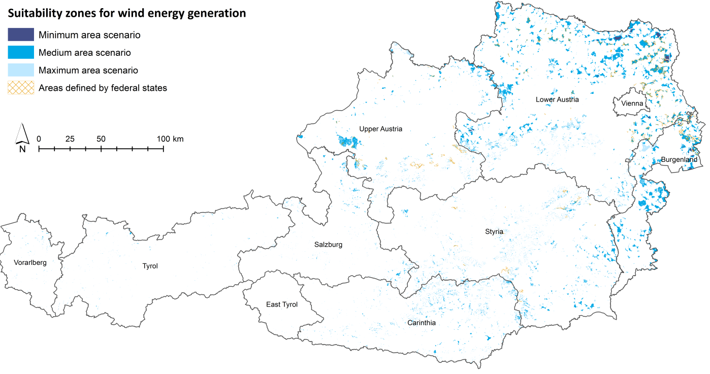
Spatial distribution of potential areas for wind turbines in the four scenarios
Notes:
Suitability areas already defined by four federal states: Upper and Lower Austria, Burgenland and Styria

Slide 8
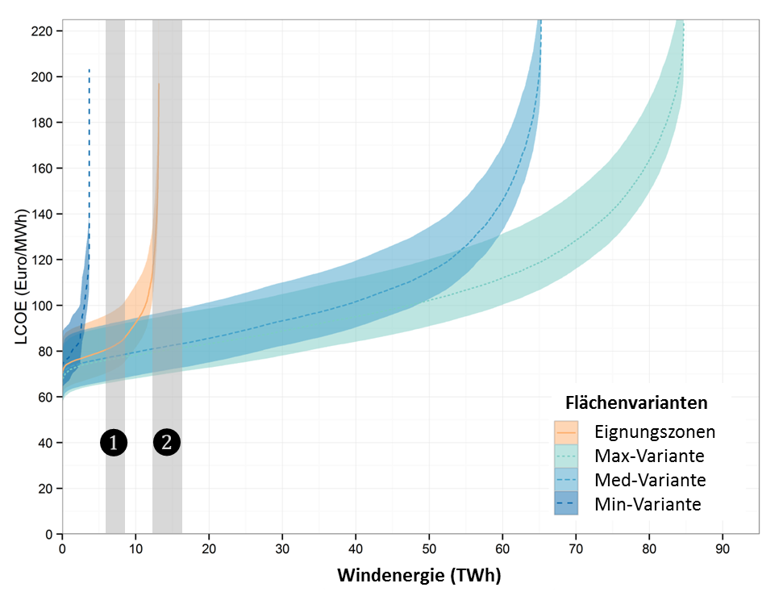

Supply curves showing the economic wind energy potential for the four scenarios
$❶$10% share of total electricity demand -> 6,20 – 8,05 TWh
❷ 20% share of total electricity demand -> 12,40 – 16,10 TWh
Notes:
Y-axis: LCOE per Megawatt hours
X-axis: production of wind energy in Terrawatt hours
In grey you see a 10% or 20% share of wind energy
The lines show the marginal baseline LCOE and the light-colored areas indicate the range between the minimum and maximum marginal LCOEs based on the input parameter assumptions.
Which conclusion can be drawn out of the supply curves:
1) The large bandwidth of our scenarios demonstrates that there is no consensus about the future role of wind energy in Austria.
2) Future legislation (e.g., the required distances of wind turbines to settlement areas) can significantly affect the LCOE of wind energy.
3) More restrictive criteria for wind turbine sites will therefore require higher support mechanisms (e.g. feed-in tariffs) to achieve the same level of wind energy production.

Slide 9
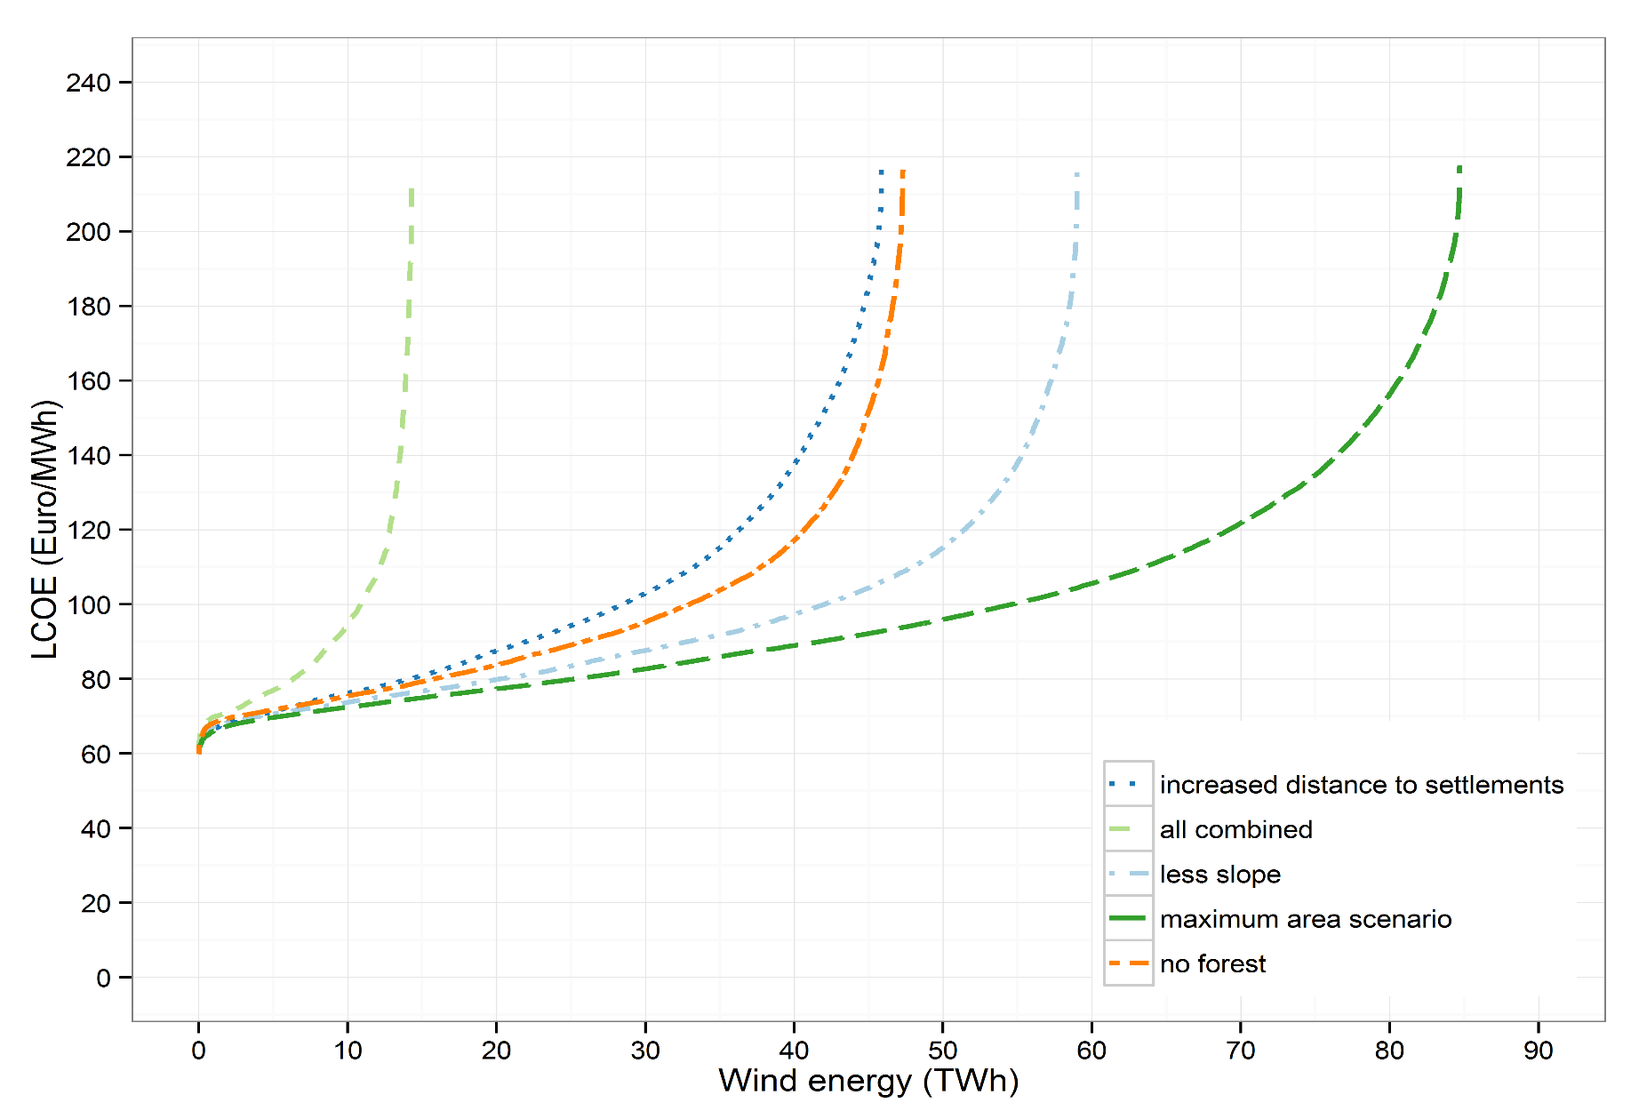
Sensitivity analysis
Notes:
The figure shows more restrictive criteria for the distance to settlements, maximum slope, suitability of forests and a combination of all three. The impacts of these changes are compared with the wind energy potential of the maximum area potential.
Reducing the maximum feasible slope from11.3° to 5.7° lowered the wind energy potential by 30%. Excluding forest areas or increasing the distance to settlement areas from1000 to 2000m resulted in an approximately 45% lower potential. All three restrictions combined reduced the wind energy potential bymore than 80%,from 92.3 to 15.7TWh.

Slide 10
Spatial distribution of optimal wind sites
Comparison of medium scenario (blue) with federal suitability zones (yellow)
Wind energy production of 12,4 TWh (= 20% share of wind energy at a total electricity demand of 62 TWh)
Notes:
What we can also do with our analysis is to show the spatial distribuation of optimal wind sites.
The economical optimal deployment of wind energy should take place in Lower Austria, Burgenland, Styria and Carinthia.
The economical potential of wind energy in the federal states of Tyrol, Vorarlberg and Salzburg is insignificant.

Slide 11
The techno-economical potential: Policy Conclusions
The already existing suitability zones exclude many optimal sites, which are possible in our medium scenario.
It is important to harmonize the legal framework conditions for defining suitable areas for wind energy in Austria. Applying them for all federal states could avoid economic inefficiencies and reduce wind energy expansion costs.
The challenge for policy makers will be to find the right balance between
limiting wind production to sites with minimal negative effects on landscape scenery, human health and the environment; and
providing enough potential wind turbine sites to allow the deployment of wind energy at feasible costs.
Notes:
The conclusions provide us with a view on the MACRO LEVEL taking into account factors from the level of socio-political and market acceptance, BUT not on the level of community acceptance!
This indicates that the techno-economic assessment definitely over-estimate the realizable potential significantly.

Slide 12
Many thanks for listening!
Patrick Scherhaufer
patrick.scherhaufer@boku.ac.at Stefan Höltinger Boris Salak Thomas Schauppenlehner Johannes Schmidt www.transwind.boku.ac.at

Slide 13
Overview of participating organisations in TransWind
interview partners on the macro scale
group | organizations
public authorities | Austrian Ministry for Transport, Innovation and Technology; Federal Ministry of Science, Research and Economy; Austrian Energy Market Regulator – E-control; Chamber of Labour; Chamber of Commerce
federal state authorities | Federal State Government Offices of Burgenland, Lower Austria, Salzburg and Styria; Ombuds Offices for Environmental Protection (Umweltanwaltschaft) of Burgenland, Lower Austria and Styria
wind park developers and operators | Energie Burgenland Windkraft GmbH; EVN Naturkraft GmbH; Ökostrom AG; PÜSPÖK Group; WEB Windenergie AG; Windkraft Simonsfeld AG
environmental and nature conservation groups | Austrian Environmental Umbrella Association (Umweltdachverband); BirdLife Austria; Coordination Centre for the Study and Protection of Bats
others | Austrian Power Grid (APG); Austrian Wind Energy Association (IG-Windkraft); the processing and administration centre of the subsidies for eco-electricity (OeMAG)

Slide 14
Mean and range of parameter values for assessing the economic potential
cost element | unit | mean value | range | references
capital expenditures | EUR kW⁻¹ | 1675 | 1600-1900 | 1, 2, 3, 7
operational expenditures | EUR MWh⁻¹ | 26.4 | 18.5-34.2 | 3, 2, 4, 5
lifetime | years | 20 | - | 5, 6, 7
discount rate | % | 5 | - | 4, 5, 7
References: (1) Arántegui, 2014 (2) Gass et al., 2013 (3) Hantsch et al., 2009 (4) Rehfeldt et al., 2013 (5) Kost et al., 2013 (6) McKenna et al., 2014; (7) Falkenberg et al., 2014

Slide 15
Potential capacity and annual wind energy generation in Austrian federal states
 | Min scenario |  | med scenario |  | max scenario |  | Suitability zones
 | GW | TWh | GW | TWh | GW | TWh | GW | TWh
Burgenland | 0.7 | 1.9 | 4.9 | 10.9 | 6.1 | 13.5 | 1.4 | 3.6
Carinthia |  |  | 3.2 | 4.9 | 5.5 | 8.3
Lower Austria | 1.0 | 2.0 | 19.5 | 38.9 | 22.0 | 43.8 | 3.6 | 8.4
Upper Austria | 0.0 | 0.0 | 4.4 | 6.8 | 6.4 | 9.8 | 0.9 | 1.4
Salzburg |  |  | 1.2 | 1.6 | 2.2 | 2.7
Styria |  |  | 5.0 | 7.8 | 8.4 | 13.1 | 0.5 | 0.9
Tyrol | 0.0 | 0.0 | 0.4 | 0.5 | 0.9 | 1.0
Vorarlberg | 0.0 | 0.0 | 0.2 | 0.3 | 0.4 | 0.4
Austria | 1.7 | 3.9 | 38.8 | 71.6 | 51.8 | 92.8 | 6.3 | 14.3
Notes:
Showing some interesting results:
Min Scenario production capacity is about 4 Terrawatt hours; in the medium about 70, in the maximum about 93 and regarding the suitability zones it is about 14
Burgenland, Lower Austria, Upper Austria and Styria have greater potentials then defined in the already existing suitability zones;
Also Carinthia has a very good potential (compared to that there is only one wind turbine already installed)

