Slide 1

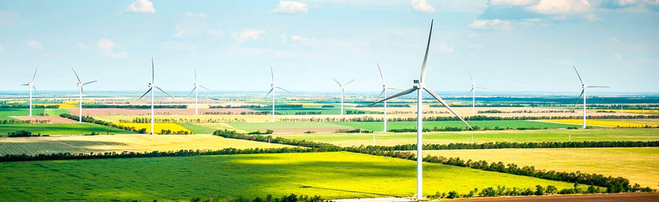
Local Acceptance of Wind Energy in Switzerland, Estonia and Ukraine. A Cross-Country Analysis based on Choice Experiments. Ebers, Tabi, Wüstenhagen, Kostyuchenko, Smolennikov, Joller.
Vienna, 04.09.2017
Notes:
I’m Anna Ebers, it is my pleasure to be here and present our work on social acceptance conducted at the University of St.Gallen jointly with our partners at the University of Tartu in Estonia and Sumy State University in Ukraine. First, let’s think about these three countries. Which one of them would you think has the highest level of installed wind energy capacity in absolute terms and per capita? Any guesses?

Slide 2

Research question 1:
How does social acceptance of wind power projects differ across countries?
Installed wind energy capacity by 2016
Notes:
With Ukraine being the largest country, it has the largest installed capacity of 426 MW of wind power in 2016. However, tiny Estonia, which btw is just slightly bigger than Switzerland, has 310 MW of capacity. Switzerland is somewhat lagging behind in absolute terms 75 MW in 2016. It turns out that Estonia is currently doing better than Switzerland or Ukraine on the per capita basis or measured by the country size. This picture might be an indication of different wind speed in the countries, or different economies of scale for the production of wind power. This could be issue of social acceptance. Despite being one of the most cost-effective sources of renewable electricity, wind parks face intense local opposition, especially near residential areas. One of the two central questions of this paper is to investigate how social acceptance of wind power differs between these counties. Let me tell you more about our geographical focus:

Slide 3
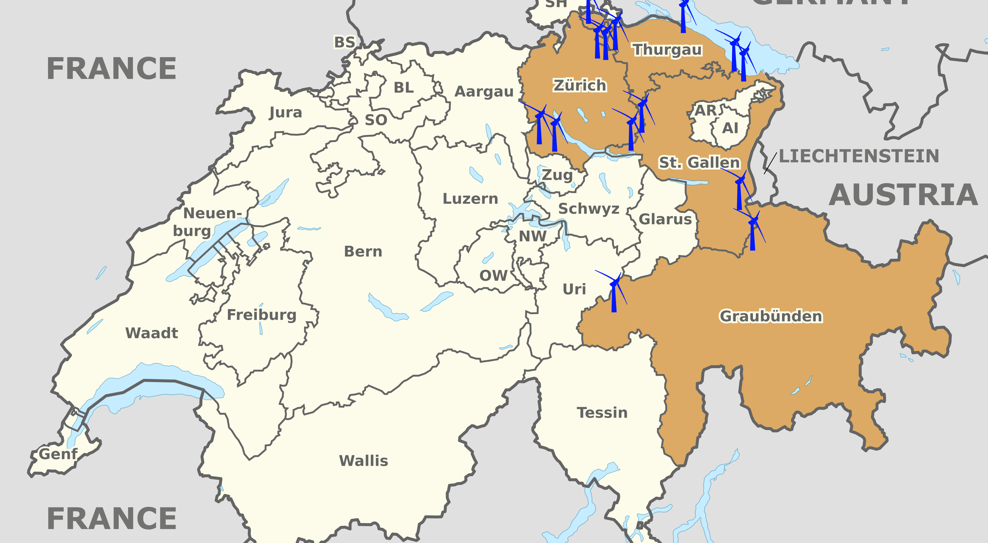
Geographic focus: Eastern Switzerland
Notes:
Geographically, this study focuses on Eastern Switzerland, Western Estonia, and Southern Ukraine, I will show you those in the next slides, which were identified as regions with high potential for wind power development. The analysis is based on a large-scale online survey of more than 2,000 respondents in three countries. 1000 of respondents were from these 4 cantons in Switzerland.

Slide 4
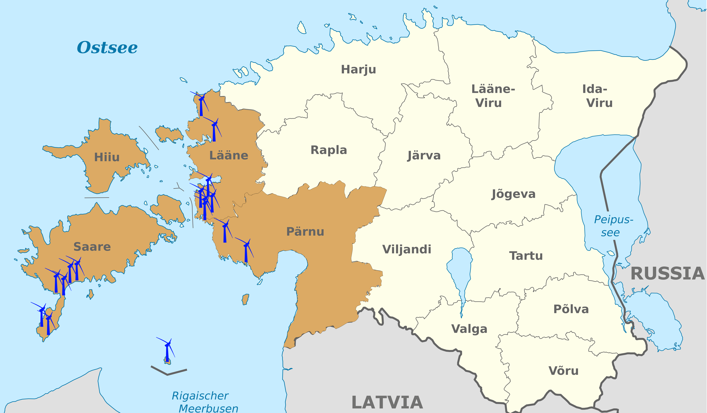
Geographic focus: Western Estonia
Notes:
500 respondents from Western Estonia and notice that these locations are on the Baltic Sea. We would have loved to focus on seaside locations in Switzerland, however, Switzerland doesn’t have a seaside but we do have the Alps.

Slide 5
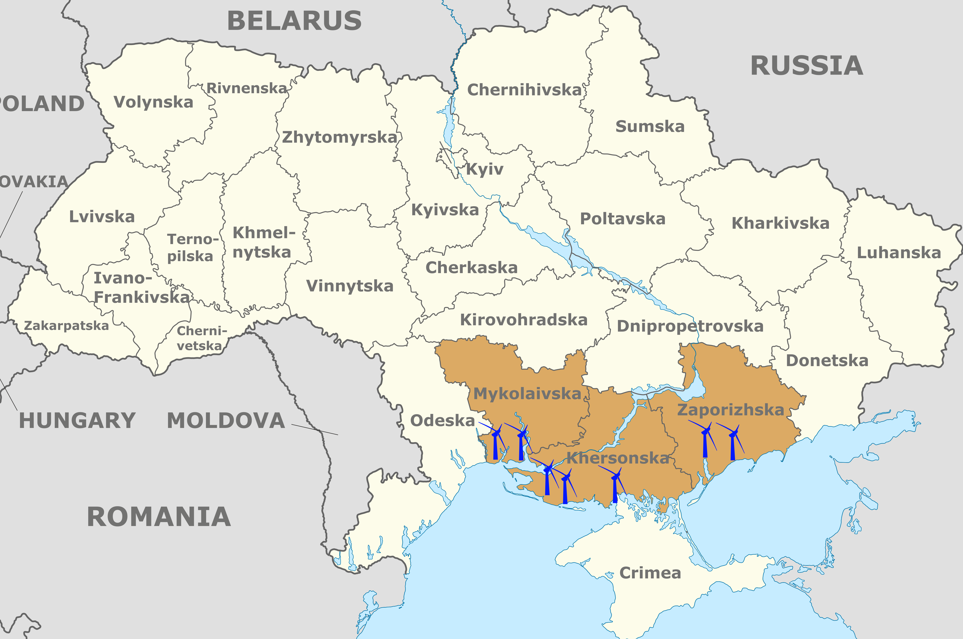
Geographic focus: Southern Ukraine
Notes:
500 more respondents were from Southern Ukraine. Again, notice the locations on the Black Sea. Such a set-up allows the comparison of social acceptance in three countries that have different histories, levels of economic development, availability of natural resources, and electricity market structures. At the same time, these countries are similar in other aspects, such as energy security concerns, RE commitments, CO2 reduction target. Moreover, our study breaks away from usual country combos when Estonia is compared to other Baltic States, CH its neighbours Germany, Italy, France and Ukraine with Russia, other post Soviet states

Slide 6
Research question 2:
What characteristics of a wind project are connected to highest social acceptance?
Ecological impact
Location
Wind project characteristics
Social acceptance
Project developer
Profit-sharing
Public participation
Source: Tabi and Wüstenhagen, 2015
Notes:
The second central question is to investigate which wind energy project characteristics have most impact on social acceptance. We looked at 5 of then. First, the negative ecological impact on flora and fauna, real and perceived. Second is the location where the project is developed. Third pertains to the identity of the project developer themselves. And two final project characteristics look into distributional justice, which is a fair allocation of costs and benefits, and procedural justice, which is fair, participatory planning processes. Again, prior research has found that social acceptance of wind energy can be increased by respecting these two justice aspects. And there is an empirical evidence gap to illustrate how justice considerations play out with respect to the expansion of wind power. These five characteristics look suspiciously convenient to conduct a choice experiment. And this is what we did. If you are unfamiliar with discreet choice experiments, think about the beauty contest for the best wind project. This wind project does not only have to be aestethically pleasing in a party dress, but it also has to care about children and volunteer their time at the homeless shelter. Thus, we jointly testes the influence of procedural and distributional justice on social acceptance, in combination with other factors.

Slide 7
Method II: CBC
Imagine that you can choose which wind energy project will be built in your region. The wind park consists of 23 wind turbines that are 120 m high.
Developer: 1) individuals from the region, 2) local electric utility, 3) cooperation between local utility and a specialized investor, 4) foreign energy company. | Location: near a residential area, on agricultural land, In industrial and commercial zones, in ecologically significant landscapes & protected areas
Profit sharing: 1) no revenue sharing, 2) revenue sharing with local landowner 3) revenue sharing with municipality 4) direct payments to all residents | Public participation: minimal participation as required by law, informational brochure and a website, public hearing, co-determining the number and location of wind turbines
Ecological impact: large medium low almost non-existent
Notes:
Here is more detail on the exact setup of the questionnaire. In a series of tasks, the respondents were asked to choose among potential wind parks to be constructed near their communities. As mentioned in the previous slide, there were 5 attributes to be considered and each attribute had 4 levels. The developer could be a local private person or a foreign utility, revenue sharing could range from none to direct payment to all residents, ecological impacts could be large to almost non-existent, location varied from building a wind project in the industrial areas to ecologically significant landscapes. And finally, we looked at different levels of public participation

Slide 8
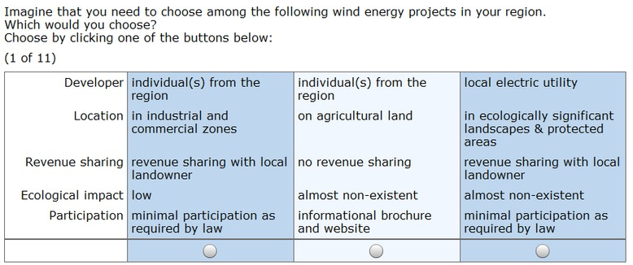
Method I: CBC
Notes:
Here is an example of such a task. There were 1 fixed task and 10 random computer-generated tasks.

Slide 9
Results I: Social acceptance
Notes:
What did we find? In general, we found high support for development of wind power in the 3 countries. And the majority of the respondents would not be disturbed by living within sight of a wind turbine. 96% of Ukrainian, 87% of Estonian, and 74% of Swiss respondents were in favour or somewhat in favor of wind energy development in their countries,

Slide 10
Results II: Importance of wind project features
Notes:
When we looked at specific project characteristics, the picture has been indeed very consistent among the countries, which is one of the most surprising findings of this research. In all three countries, ecological impacts was the most important feature, followed by location and identity of the project developer. Justice aspect, while being important, had lower importance levels than three other aspects.

Slide 11
Results III: cross-country comparison
Notes:
Based on an evaluation of part-worth utilities, projects with the smallest impacts on local flora and fauna were most preferred. With respect to project location, respondents were most willing to accept wind parks in industrial and commercial zones and on agricultural land. This is in line with previous studies showing the significance of the landscape and environmental impacts for local acceptance (e.g., Alvarez-Farizo and Hanley, 2002; Meyerhoff et al., 2010). Electric utilities were viewed as the most suitable project developers. This confirms prior findings demonstrating that local ownership has a significant positive effect on acceptance (Bergmann et al., 2006; Warren and McFadyen, 2010). Interestingly, Estonian respondents viewed project development by individuals positively, as well as revenue sharing with local private landowners. By contrast, Swiss and Ukrainian respondents preferred revenue sharing with the municipality and all residents. Engagement of the local population also contributes to social acceptance, but certain participation opportunities were viewed more positively than others. For example, having a public informational meeting or informational brochure and a website was not found to greatly increase a project’s social acceptance. Yet, direct participation of the local population in determining the number and location of wind turbines was connected to higher social acceptance. Studies by Gross (2007) and Ek and Persson (2014) also confirmed that local participation in the planning process, and the transfer of revenue to a local community has a positive influence on social acceptance.

Slide 12
Conclusions I:
High share of population in CH, EE, UA would like to see wind energy developed on national and local levels
Despite different history, natural resource endowment, & electricity market structure, respondents in CH, EE, and UA had similar preferences wrt to features of wind projects
Eco-impact, location, developer identity of higher importance, followed by procedural and distributional justice
Most important to keep wind projects ‘nature-friendly’ and ‘local’
Notes:
A large share of Swiss, Estonian and Ukrainian respondents were in favour or somewhat in favor of wind energy development in their countries, and the majority of the respondents would not be disturbed by living within sight of a wind turbine. Second, despite apparent differences among the countries, the respondents had strikingly similar preferences with respect to wind power project features. One would think that economic aspects such as profit sharing would be more important in Ukraine, which has comparatively lower level of economic development, while Switzerland, which prides itself in its democratic process, would rank public participation more highly. And finally, the wind project to win our beauty contest could be described as local and most nature friendly.

Slide 13
Conclusions II:
Highest social acceptance of the wind project that:
-has smallest ecological impact
-is in industrial or commercial zone
-is developed by a utility company, alone or with a specialized investor
-offers revenue sharing with municipality or all residents
-allows local population co-determine the number and location of wind turbines
Notes:
Minimizing ecological impacts of wind projects could significantly increase social acceptance. The background of the project delevoper is found to be important for local population: the respondents in all three countries preferred the projects to be carried out by local utilities, either alone or in collaboration with a specialized investor. The involvement of foreign utilities is viewed with skepticism. Thus, keeping wind power projects local and nature-friendly are the two most important attributes influencing social acceptance among residents.

Slide 14
Thank you
anna.ebers@unisg.ch
aebers@umd.edu
Funding:
Swiss National Science Foundation
CTI and SCCER CREST
Private donations
Notes:
Furthermore, we find that wind power’s potential to reduce energy import dependence, add value to the local economy and lower carbon emissions are key arguments that resonate with the population, while concerns remain with regard to the potential impact of wind projects on health and local real estate prices.

Slide 15
Local energy source

Slide 16
Economic opportunity
Notes:
Most believed that there will be more PV than wind, in all 3 countries. Some even believed that solar and wind will be more than 100% of energy mix. Sometimes I wish there was a way to ask a follow up question on some responses.

Slide 17
Problematic aspects
Notes:
Most believed that there will be more PV than wind, in all 3 countries. Some even believed that solar and wind will be more than 100% of energy mix. Sometimes I wish there was a way to ask a follow up question on some responses.

Slide 18
Landscape impacts
Notes:
Most believed that there will be more PV than wind, in all 3 countries. Some even believed that solar and wind will be more than 100% of energy mix. Sometimes I wish there was a way to ask a follow up question on some responses.

Slide 19
Wind energy beliefs
Notes:
Most believed that there will be more PV than wind, in all 3 countries. Some even believed that solar and wind will be more than 100% of energy mix. Sometimes I wish there was a way to ask a follow up question on some responses.

