Slide 1
Irreversible Time Commitments for LNG Trade: Constraints on Spatial Market Integration
Atle Oglend, Petter Osmundsen, Tore Selland Kleppe

Slide 2
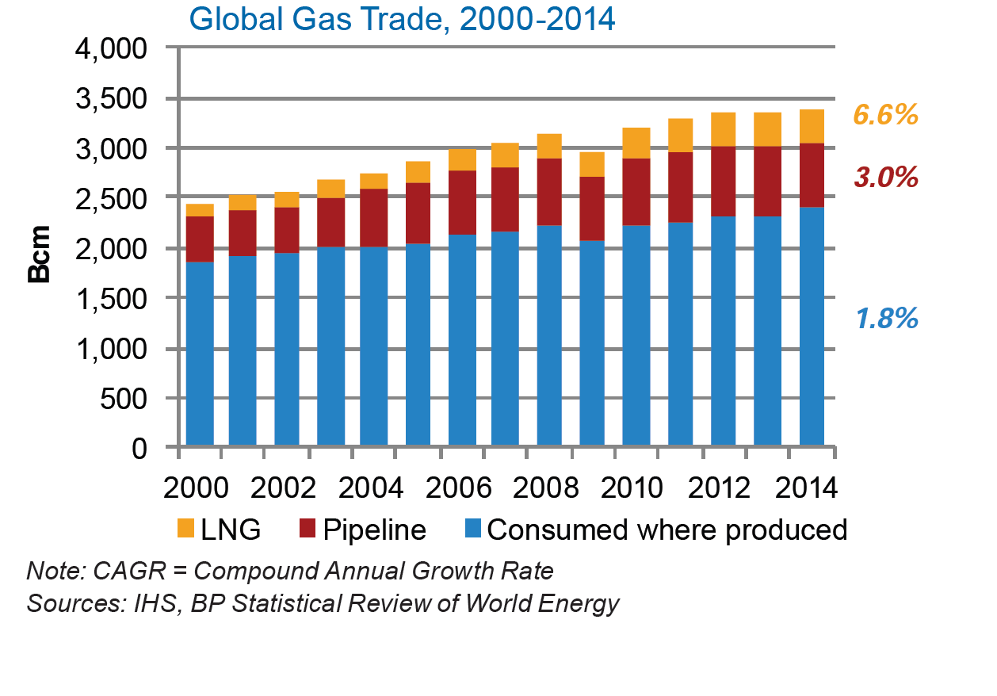
Introduction – LNG trade
LNG trade – Small, but important for the value of natural gas resources
Connects regional supplies to global markets
A common global natural gas price possible?

Slide 3
LNG trade and Market Integration
Literature show some (but weak) evidence for LNG trade facilitating improved regional natural gas market integration (Neumann, 2012; Li et al., 2014; Dehnavi and Yegorov, 2012; Oglend et al., 2016)
Barriers to LNG facilitated Market Integration
Regulatory restrictions, inflexible and slow regulatory process, domestic security concerns
Differences in how gas is transacted (Spot vs forward contracting based on indexed pricing).
Specific, lumpy and time-consuming investments in the LNG supply chain (liquefaction plants, LNG carriers, regasification plants). Gives inelastic supply of transportation services in the short run and cyclical expansion/contraction of capacity
Unsynchronized investments in the supply chain due to decentralized decisions
Time commitments to LNG shipments due to transportation over long distances

Slide 4
The cost of LNG trade – Freight rates
Investment expansion cycle has been completed
Freight markets are highly integrated across exporter and importer regions

Slide 5
The cost of LNG trade – Freight rates
The cyclicality and persistence of LNG freight rates reflects the technological demanding nature of LNG trade
Capacity is fixed in the short-run and so prices are sensitivey to demand changes
Coordinating capacity adjustments in the supply-chain is complicated
Investments are lumpy
Not accounting for the endogeneity of trade costs will bias measures of LNG market efficiency and integration downwards (Dehnavi and Yegorov, 2012; Oglend et al., 2016)
Large regional price spreads does not translate to arbitrage opportunities

Slide 6
Freight rates and Regional price spreads

Slide 7
Time Commitments in Trade
LNG trade occurs over long distances
Main LNG exporting countries are Australia, Algeria, Egypt, Malaysia, Nigeria, Qatar and Trinidad
Main destination markets are Asia (Japan, South Korea), Europe (Belgium, Spain and the UK), India, and to a less degree now the US.
Irreversible time commitments to trade imposes an additional barrier to market integration
Novel barrier to trade not analysed previously in the literature

Slide 8
Time Commitments in Trade
Irreversible time commitment generates an opportunity cost of trade that augments the direct accounting transportation cost
Cost of LNG trade per MMBtu:
C= liq_cost + regas_cost + freight_rate*distance + ω(S)
S – Price spread – i.e. terms of trade condition
ω(S) – opportunity cost due of trade commitment
ω(S) - typically convex in S

Slide 9
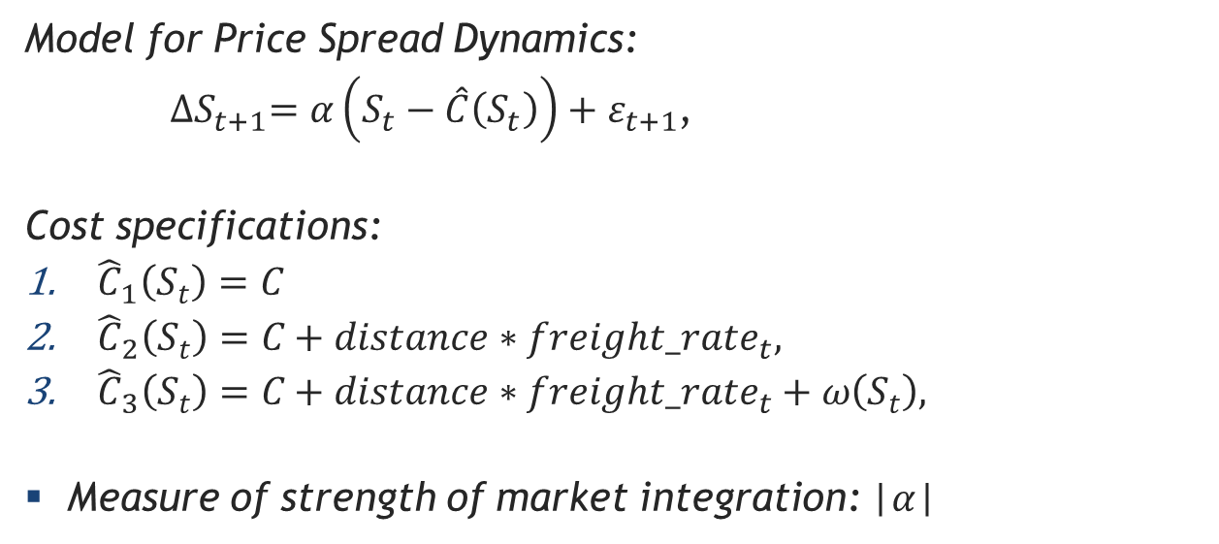
Measuring Market Integration, Example
Model for Price Spread Dynamics:
${∆S}_{t+1}=α\left(S_{t}−\hat{C}\left(S_{t}\right)\right)+ε_{t+1}$,
Cost specifications:
${\hat{C}}_{1}\left(S_{t}\right)=C$
${\hat{C}}_{2}\left(S_{t}\right)=C+distance∗freight_rate_{t},$
${\hat{C}}_{3}\left(S_{t}\right)=C+distance∗freight_rate_{t}+ω\left(S_{t}\right),$
Measure of strength of market integration: |$α$|

Slide 10
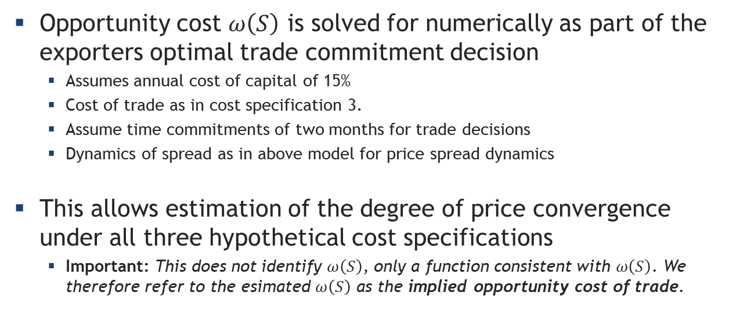
Example: EU/US spread (2006-March 2017)
Opportunity cost $ω\left(S\right)$ is solved for numerically as part of the exporters optimal trade commitment decision
Assumes annual cost of capital of 15%
Cost of trade as in cost specification 3.
Assume time commitments of two months for trade decisions
Dynamics of spread as in above model for price spread dynamics
This allows estimation of the degree of price convergence under all three hypothetical cost specifications
Important: This does not identify $ω\left(S\right)$, only a function consistent with $ω\left(S\right)$. We therefore refer to the esimated $ω\left(S\right)$ as the implied opportunity cost of trade.

Slide 11
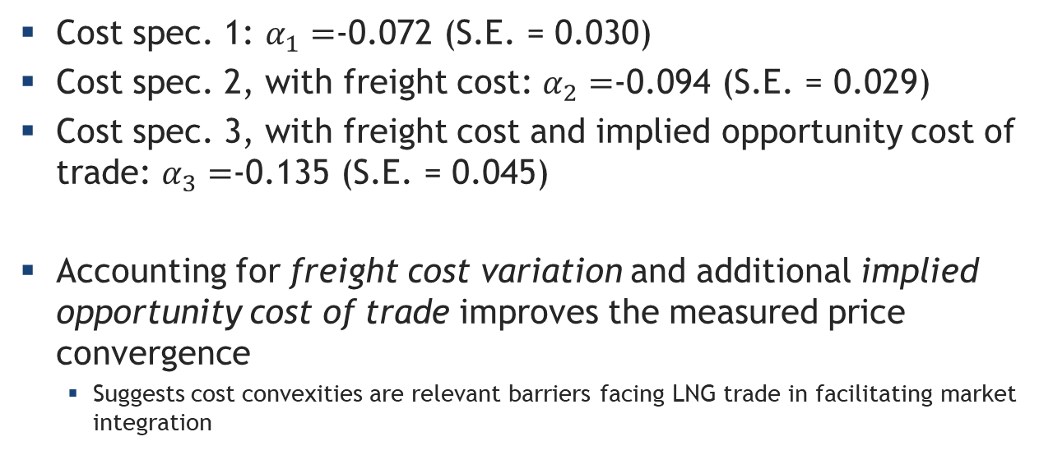
Application: EU/US spread (2006-March 2017)
Cost spec. 1: $α_{1}=$-0.072 (S.E. = 0.030)
Cost spec. 2, with freight cost: $α_{2}=$-0.094 (S.E. = 0.029)
Cost spec. 3, with freight cost and implied opportunity cost of trade: $α_{3}=$-0.135 (S.E. = 0.045)
Accounting for freight cost variation and additional implied opportunity cost of trade improves the measured price convergence
Suggests cost convexities are relevant barriers facing LNG trade in facilitating market integration

Slide 12
Concluding Remarks
LNG trade is technologically demanding
Remains an important barrier for LNG trade in ensuring regional market integration
Is partly reflected in the cyclicality and persistence of LNG freight rates
Irreversible time commitments to trade adds an opportunity cost to the direct cost of trade
The asset is locked in during transit
Raises an additional barrier to LNG trade not previously discussed in the literature
Cost convexities and endogeneity are empirically important to explain lack of regional price convergence

