Slide 1
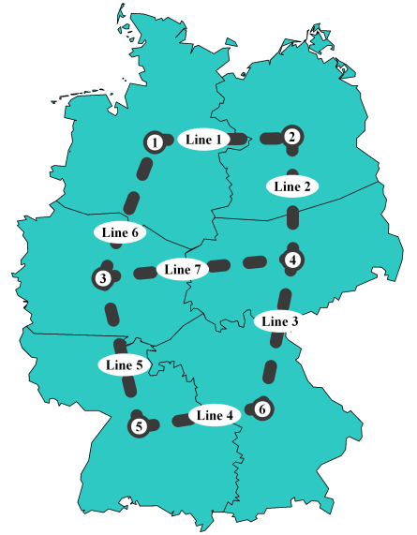
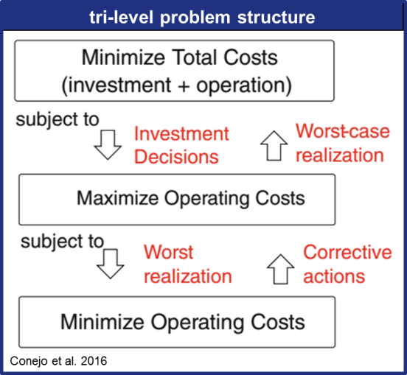
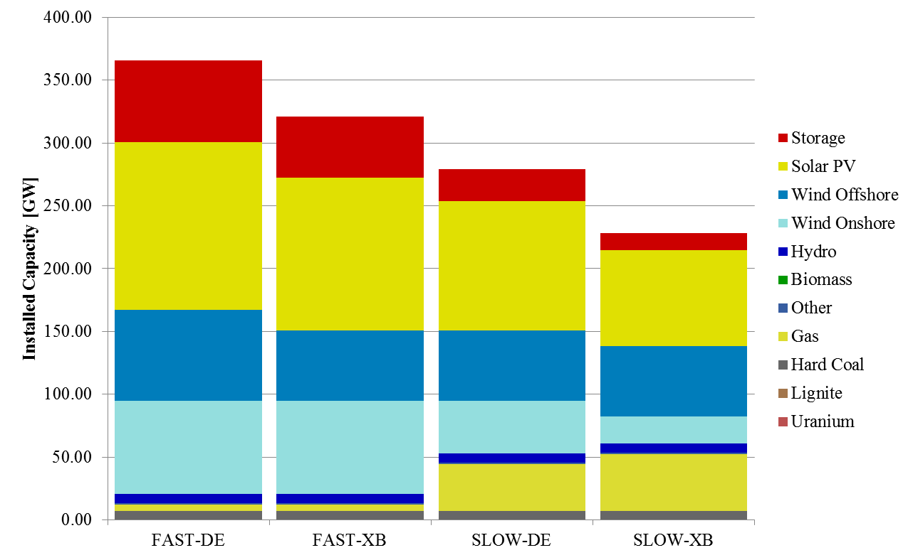

IAEE European Conference
Vienna, 06 September 2017
Robust Transmission Planning –
An Application to the Case of Germany in 2050
Alexander Weber, Clemens Gerbaulet, Mario Kendziorski,
Christian von Hirschhausen, Jens Weibezahn
Research funded through grant „LKD-EU“, FKZ 03ET4028A,
German Federal Ministry for Economic Affairs and Energy
Notes:
1

Slide 2
Motivation and Research Question
How should uncertainty be tackled in transmission planning?
What role can robust optimization play?
What decision calculus is appropriate from a social perspective?

Slide 3
Introduction: Robust Optimization
Some Decision-Making Strategies
Types of Uncertainties
(Deterministic)
Stochastic Optimization; Expected value
  Minimize the average (expected) cost.
Robust Optimization
  Minimize the cost of the worst case realization
  Alternatively: “Minimax Regret” to minimize the highest extra cost of „not-knowing“
(Certainty)
Risk vs. Knightian Uncertainty
  Sometimes, this may be a data problem...
“High” vs. “low” frequency uncertainties
  “High frequency” uncertainties allow for bad outcomes to be compensated by good outcomes
Other Issues
  Implementation of solution subject to “tolerances”
  Problem/Model very sensitive to (small) parameter changes

Slide 4
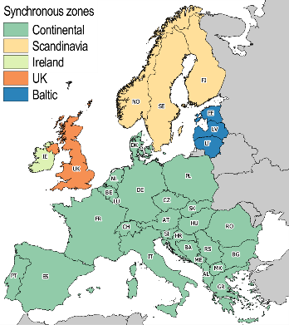
dynELMOD –Investment and Dispatch model for Europe
dynELMOD: dynamic Electricity Model
Characteristics
33 European Countries
Flow-based market coupling
Investment: five-year steps
2020 – 2050
Dispatch during optimization: hourly resolution for about 2 weeks
Dispatch during validation: hourly resolution for entire year: 8760 hours
Open source (soon)
  diw.de/elmod
Objective: System Cost minimization
  Investment
  Operation and Maintenance
  Generation
  Cross-border line expansion
Investment options
Boundary conditions
CO₂ Emission Constraint
Conventional power plants
Renewables
(PV, Wind On/Offshore, CSP)
Storage and DSM technologies
(endogenous P/E Ratio)
Grid expansion
(increase of NTCs)
Electricity demand development
CO₂ budget over time
CO₂ storage potential per country
Renewable availabilities
Renewable investment potentials

Slide 5
The Case of Transmission Planning in Germany
Scenarios for generation and exchanges are generated using “dynELMOD” (Gerbaulet & Lorenz, 2017)
  European-scale, country-level fully fledged generation and transmission investment model (EU-28 + CH + NO + Balkans)
Scenarios (2x2)
  “FAST” -> 2050 carbon emission reduction of 98% (rel. to 2015)
  “SLOW” -> only 80% reduction
  “DE” no interconnector expansion
  “XB” cost-minimal interconnector expansion

Slide 6
Transmission Planning in Germany: Model
Model
  Simple 6-node Model (transport, zero initial transport capacity)
  Int’l Exchanges fixed
  179 time steps
  Allocation of generation capacities using potential maps/existing sites; Storages at RES-Sites
Four scenarios
  FAST-DE and FAST-XB
  SLOW-DE and SLOW-XB
Four optimization strategies
  “Pure” Robust Optimization
  minimax Regret (“pure” and min regret)
  Deterministic (FAST-DE/-XB, SLOW-DE/-XB)
  expected costs (uniform probability)

Slide 7
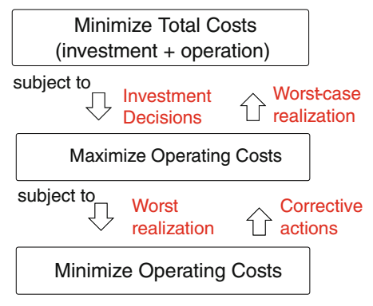
Applications of Robust Optimization to Transmission Planning
Backup
There are only few ‘advanced’ publications on robust TEP
  Jabr (2013)
    Uncertainty set: Load and Generation (continous)
    24/96 nodes
  Ruiz/Conejo (2015)
    (smaller) extension to Jabr (2013), investment budgets, larger uncertainty set
  Chen/Wang (2016)
    Uncertainty set: generation retirements and replacement (large discrete set)
    240 nodes
    5 investment periods
Challenges
  Tri-level structure
  Adequate uncertainty sets!
tri-level problem structure
Conejo et al. 2016

Slide 8
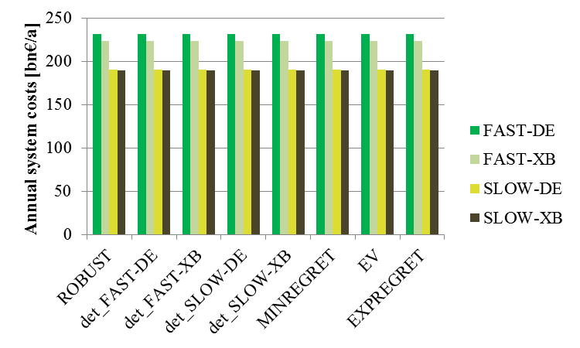
Results: Annual System Costs (1/2)

Slide 9
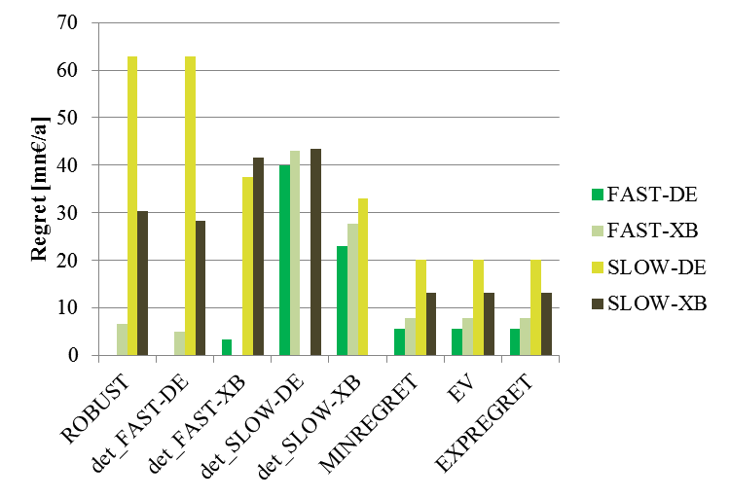
Results: Annual System Costs (2/2)

Slide 10
Results: Transmission Investment
Backup
Decision Strategy | Line investment levels [GW] |  |  |  |  |  |  | Line cost [bn€]
 | #1 | #2 | #3 | #4 | #5 | #6 | #7
ROBUST | 2 | 9 | 7 | 4 | 19 | 29 |  | 70
det_FAST-DE | 2 | 9 | 7 | 4 | 19 | 29 | 2 | 72
det_FAST-XB | 2 | 9 | 8 | 5 | 18 | 28 | 2 | 72
det_SLOW-DE | 1 | 13 | 11 | 8 | 15 | 25 |  | 73
det_SLOW-XB | 3 | 10 | 7 | 4 | 19 | 29 |  | 72
MINREGRET | 3 | 9 | 7 | 4 | 19 | 29 |  | 71
EV | 3 | 9 | 7 | 4 | 19 | 29 | 1 | 72
EXPREGRET | 2 | 10 | 8 | 5 | 18 | 28 | 1 | 72

Slide 11
Results: Transmission Investment
Conclusion
  Basic application of robust optimization to TEP in Germany
  Scenarios have a high “intrinsic” cost impact => different transmission expansion strategies play are comparatively narrow role. (Full DCLF may change this)
  When overall costs are targeted at, robust optimization will direct all its efforts on the alternative which is – overall – most expensive.
    => “minimum regret” strategies may be more adequate here
Further extensions
  Full transmission network representation (should increase value of robust decision making)
  Adaptive decision-making! (should decrease reduce the contribution of robust decision making while increasing overall efficiency)
“Philosophical”(?) question:
  From a “social” perspective – what is the correct decision calculus?
    “Robust” vs. “Minimax Regret” vs. X?
    Is there a well-grounded concept of social decision-making under uncertainty (except for the notion of risk-neutrality)?

Slide 12
Literature
Chen, B. & Wang, L. (2016). Robust Transmission Planning Under Uncertain Generation Investment and Retirement. IEEE Transactions on Power Systems, PP(99), pp. 1–9.
Conejo, A.J., Baringo Morales, L., Kazempour, S.J. & Siddiqui, A.S. (2016). Investment in Electricity Generation and Transmission: Decision Making under Uncertainty. Heidelberg, New York: Springer.
Gerbaulet, C. & Lorenz, C. (2017). dynELMOD: A Dynamic Investment and Dispatch Model for the Future European Electricity Market. DIW Berlin, Data Documentation forthcoming, Berlin, Germany.
Jabr, R.A. (2013). Robust Transmission Network Expansion Planning With Uncertain Renewable Generation and Loads. IEEE Transactions on Power Systems, 28(4), pp. 4558–4567.
Ruiz, C. & Conejo, A.J. (2015). Robust Transmission Expansion Planning. European Journal of Operational Research, 242(2), pp. 390–401.

