Slide 1
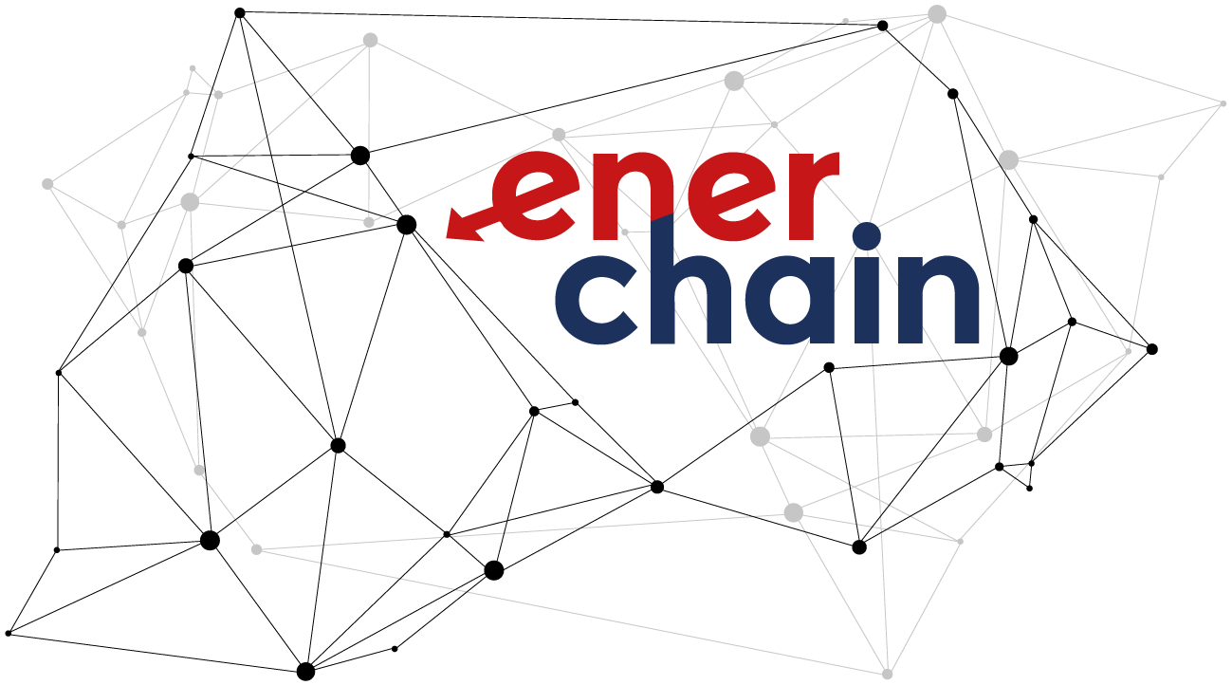
The role of Blockchain in the future of electricity markets Michael Merz - PONTON GmbH

Slide 2
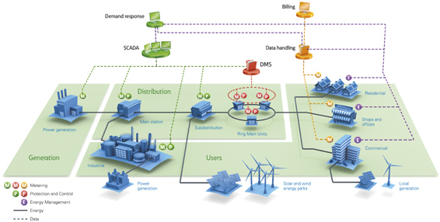
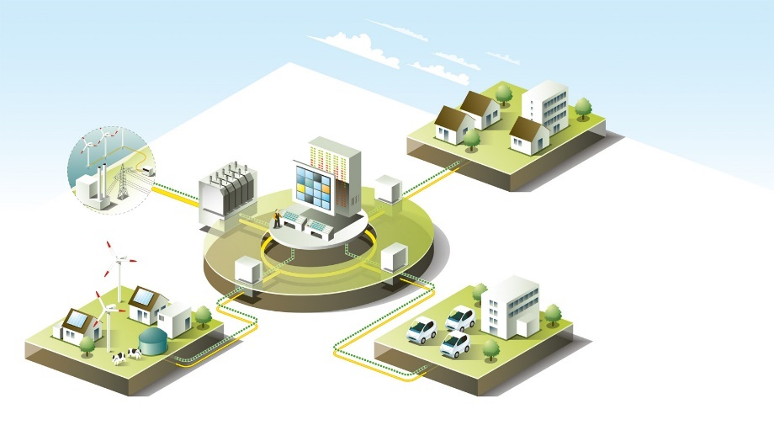

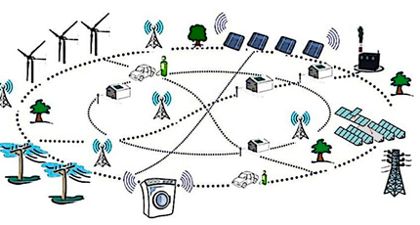
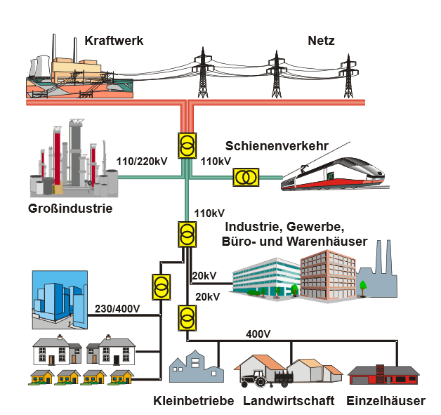
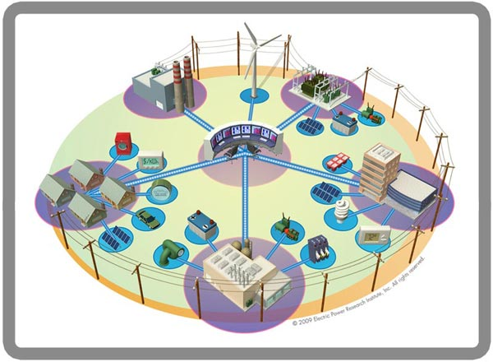
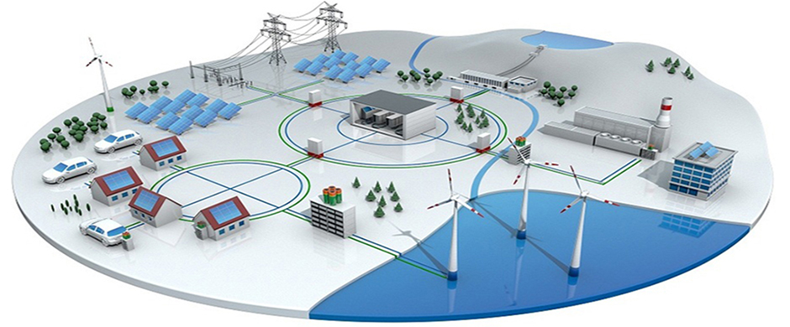
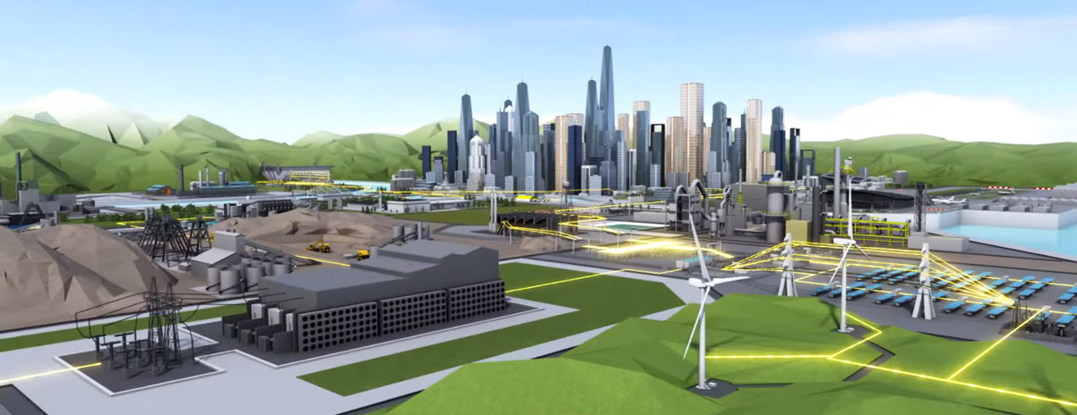
Power Grids – today and tomorrow…
Energie-wende

Slide 3
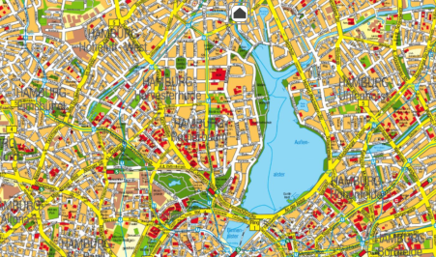
Scenario 2030: Hierarchical Markets for the Balancing of local Grids
DSO Grid
Balance
€
Trades
Wholesale Market
Residual
Load
Provider
Area
€
Grid-wide Market
E⁻
Residual
Load
Provider
Village
€
Regional Market
E⁻
Residual
Load
Provider
Local Market
E⁻
€
E⁻

Slide 4




The „Blockchain & Energie“ Space
Vertical Focus (energy)
P2P Trading - Microgrid
- Local grid
Flexibility Market
- TSO / DSO Grid
P2P
- Wholesale market
Settlement
Financial
Physical
Grid Control - TSO vs. DSO
Internet of Things
(Lift device data into the digital sphere)
Horizontal Technical Features & Challenges
Access / Identity Management / Archive historic blocks
Load / Performance / Stability / Security / Privacy

Slide 5

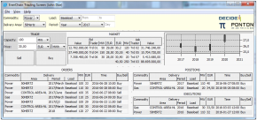

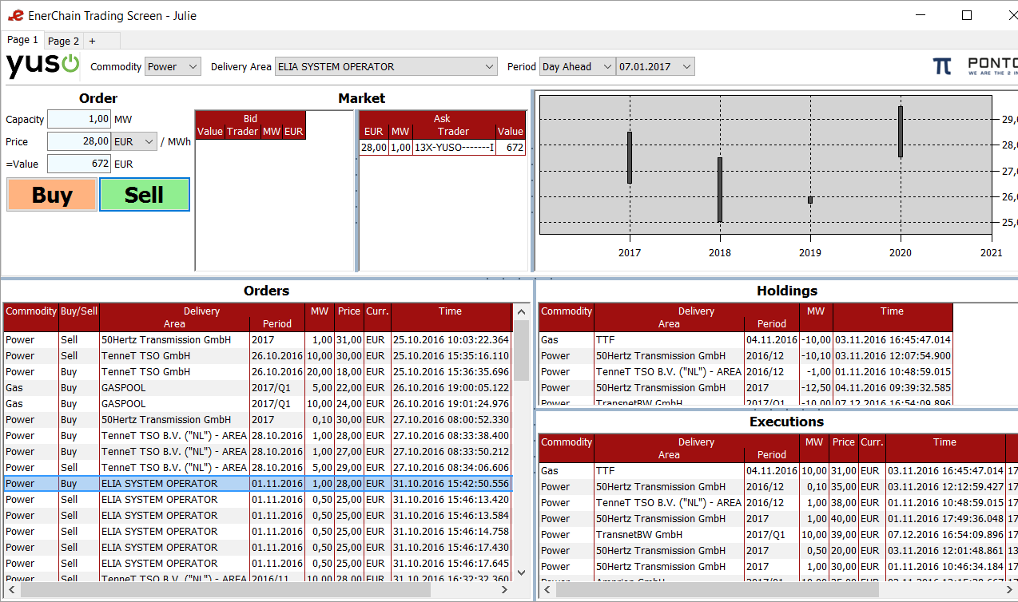
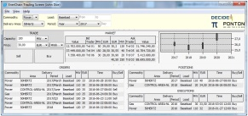
Project Enerchain The world‘s wholesale first energy trade over the blockchain

Slide 6
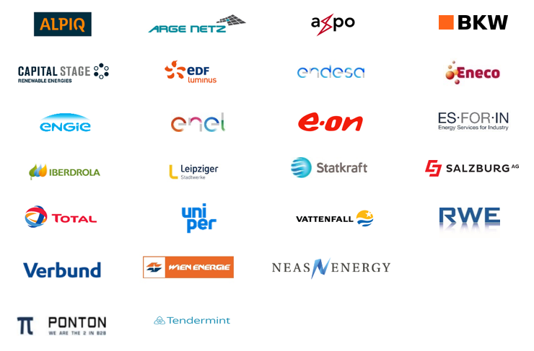
Project Enerchain 25 Participants (2 logos hidden)

Slide 7


Local Market for Flexibility based on Blockchain Technology
Battery
Other
Market Price Index
1
24h
50 €/MWh
API
Power Price
(front hour)
1
2
Agent: Exchange
0 €/MWh
Agent:
Battery-
storage
Demand
Supply
€
2
100%
Battery
0%
Marketplace
(via Blockchain)
3
100%
Electrolyser
50%
4
100%
Electric Vehicle
. . .
0%
API
5
3
100%
Office
Building
(heating)
Agent:
Electro-
lyser
4
0%
Agent:
Electric
Vehicle
5
API
Agent:
Office
Building

Slide 8
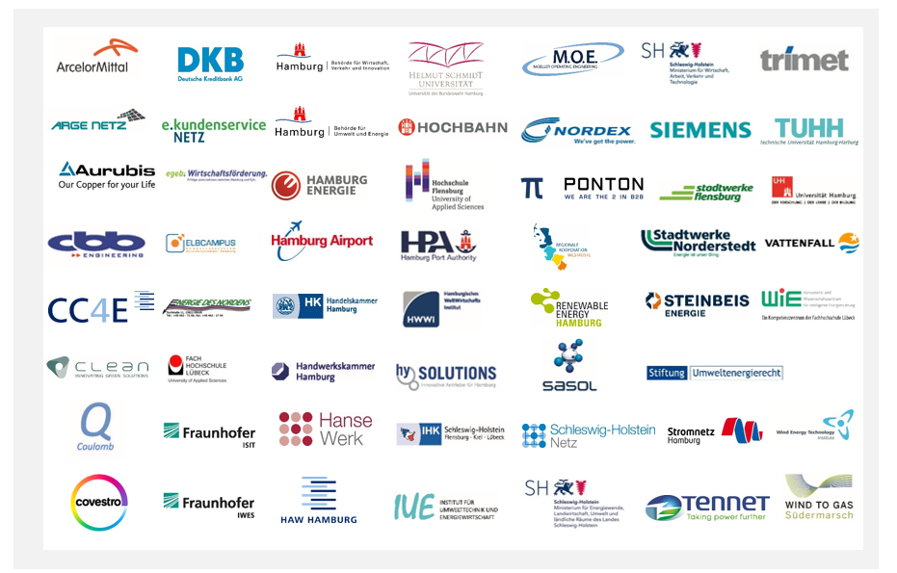
NEW 4.0 – „Norddeutsche Energiewende“
Region Hamburg/Schleswig Holstein, > 50% RES share, develop Smart Market for Flex.

Slide 9
Where is the Business Case for Blockchain?
High availability at reduced cost (operation & transaction)
Disintermediate
Integrate token currency
Allow for minimal transaction volumes through reduced transaction cost
Directly link people to people / assets to assets
Trustlessness
Standardisation effect
„So, again, where is the business case in using blockchain technology?“
It is the mix, stupid!

Slide 10

Why is it so difficult to „Think Blockchain“?
Classic Approach
Blockchain Approach
Business Case
?
?
Software
Design / Spec.
This won‘t work!
Software Implementation
Blockchain
Technology
Blockchain-based
design is a
permanent
elevator ride
Operation
Blockchain
(e.g. Ethereum)

Slide 11
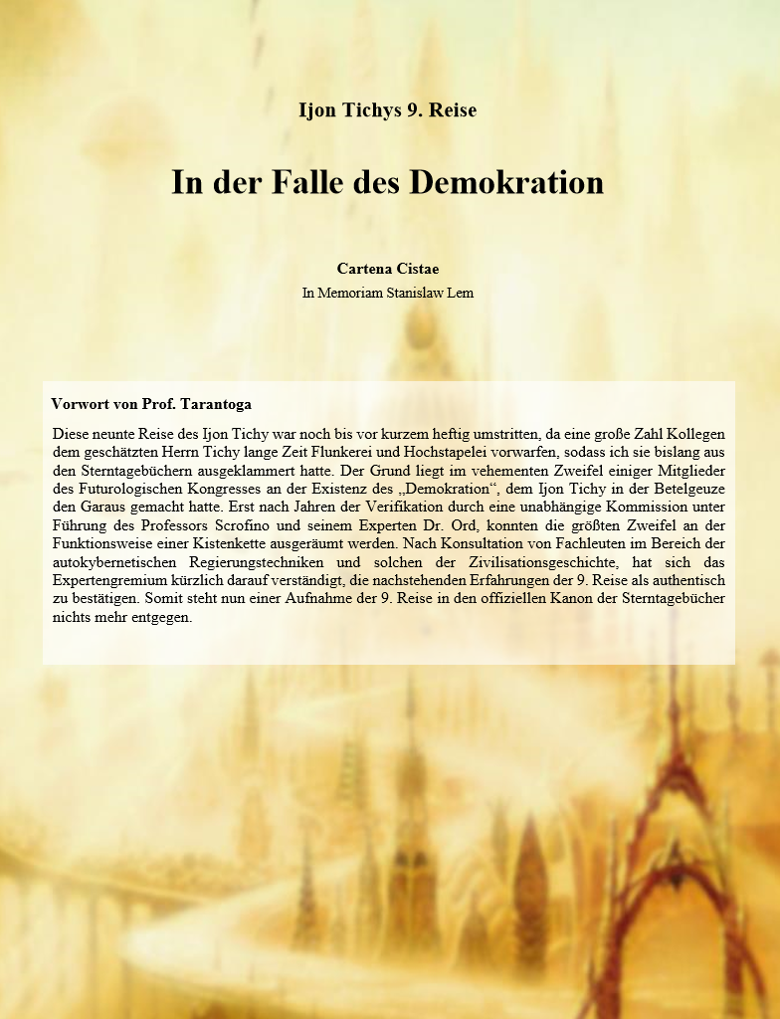
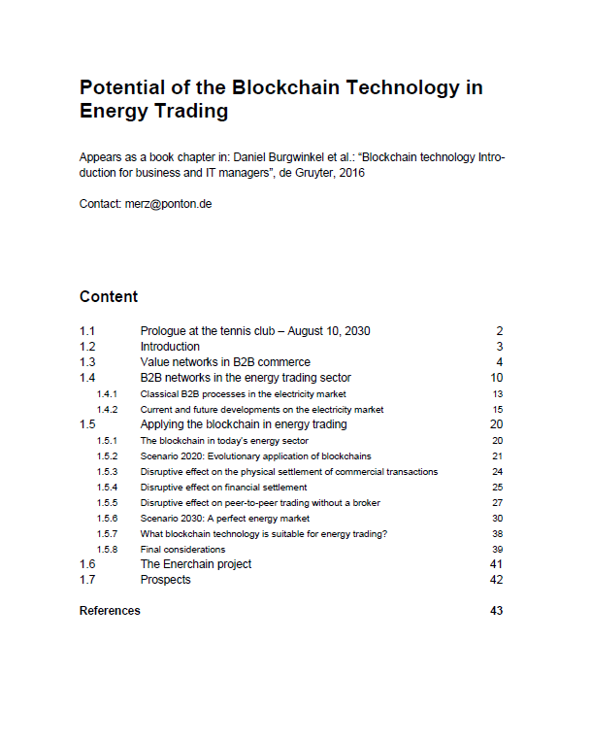
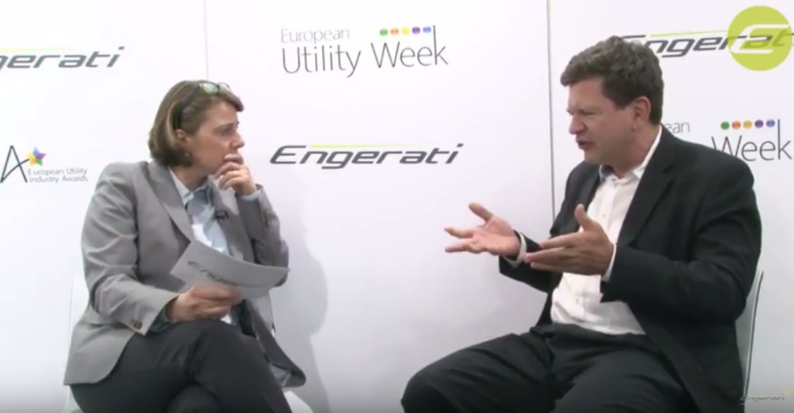
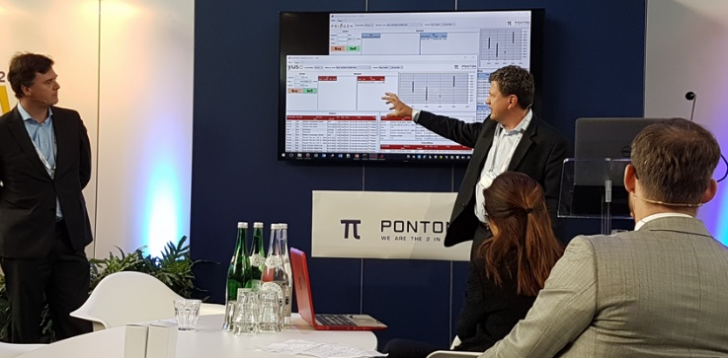
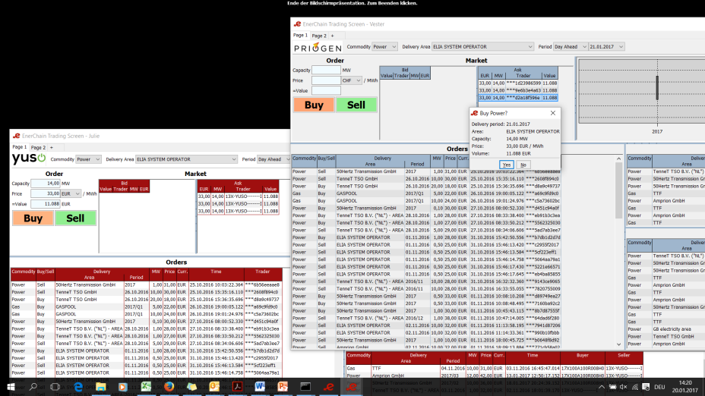
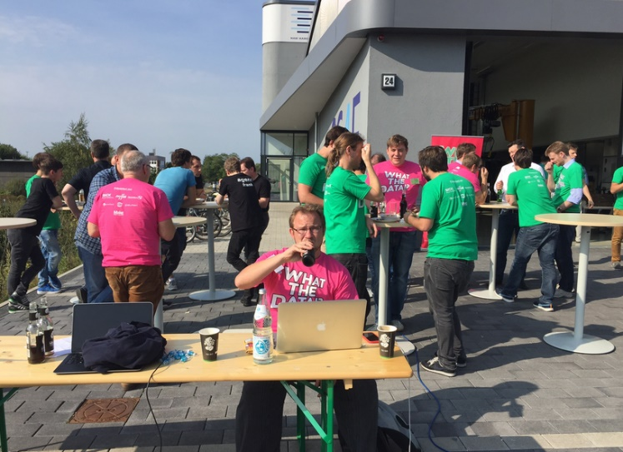
PONTON / Blockchain Hall of Fame
Find more information here: http://enerchain.ponton.de
http://www.ponton.de/downloads/enerchain/InDerFalleDesDemokration.pdf
https://m.youtube.com/watch?v=M_Sbim-5VoI
http://enerchain.ponton.de/index.php/3-applying-the-blockchain-to-energy-trading
plus projects under NDA…

Slide 12
Thank you
Michael Merz merz@ponton.de

