Slide 1
THE POLITICAL ECONOMY STRUCTURES OF ENERGY TRANSITIONS: FROM SHALE GAS TO RENEWABLE ENERGY Presentation in the IAEE European conference, Vienna 3-7.9.2017, session 5F Renewable energy
www.el-tran.fi; @Eltranteam
6.9.2017
Prof. Pami Aalto
University of Tampere
Prof. Mert Bilgin
Medipol University
Prof. Kim Talus
University of Eastern Finland

Slide 2
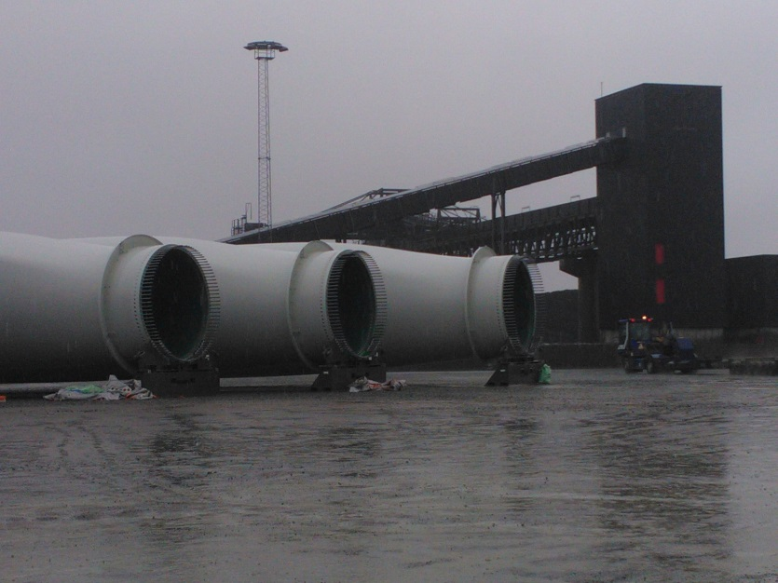
The US and German energy transitions, what & why?
The switch towards using new resources in the USA and Germany results in a new energy mix where different fossil and non-fossil resource sectors are interdependent
Our primary interest is in these complex interrelationships among choices vis-a-vis the new resources available and in the difficulty of controlling the outcomes
As the transitions extend to new sectors of society, involving new actors, they must reconcile several interests to be successful: cross-sectoral policies indispensable
This calls for interdisciplinary research in the IPE of energy
We respond to the call for interdisciplinarity by applying the purposefully open structuration approach to the study of energy transitions
No single causality/mono-theoretical assumptions
We propose a more comprehensive analysis of the actors in energy transitions, their interests & the structures enabling and constraining their conduct with both material and social qualities

Slide 3
Research questions & basis for comparison
What interests drive the actors in the energy transitions in the USA and Germany?
How do the complex structures of political economy enable and constrain their conduct?
Both cases highly adaptable ’open access orders’ (North; Andrews-Speed 2016; Lockwood et al. 2017) conducive for transitions
But they examplify different varieties of capitalism
No direct comparisons exist so far of these landmark cases for the IPE of energy pursuing unprecedented measures in the shale and renewable sectors respectively

Slide 4
The structuration approach covers a broader scope of structures shaping energy transitions than e.g. sociotechnical systems or institutionalist approaches
Federal-state level governments, regulators & agencies | Producers of fuels, electricity and heat; equipment, service & consultancy companies | Network infrastructure developers | Regional & local actors, consumers & prosumers | International & national financial institutions
Outputs: similarities and differences in the energy transitions of the USA and Germany
Interests of actors vs. the energy system: security of supplies; socioeconomic issues; profits & fiscal gains; R&D; foreign policy; environmental stewardship; efficiency
Structure (policy environment): constraints and enablers
Resources, technology & infrastructure | Finance, markets and business models | Institutions | Ecology
Resources used for energy production (fuels; electricity and heat, industrial needs) | Investment and production costs; taxation regime | Formal institutions incl. regulation (EU/NAFTA/federal/state); agreements, contracting, permits and licenses | Risks to natural environment (accidents, water pollution, etc.)
Network infrastructure incl. pipelines, railroads, terminals, transmission & distribution networks; local networks and microgrids | Organisation of energy markets incl. subsidies & trading systems; balance between supply and demand | Informal institutions including relations among authorities, producers, consumers and NGOs including citizens | Use of land and space for energy extraction and production vs. other economic activities and recreation
Technologies incl. extraction, conversion, storage, network automation, gas turbines, wind turbines, solar panels, etc. | Energy business models incl. services, maintenance, management | Global and regional institutions influencing governance and order among energy actors and stakeholders | GHGs and other emissions into the air and atmosphere
Path dependencies

Slide 5
Fossil fuels and renewables depend on each other if we wish to further all interests attached vis-a-vis the energy system

Slide 6
Results: in the USA ’energy mix’ is a goal of its own, in Germany it is a transitory state
 | Resources, technology & infrastructure | Finance, markets and business models | Institutions | Ecology
USA | Federal Government supports both shale and renewable sectors by means of R&D, to promote its fiscal interests and access to low-cost electricity, and to substitute imports of natural gas and part of coal & potentially some oil | Bottom-up proliferation of shale gas producers creates gas-to-gas competition; stable nuclear production, technological progress & federal support for renewables further help to keep prices down | Several rounds of regulation facilitated the breakthrough of the shale industry, supporting the business and fiscal interests, mitigating the related environmental concerns & responding to security of supply issues | The academia and industry work together to control the environmental risks of the shale industry, which in the long run can only modestly lower GHG and other emissions
Germany | Many vested interests and path-dependencies maintaining existing technologies and infrastructures to overcome, esp. in transport; electricity generation needs back-up power (natural gas) although incumbents have developed a business interests in decarbonisation. Some tensions between decentralisation and centralisation of the grid. | Low fossil fuel prices and subsidised renewables keep wholesale prices low in the interest of industrial buyers. The new lock-in to feed-in-tariffs does not optimally support R&D interests. New business models emerge owing to the highly variable output of solar and wind power and decentralisation. | Incumbent and emerging market actors brought together around a common profit interest in continued feed-in tariffs. Some institutional change from the EU level, integration supporting the German transition with back-up capacity through cross-border trade in electricity and natural gas & policy coordination. | The long-term decarbonisation prospects are more genuine than in the USA but land use and maritime landscape issues set constraints for wind power. Vis-à-vis environmental interests the German bioenergy sector is not prioritised by the Government.

Slide 7

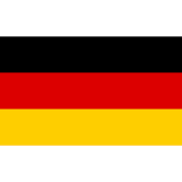
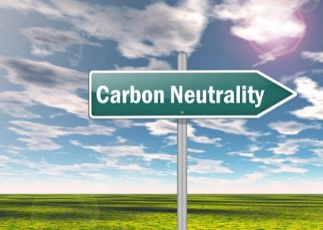
Conclusions: comparison of the two cases
Germany seeks to reduce the risks of nuclear energy domestically in the short-to-medium term, and in the long term, a reduction of GHG emissions
Several path-dependencies need to be broken on the demand side in favour of a more decentralised energy system involving more citizen and prosumer participation and flexible consumption
However, owing to the complex interrelationships among resource sectors, the German transition has not so far delivered more vis-à-vis its long-term objectives than the US case
The US transition deliberately maintains many path-dependencies of the fossil fuels–based economy while it emerges alongside a new renewable economy
It addresses environmental issues with regulatory constraints imposed by the government to prevent risk to profits and the wider economic effects that they expedite

Slide 8
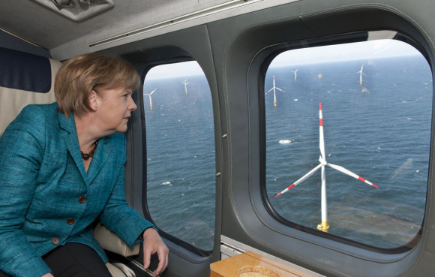
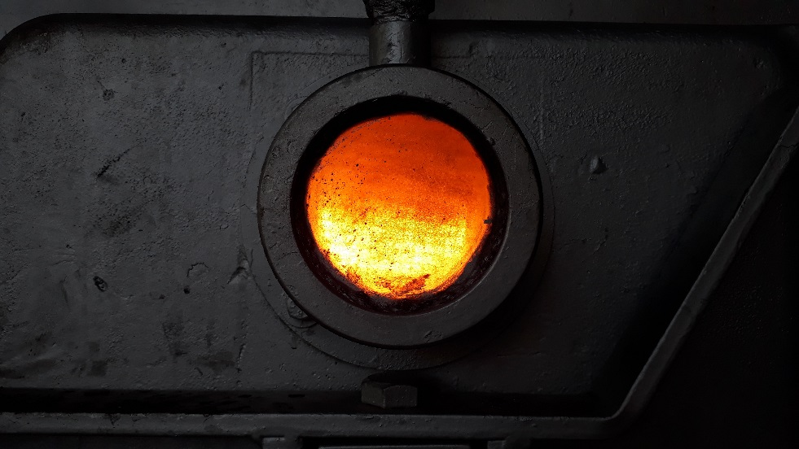
Conclusions: the global level implications
The German energy transition explicitly supports technology exports as a federal level objective, having first adopted wind power technologies from Denmark in the 1990s, and then diffusing these further:
Facilitates innovation, learning and cost reduction to gradually make subsidies redundant
The competitiveness of renewable energy technologies and solutions depends on the global prices and trade in competing energy resources, including oil and natural gas, and the effects of the shale revolution which increases competition
Vs., or plus?

Slide 9
Conclusions: the structuration approach
R&D is a major driver of the transition. Our structuration approach reveals:
The innovation niches, pointed out by studies on socio-technical systems, belong in our framework to the dimension of resources, technologies and infrastructure, but depend on the dimension of finance, markets and business models, and on the institutional dimension
Most US policies address supply side
In Germany, demand side measures more widespread but hit institutional constraints: inadequate coordination vis-à-vis regulations on buildings and transport; and on our financial dimension in terms of insufficient policy innovation to keep up with market developments
The German model creates demand for new services in planning, consultancy, equipment installation & energy efficiency; facilitates the emergence of prosumers and aggregators of small-scale production

Slide 10
Conclusions: markets vs. wider societal interests
Little steered markets such as the US one unable to cater for the wider interests of the state and society in the transition, e.g. vis-à-vis energy efficiency
This dilemma of serving disparate interests remains also unresolved in Germany:
E.g. the long-term aim of converting towards intermittent, emerging technologies in the power markets does not serve security of supply interests as well as does the shale-derived oil and gas in the USA
Although the US transition stems from liberal features of the market economy, full autonomy in markets will not produce an energy transition (esp. environmentally sustainable one)
The more coordinated capitalism of Germany also faces constraints and unintended consequences: debate on state transformation = different state responses
Here our structuration approach draws attention to the difficulties in reconciling state interests & policies with the structural context including all its dimensions

