Slide 1

Financial Feasibility of Storage Technologies in Electricity Systems
Empirical Evidence from Chile
Héctor Osorio, Carlos Silva, Shahriyar Nasirov, and Claudio A. Agostini
Universidad Adolfo Ibañez
IAEE 2017
Vienna, Austria, 03-06 September 2017
Session 6G
Wednesday, September 06, 11:00 am – 12:30 am

Slide 2
Presentation overview
Introduction
Methodology
Results
Conclusion

Slide 3
Chilean electric market
G1
Market of financial bilateral contracts
G2
Distributor
Regulated client
Free client 1
Spot Market
Free client 2
Free client 3
G3
Purchase/sale to spot market
Regulated contract
Contract by direct negotiation

Slide 4
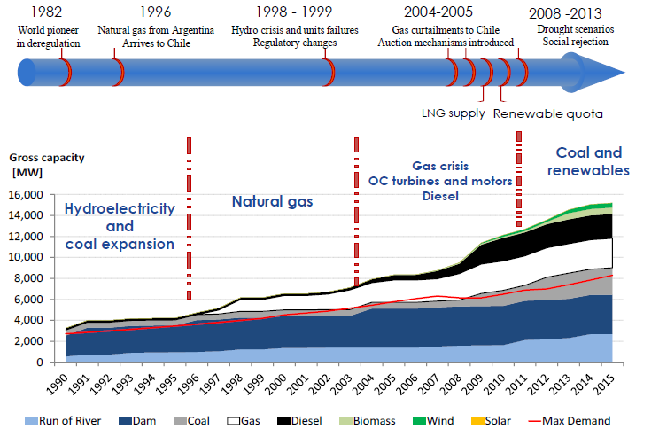
Evolution of Chilean Energy Matrix
Source: Solar Energy Research Center. 2016

Slide 5
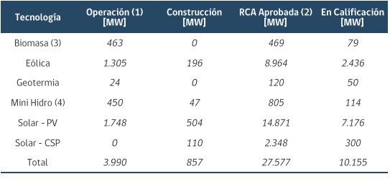
Renewables and it challenges
RPS scheme (Renewable Portfolio Standards) – 20% renewable energy target by 2025¹
Favorable solar radiation
Challenges
Reliability of supply
Variability of supply
Generation disconnected from demand
Oversized transmission systems
Frequency
Voltage
Source: Generadoras Chile. 2017
1: Installed capacity of 22,000 MW approximately

Slide 6
Energy storage systems in Chile
First energy storage system installed in 2009 (12 MW-3MWh Li-ion batteries)
Second energy storage system installed in 2011 (20 MW-5MWh Li-ion batteries)
Future projects
  Espejo de Tarapacá (300 MW hydro pump storage system)
  Cerro Dominador (110 MW CSP with 17.5 hours of energy storage)
  Are Energy Storage Systems economically feasible in Chile?

Slide 7
Methodology
Annual benefits vs. costs
Price arbitrage
Diminishment in transmission losses
Defer of transmission investment
Annual benefits
Different spot price for each hour
Less transmission losses
Annual costs
Annuity of investment²
O&M costs
2: To determine annual costs, a WACC of 6,67% was calculated

Slide 8
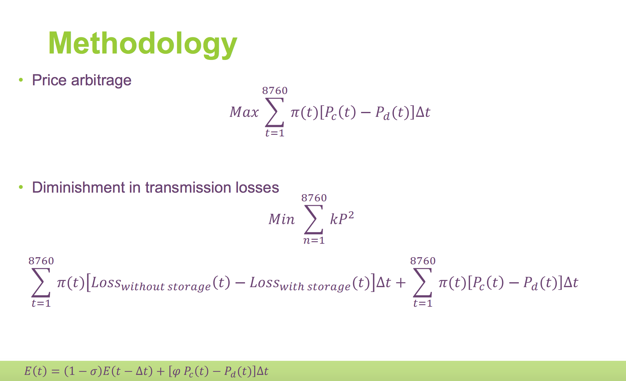
Methodology
$$E\left(t\right)=\left(1−σ\right)E\left(t−∆t\right)+\left[φ P_{c}\left(t\right)−P_{d}(t)\right]∆t$$

Slide 9
Methodology
Defer of transmission investment
Solar Jama 50% capacity increase
Solar Jama 100% capacity increase
Source: Obtained from simulations
Source: Obtained from simulations

Slide 10
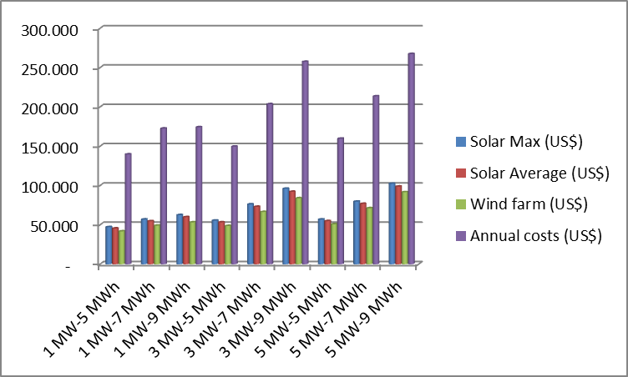
Results: Price arbitrage
Source: CDEC – SING 2016
Source: Obtained from simulations

Slide 11
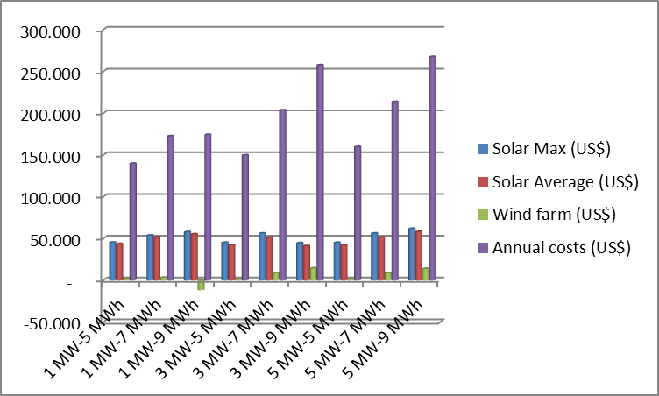
Results: Diminishment in transmission losses
Source: CDEC – SING 2016
Source: Obtained from simulations
Source: CDEC – SING 2016

Slide 12
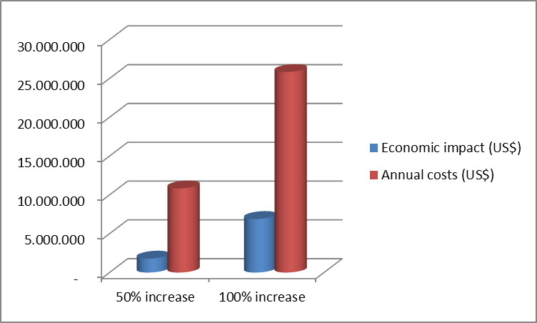
Results: Defer of transmission investment
Source: CDEC – SING 2016
Source: Obtained from simulations
Source: CDEC – SING 2016

Slide 13
Conclusion
Energy storage is needed to connect supply and demand of renewables
Energy storage is technically capable, but expensive
Price arbitrage seems to be the best option
Government subsidies needed
Not recommended until price drops to around a third or the obtainable benefits increase

