Slide 1


Impact of storage efficiency and charging costs on storage profitability in the electricity market 15th IAEE European Conference 2017 Vienna – 6th September 2017
Andreas Belderbos
Erik Delarue
Kris Kessels
William D’haeseleer

Slide 2
Overview
The Levelized Cost of Electricity – LCOE
The Levelized Cost of Storage – LCOS
Insights in storage cost metrics
Shortcomings of metrics
Using storage cost metrics

Slide 3
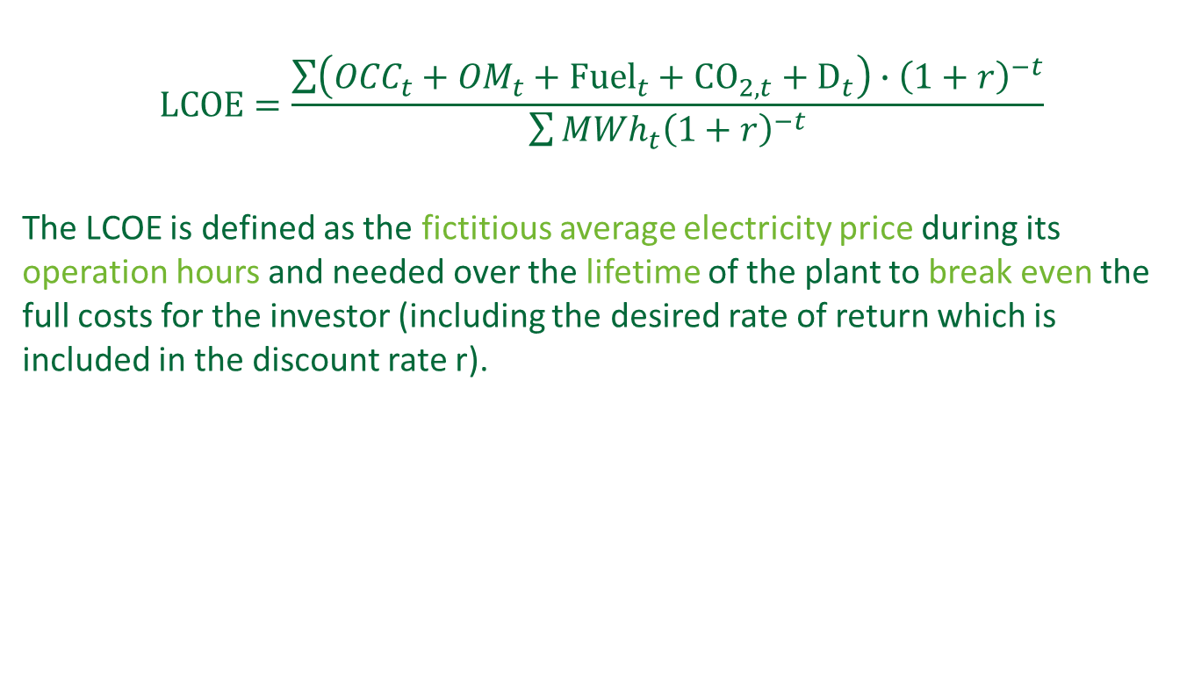
Levelized Cost of Electricity - LCOE
Overnight Capital Cost
Operating & maintenance
Decommissioning
$$LCOE=\frac{\sum{\left({OCC}_{t}+{OM}_{t}+{Fuel}_{t}+{CO}_{2,t}+D_{t}\right)∙{\left(1+r\right)}^{−t}}}{\sum{{{MWh}_{t}\left(1+r\right)}^{−t}}}$$
The LCOE is defined as the fictitious average electricity price during its operation hours and needed over the lifetime of the plant to break even the full costs for the investor (including the desired rate of return which is included in the discount rate r).
Average electricity price during generation
D
€/MWh
CO₂
Fuel
OM
OCC

Slide 4
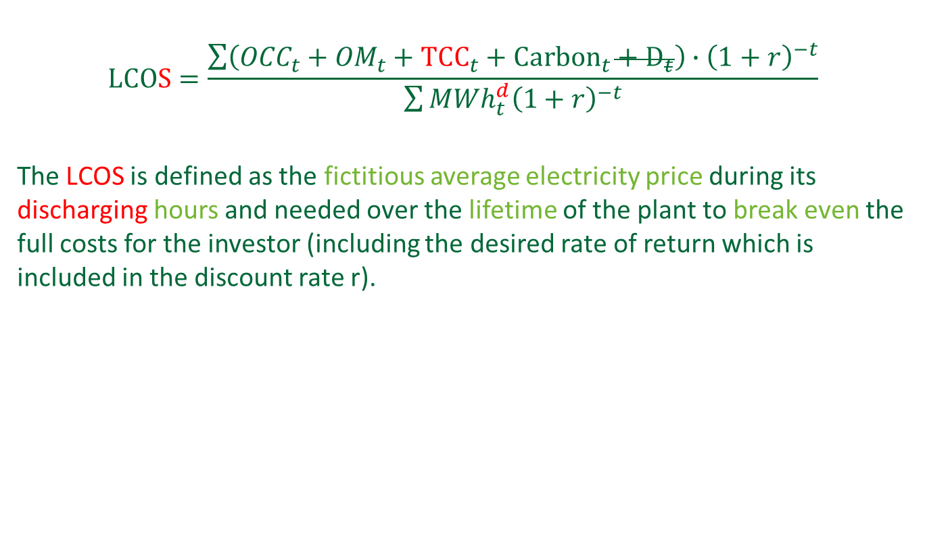
Levelized Cost of Storage - LCOS
Total Charging Cost
$$LCOS=\frac{\sum{\left({OCC}_{t}+{OM}_{t}+{TCC}_{t}+{Carbon}_{t}+D_{t}\right)∙{\left(1+r\right)}^{−t}}}{\sum{{{MWh}_{t}^{d}\left(1+r\right)}^{−t}}}$$
The LCOS is defined as the fictitious average electricity price during its discharging hours and needed over the lifetime of the plant to break even the full costs for the investor (including the desired rate of return which is included in the discount rate r).
Average electricity price during discharging
Average Charging cost per MWh^{d}
Charging cost of useful electricity
= Average Charging cost per MWh^{c} = €/MWh^{c}
€/MWh
Efficiency losses
Fixed OM
OCC

Slide 5
Additional metrics
Since ‘primary energy’ is same commodity as ‘secondary energy’
Required Average Discharge Price – RADP ( = LCOS)
Required Average Price Spread – RAPS
Required Average Operational Profit – RAOP
Average electricity price during discharging
Average charging cost per MWh^{c}
Average charging cost per MWh^{c}
Average charging cost per MWh^{d}
€/MWh
Efficiency losses
Efficiency losses
Fixed OM
Fixed OM
Fixed OM
OCC
OCC
OCC
RADP
RAPS
RAOP

Slide 6




Key parameters
Overnight Construction Cost
Total Charging Cost
$$RADP=\frac{\sum{\left({OCC}_{t}+{OM}_{t}+{TCC}_{t}\right)∙{\left(1+r\right)}^{−t}}}{\sum{{{MWh}_{t}^{d}\left(1+r\right)}^{−t}}}$$
Capital cost
O&M
Charging cost
MWh discharged
Average charging price per MWh^{c}
Efficiency

Slide 7

Storage parameters used for illustration
Installed power capacity (P) | 1 MW
Equivalent Annual Fixed cost (OCC + FOM) | 30,000 €
Round-trip efficiency (η_{RT}) | 80 %
Number of discharging hours (NDH) | 1000 h
Averaged charging cost (ACC) | 20 €/MWh^{c}

Slide 8
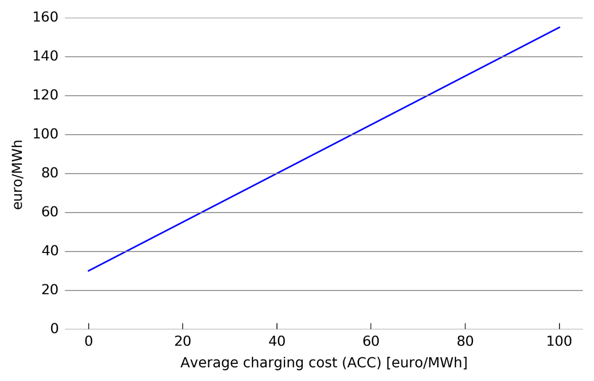
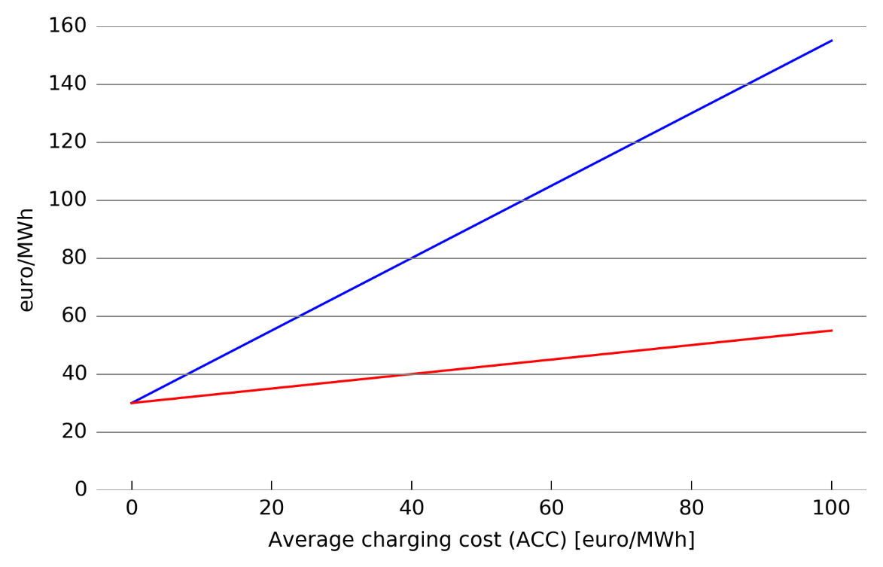
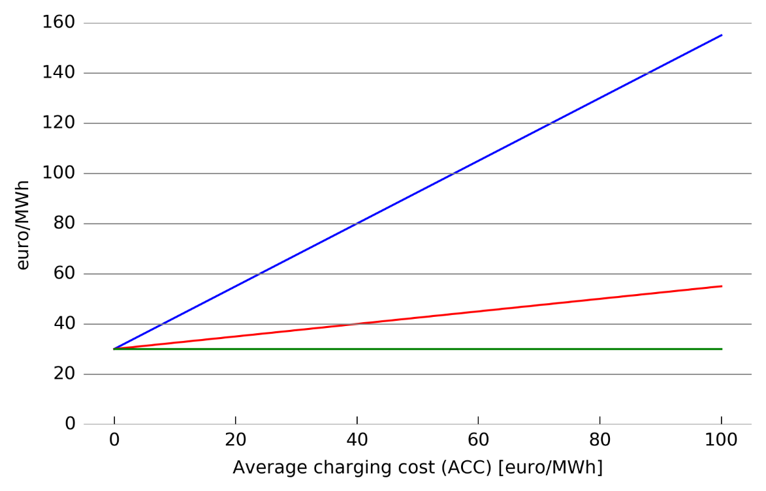
Varying the average charging price
RADP
RAPS
RAOP
Notes:
If ACC = 0, all metrics equal !This effectively means that even for the RADP and RAPS, no efficiency is taken into account.

Slide 9
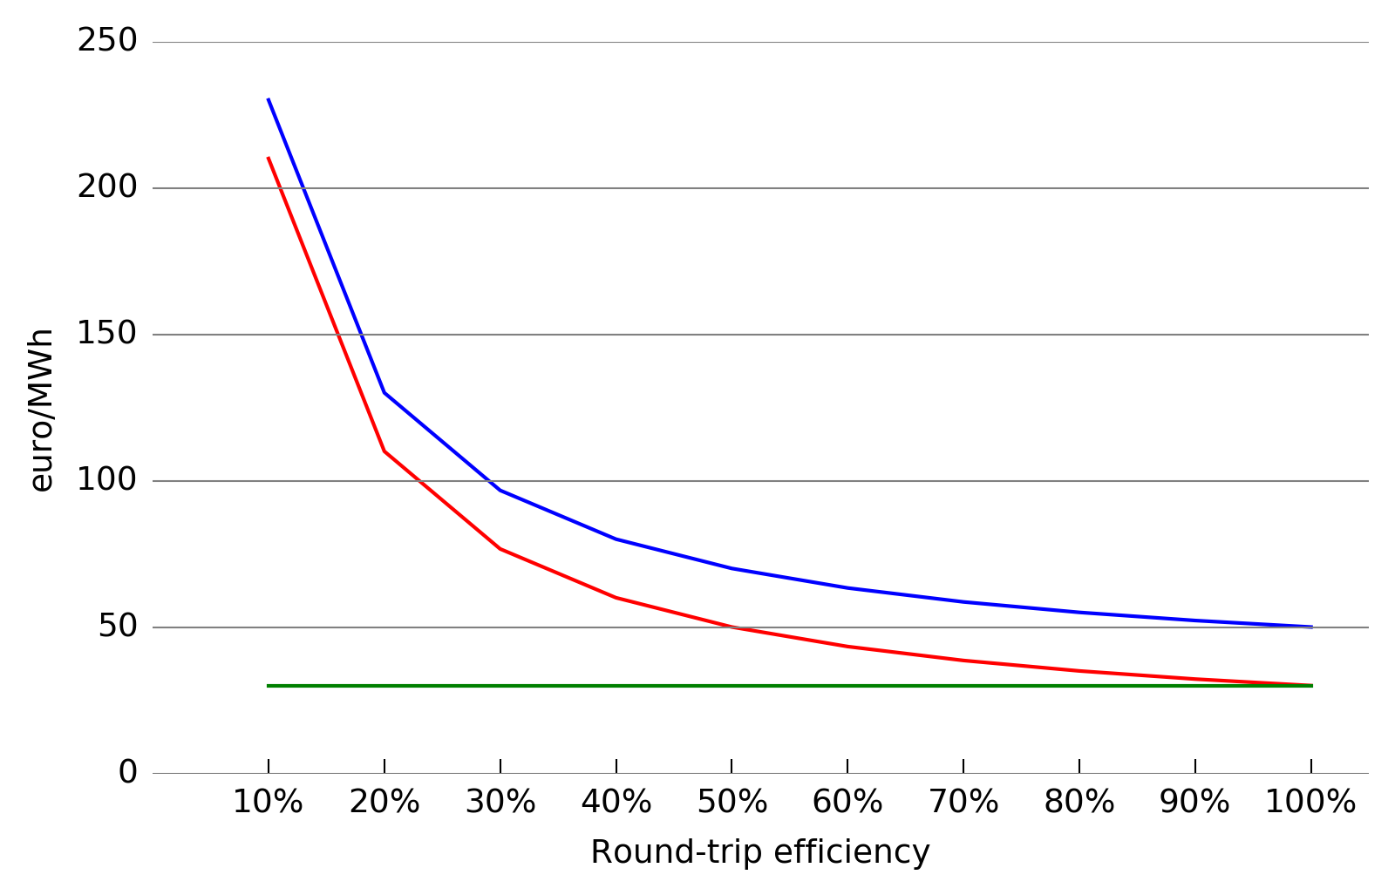
Varying the round-trip efficiency
RADP
RAPS
RAOP

Slide 10
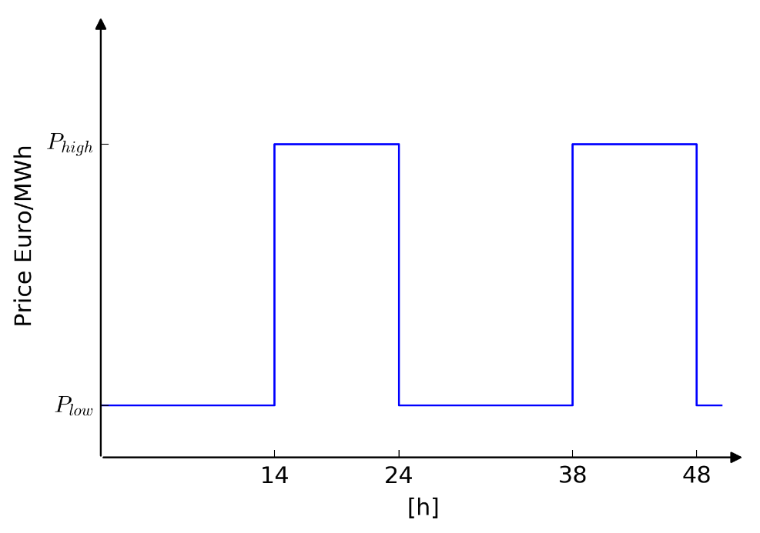
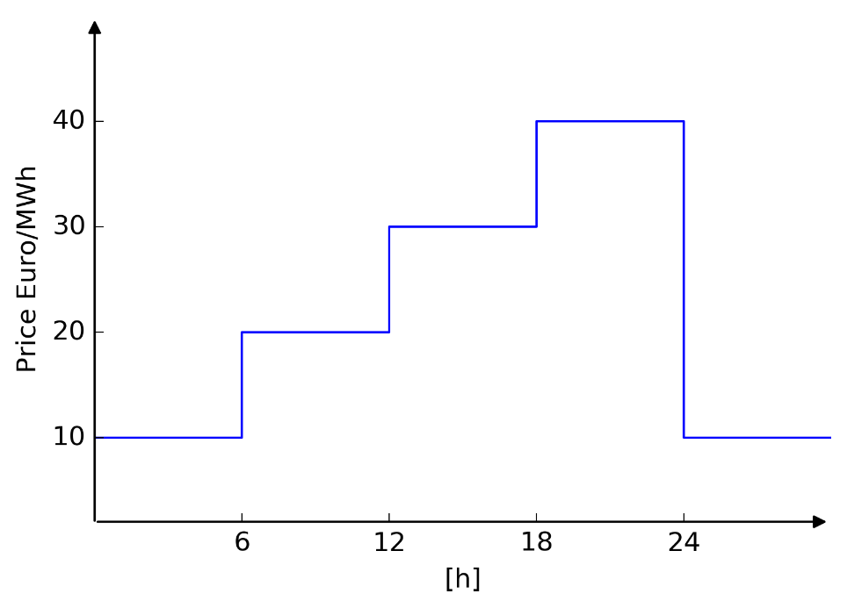
Using the different cost metrics
Levelized cost metrics work well when unit is fully dispatchable
-> storage is dispatchable…
… unless the energy capacity is limited
Occurring price profile <-> available price profile

Slide 11
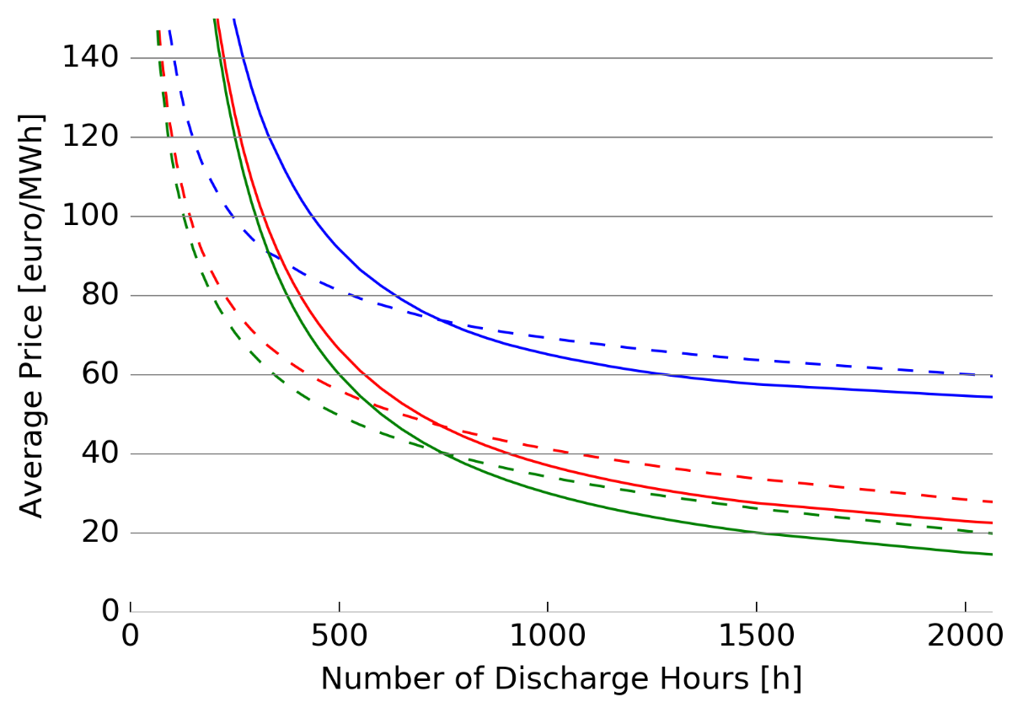
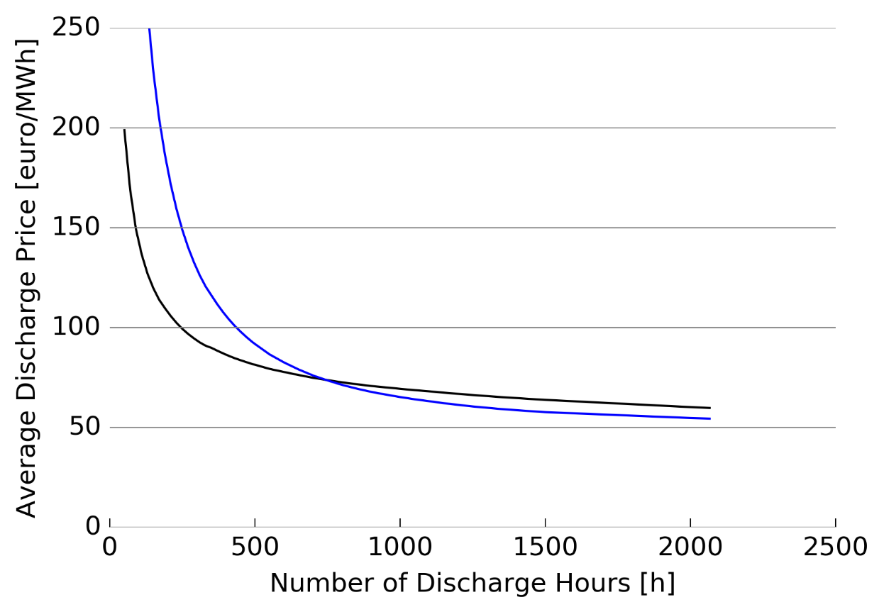
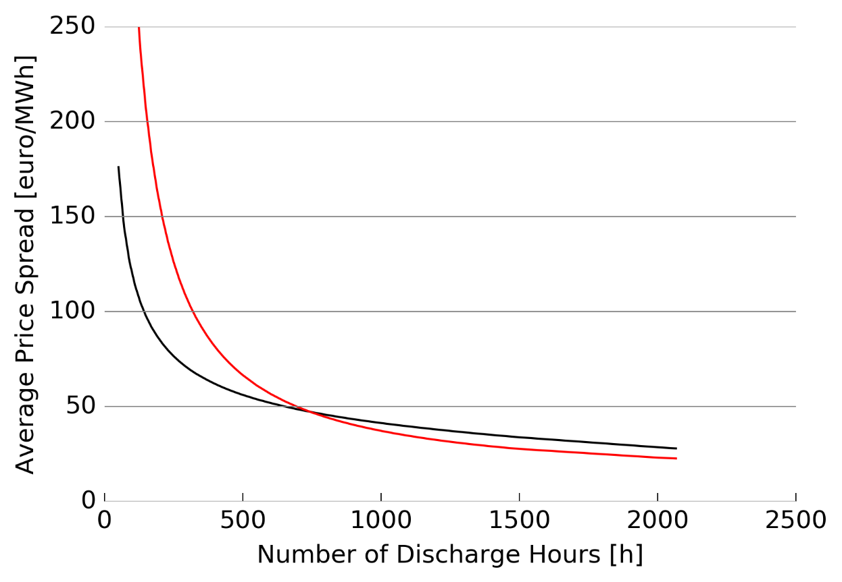
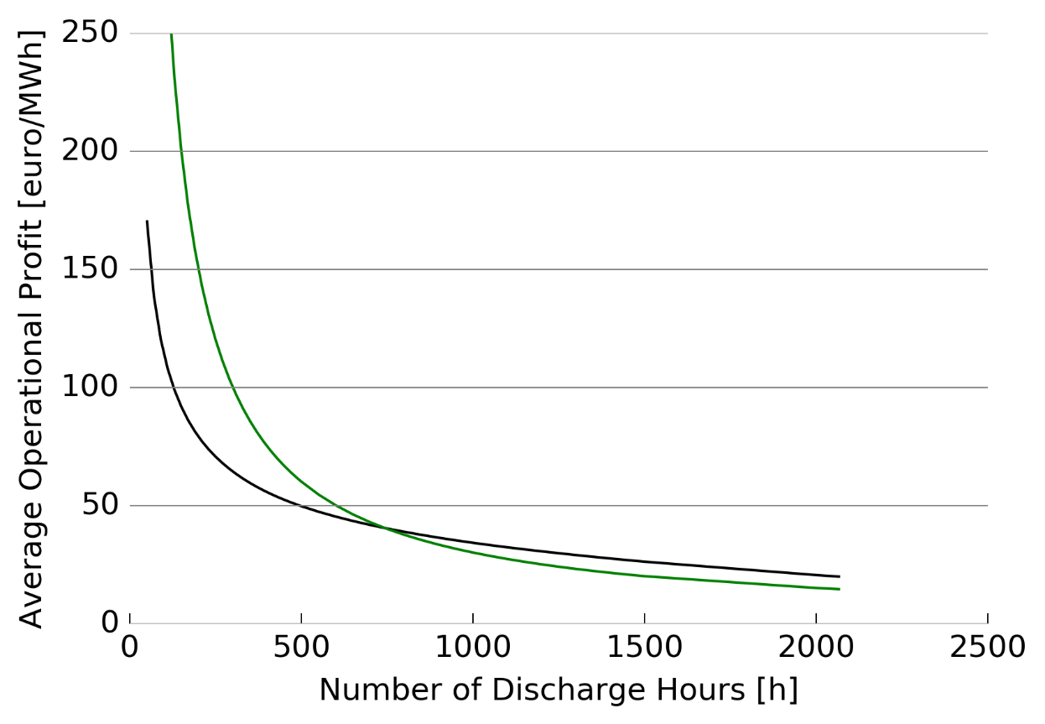
Correctly using the different cost metrics
Compare the required cost metrics to the corresponding available price metric
Required prices
RADP
RAPS
RAOP
Available prices
AADP
AAOP
AAPS

Slide 12
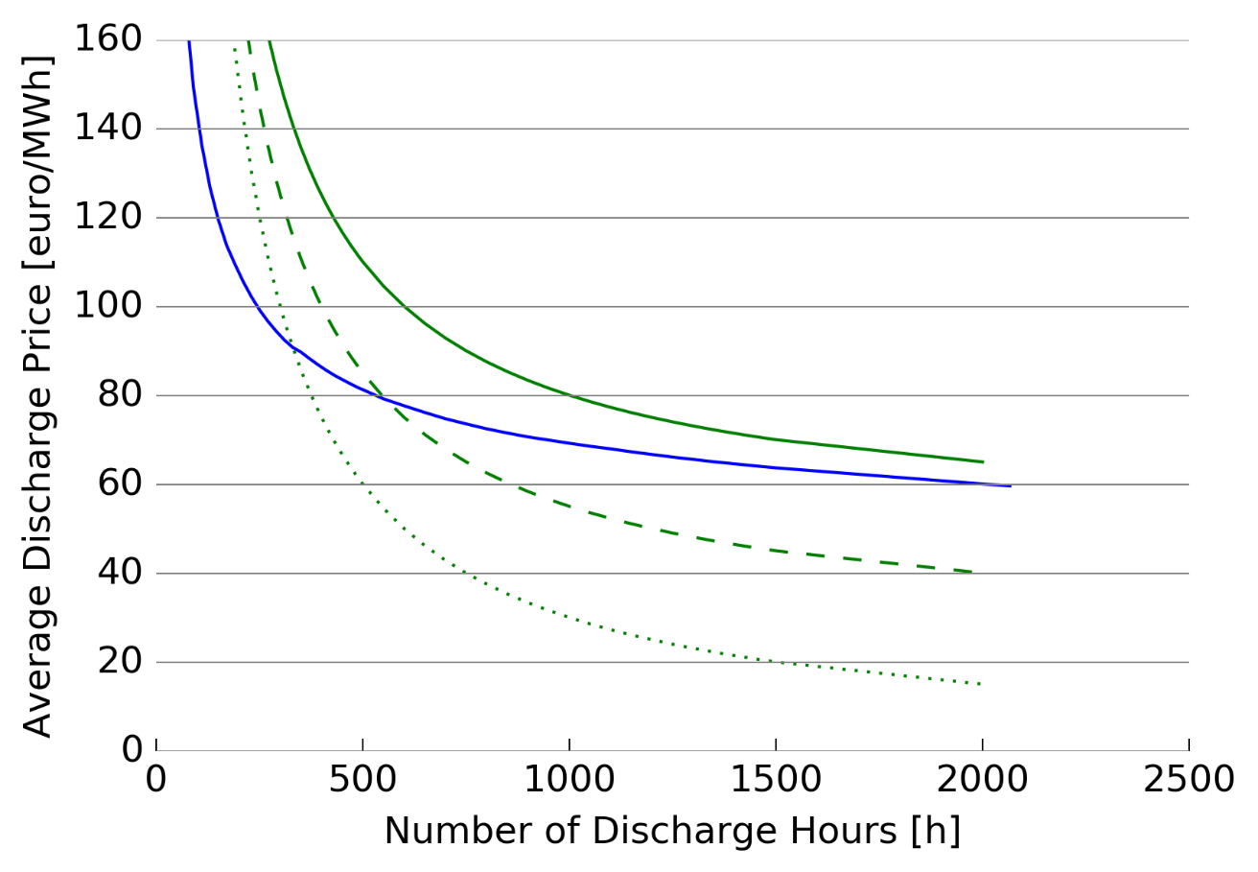
Caution with the charging cost
If assumed charging cost differs from actual available charging cost, intersection is not necessarily the break-even point
Required prices
Available price
Required Average Operational Profit -> Most transparent metric

Slide 13
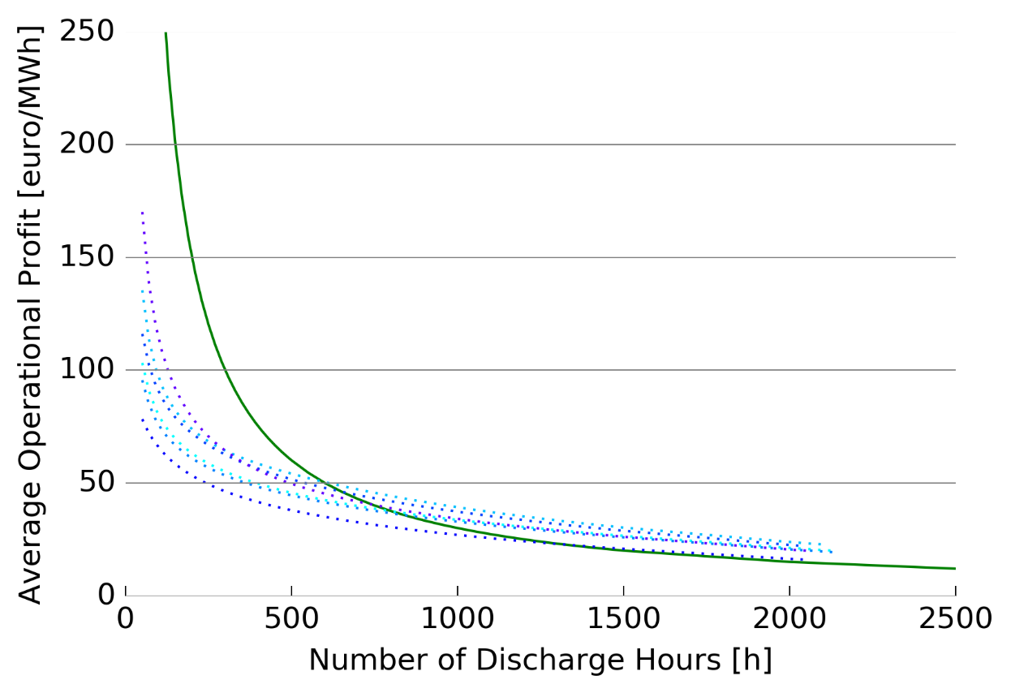
Analyzing the Required Average Operational Profit for different price profiles
RAOP
AAOP for multiple years

Slide 14
Wrap-up
LCOE
For charging cost = 0 €/MWh: RADP = RAPS = RAOP: neglecting efficiency
Caution when using metrics for storage with limited energy capacity
RAOP is most transparent metric and preferred
Required Average Discharge Price (RADP)
Required Average Price Spread (RAPS)
Required Average Operational Profit (RAOP)

Slide 15
Reference & Contact
Paper available:
A. Belderbos, E. Delarue, K. Kessels, W. D'haeseleer,
Levelized cost of storage — Introducing novel metrics,
Energy Economics, Available online 1 September 2017
Contact: andreas.belderbos@kuleuven.be
KU Leuven – TME
Energy & Environment

