Slide 1
15th IAEE European Conference
A system approach for evaluating clean energy goals and the role of flexibility technologies: the case of France
Manuel Villavicencio
Ph.D. candidate
Université Paris-Dauphine, PSL Research University
LEDa – CGEMP
Vienna 06/09/2017

Slide 2
Agenda
1
Context and research questions
2
Definitions and methodology for valuating flexibility technologies
3
Findings for the case of France
4
Conclusions
Manuel Villavicencio. Université Paris-Dauphine, PSL Research University

Slide 3
1. Context and research questions
The 2015’s French Energy transition Act: How important is the energy policy shock ?
Loi nº 2015-992 of 17 August 2015: “Transition énergétique pour la croissance verte”
Standards |  | H2020 | H2025 | H2030
VRE shares | > | 27% | - | 40%
Nuclear shares | < | - | 50% | 50%
CO₂ cost [€/ton] | = | 20 | 20 | 20
The French Power system by 2015:
EOM, Reserve markets and CRM
Peak load = 93.63 GW
Total energy =541.4 TWh/year
VoLL = 10 000 €/MWh
Annual Lost load < 3 h/year
CO₂ cost: 6-8 €/ton
Installed capacity
Manuel Villavicencio. Université Paris-Dauphine, PSL Research University
Notes:
It is a nuclear dominated system with some hydro a OCGT => moderate flexibility capabilities

Slide 4
1. Context and research questions
Net demand variability patterns, an interpretation through Scitovsky’s externalities (1954):
RE_share = 0%
RE_share = 20%
RE_share = 40%
RE_share = 60%
Effect of VRE curtailment
Manuel Villavicencio. Université Paris-Dauphine, PSL Research University
Notes:
Max load stays high and variability highly increases

Slide 5
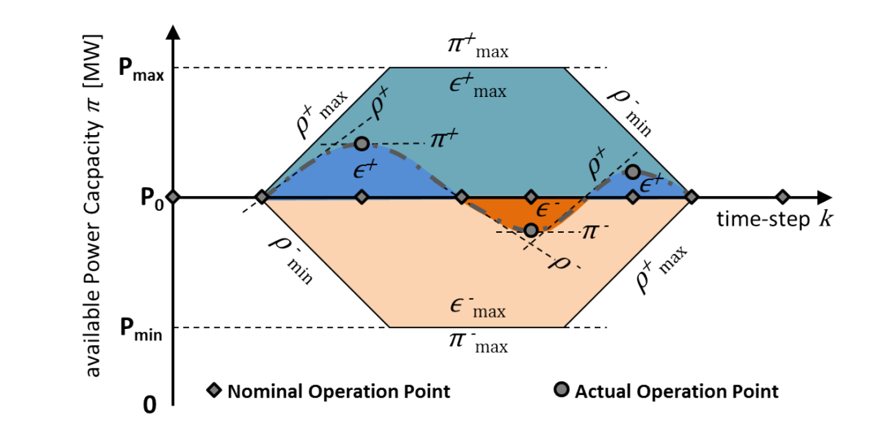
1. Context and research questions
Operational constraints limiting arbitrage produce differences on the marginal value of electricity
Example: Ramping capabilities
Power plant cycling restrictions:
Ramping constraints
Start-up and shut down technical restrictions
Minimum load
In load range
Reserve capabilities
DSM usage restrictions
Among others
But also, cycling is costly..
(Kumar et al. 2012), (Hentschel et al. 2016)
Power Ramp-rate ρ, Power π and Energy ε
Flexibility metrics in power system operations. Source: Ulbig and Andersson 2013
Manuel Villavicencio. Université Paris-Dauphine, PSL Research University
Notes:
As physical constraints limit arbitrage => the marginal value of electricity varies

Slide 6
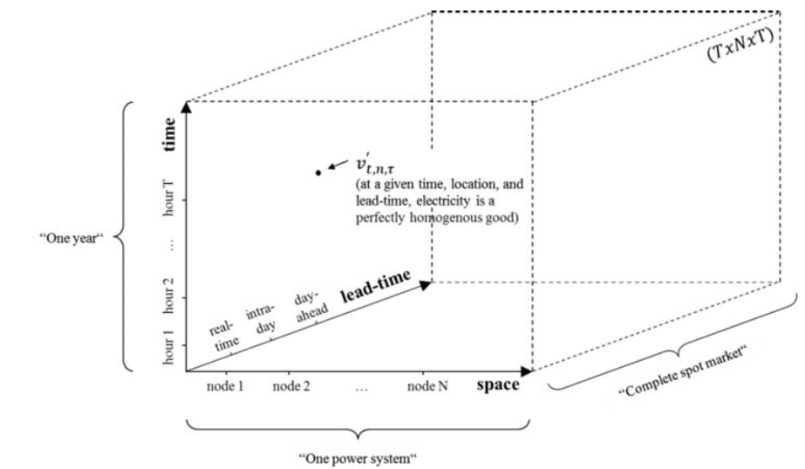
1. Context and research questions
Electricity is:
≠
A homogeneous energy vector
(physics)
A heterogeneous financial good
(economics)
Marginal value space of electricity (heterogeneity). Source: Hirth 2015
Manuel Villavicencio. Université Paris-Dauphine, PSL Research University
Notes:
At a given point in this three-dimensional space, electricity is a perfectly homogenous good.
Electricity is heterogeneous because not all elements of v are the same.
As physical constraints limit arbitrage, the marginal value varies along all three axes. This is, according to our definition, heterogeneity.

Slide 7
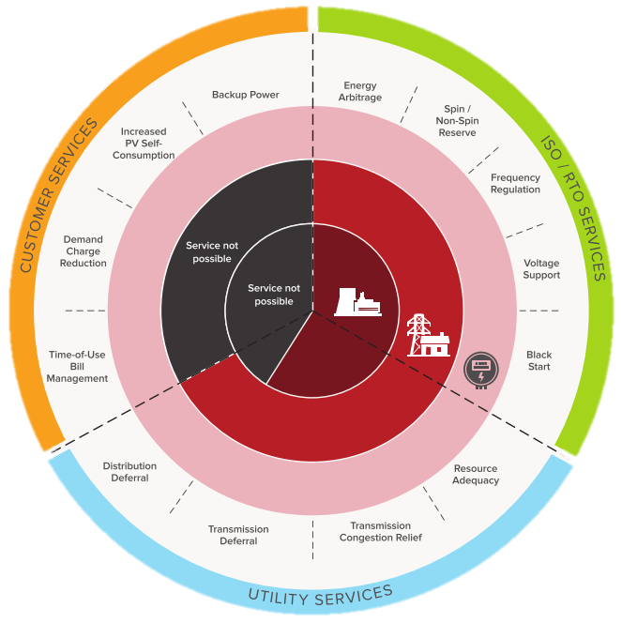
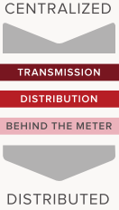
3. Context and research questions
The system benefits of storage capabilities
Services that can be provided by EES technologies. Source: (Fitzgerald et al., 2015)
Manuel Villavicencio. Université Paris-Dauphine, PSL Research University

Slide 8
1. Context and research questions
Would investments in storage capacity be cost-optimal on these settings?
Remark 1: Cost-optimality assumes a system perspective assessment with an unique solution.
What is the system value added by storage?
Remark 2: In such framework the value corresponds to the net social value.
What are the distributional effects of such investments?
Remark 3: What is in stake is the surplus variations across market players triggered by optimal storage
Manuel Villavicencio. Université Paris-Dauphine, PSL Research University
Notes:
Remark1: which don’t necessarily correspond to private/project profitability due absence of markets and/or regulatory veils.

Slide 9
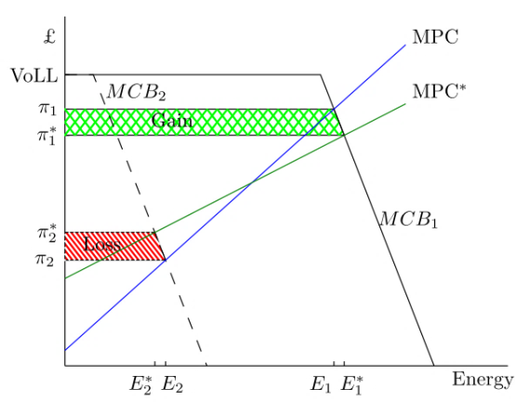
2. Definitions and methodology for valuating flexibility technologies
Welfare effects of storage:
Short-term:
MPC: marginal production cost
MCB: marginal consumer benefit
Welfare effect of storage during peak and off-peak periods. Source: (Grünewald, 2011)
Mid and long-term (capital stock re-allocations):
Generation and flexibility investments are co-optimized, meaning that the slope and the rotation extent of the MPC curve is adjusted to enhance technologic complementarities, which makes the social welfare gains to be maximized.
Manuel Villavicencio. Université Paris-Dauphine, PSL Research University

Slide 10
2. Definitions and methodology for valuating flexibility technologies
Interrelated and system dependent issues
Capacity adequacy problems
Energy security issues
Scissor effect
Long-term
(years)
Capital allocation
Short-term
(h)
Missing money problem
Merit Order Effect
Higher operational cost for committed units
Less flexible dispatch but higher flexibility is needed
Economic-dispatch
Real time
(sec-min)
Balancing issues
Congestion management difficulties
Increased need for ancillary services
Reliability requirements
Manuel Villavicencio. Université Paris-Dauphine, PSL Research University
Notes:
Intercorrelated effects, need for an holistic approach => System study

Slide 11
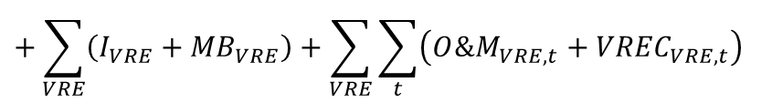
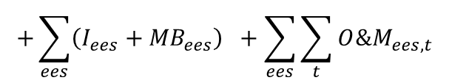
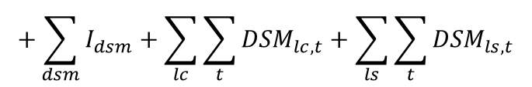
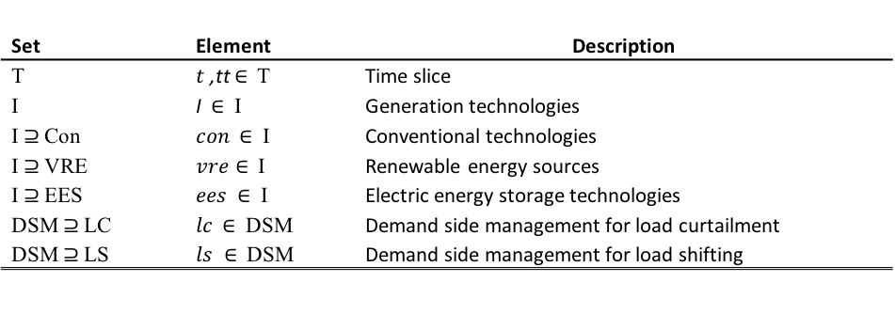

2. Definitions and methodology for valuating flexibility technologies
System cost represented as:
$$Y= \sum_{con}{\left(I_{con}+{MB}_{con}\right) +}\sum_{con}{\sum_{t}{\left({O\&M}_{con,t}+F_{con,t}{+ CO2}_{con,t}+{∆G}_{con,t}\right)}}$$
S.T. operational constraints:
Ramping constraints
Min/max generation level
Part load efficiencies
FRR requirements
DSM and EES operating constraints
Capacity obligation (CRM)
Clean energy policies…
min
$$+\sum_{VRE}{\left(I_{VRE}+{MB}_{VRE}\right)}+\sum_{VRE}{\sum_{t}{\left({O\&M}_{VRE,t}+{VREC}_{VRE,t}\right)}}$$
ST
$$+\sum_{ees}{\left(I_{ees}+{MB}_{ees}\right)} +\sum_{ees}{\sum_{t}{{O\&M}_{ees,t}}}$$
$$+\sum_{dsm}{I_{dsm}}+\sum_{lc}{\sum_{t}{{DSM}_{lc,t}}}+\sum_{ls}{\sum_{t}{{DSM}_{ls,t}}}$$
$$+\sum_{t}{{LL}_{t} VoLL}$$
(optional)
LT
RT
Set | Element | Description
T | $t$ ,tt $∈$ T | Time slice
I | I $∈$ I | Generation technologies
I $⊇$Con | $con$ $∈$ I | Conventional technologies
I $⊇$VRE | $vre∈$ I | Renewable energy sources
I $⊇$EES | $ees$ $∈$ I | Electric energy storage technologies
DSM $⊇$LC | $lc$ $∈$ DSM | Demand side management for load curtailment
DSM $⊇$LS | $ls ∈$ DSM | Demand side management for load shifting
Manuel Villavicencio. Université Paris-Dauphine, PSL Research University
Notes:
Operation research problem
DIFLEXO: Dispatch, investments and flexibility optimization model
A self-developed tool for market design benchmarking and technology valuation

Slide 12
2. Definitions and methodology for valuating flexibility technologies
Experimental setup:
Brownfield optimization considering existing
capacities on 2015.
DIFLEXO formulation: EOM, FRR and CRM and VoLL (perfect foresight)
Peak load = 93.63 GW
Total energy =541.4 TWh/year
VoLL = 10 000 €/MWh
Annual Lost load < 3 h/year
Bulk storage technologies (EES) : PHS, DCAES, ACAES, VRFB, NaS, Li-ion
DSM: Load curtailment and load shifting less than 1% and 2% of load respectively
Installed capacity
Solved in GAMS under CPLEX 12.5 using the barrier algorithm
 |  | Horizon 2020 | Horizon 2030
VRE shares | > | 27% | 40%
Nuclear shares | < | Current levels of 2015 | 50%
CO₂ cost [€/ton] | = | 20 | 20
Cost assumptions | appendix | JRC-ETRI projections for 2020 | JRC-ETRI projections for 2030
Manuel Villavicencio. Université Paris-Dauphine, PSL Research University

Slide 13
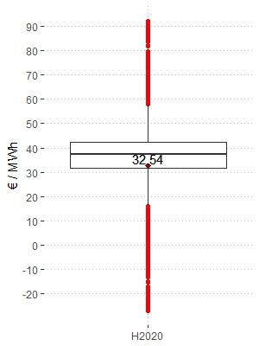
3. Findings for the case of France
By 2020:
No EES capacity is cost-optimal => storage adds no value
Technology | Investments | Retirements | Total capacity H2020
 | [GW] | [GW] | [GW]
Nuclear | - | - | 63,13
Hard coal | - | -6,34 | -
CCGT | - | -10,46 | -
OCOT | 15,87 | - | 15,87
OCGT | - | - | 8,78
Reservoir | - | - | 8,21
Wind | 44,38 | - | 51,36
PV | - | - | 3,43
PHS | - | - | 4,30
DSM | 4,68 | - | 4,68
Min. | 1st Qu. | Median | Mean | 3rd Qu. | Max.
[€/MWh] | [€/MWh] | [€/MWh] | [€/MWh] | [€/MWh] | [€/MWh]
-27,0 | 31,7 | 37,4 | 32,5 | 42,2 | 92,3
Manuel Villavicencio. Université Paris-Dauphine, PSL Research University

Slide 14
3. Findings for the case of France
However, by 2030 some EES investments are cost-optimal:
Technology | Investments |  | Retirements |  | Total capacity
 | [GW] |  | [GW] |  | [GW]
 | EES | noEES | EES | noEES | EES | noEES
Nuclear | - | - | -14,04 | -15,11 | 49,09 | 48,02
Hard coal | - | - | -4,06 | -4,63 | 2,28 | 1,71
CCGT | - | - | - | - | 10,46 | 10,46
OCOT | 8,61 | 11,72 | - | - | 8,61 | 11,72
OCGT | - | - | - | - | 8,78 | 8,78
Reservoir | - | - | - | - | 8,21 | 8,21
Wind | 72,73 | 73,28 | - | - | 79,71 | 80,26
PV | 16,62 | 19,90 | - | - | 20,05 | 23,33
PHS | - | - | - | - | 4,30 | 4,30
DSM | 4,68 | 4,68 | - | - | 4,68 | 4,68
DCAES | 2,00 | - | - | - | 2,00 | -
ACAES2 | 1,23 | - | - | - | 1,23 | -
v
v
v
Manuel Villavicencio. Université Paris-Dauphine, PSL Research University

Slide 15
3. Findings for the case of France
Results: The supply curve changes as well as the dispatch schedules
Click to see the hourly dispatch
Manuel Villavicencio. Université Paris-Dauphine, PSL Research University
Notes:
Two different mixes… => Changes in the supply curve and in the optimal dispatch

Slide 16
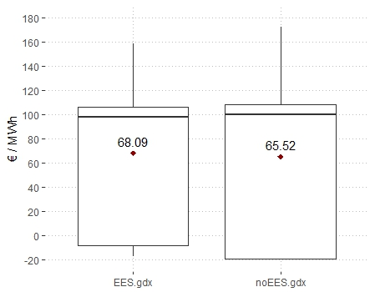
3. The public value of electricity storage and its welfare effects
There surplus variations of consumers are due to electricity price variations:
Electricity price statistics
 | Min. | 1st Qu. | Median | Mean | 3rd Qu. | Max.
 | [€/MWh] | [€/MWh] | [€/MWh] | [€/MWh] | [€/MWh] | [€/MWh]
EES | -17,3 | -8,5 | 98,1 | 68,1 | 106,1 | 158,7
noEES | -19,4 | -19,4 | 100,1 | 65,5 | 108,7 | 172,4
Other markets (Marginals)
 | Price of Capacity obligations | RPS | Nuclear cap
 | [€/MW.year] | [€/MWh] | [€/MWh]
EES | 29 649 | 7,46 | 68,76
noEES | 44 962 | 12,92 | 65,76
Manuel Villavicencio. Université Paris-Dauphine, PSL Research University

Slide 17
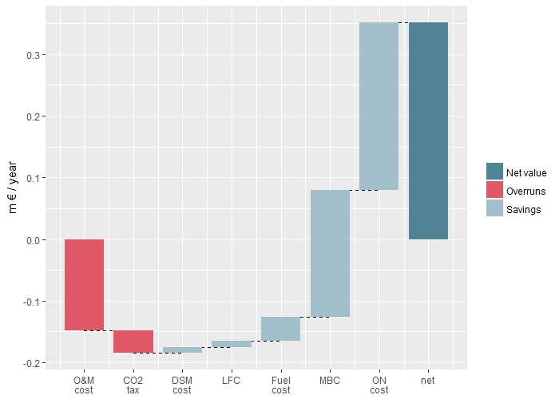
3. Findings for the case of France
The value of storage by H2030
Manuel Villavicencio. Université Paris-Dauphine, PSL Research University

Slide 18
3. Findings for the case of France
The net surplus variation is 670 M€/year, which is around 2.7% of total system cost
Welfare effects of storage by H2030
Manuel Villavicencio. Université Paris-Dauphine, PSL Research University
Notes:
The surplus variation of consumers, VRE and ACAES is positive, while producers are worst-off.

Slide 19
4. Conclusions
A clear definition and a convenient methodology has been applied for assessing the value of new flexibility technologies.
An integrated valuation approach based on the DIFLEXO model has been implemented to study the case of France:
H2020: even if there is a higher need for flexibility, storage investments are not cost optimal.
H2030: CAES technologies are cost-optimal provided that:
They participate on VRE integration, supply FRR services and participating on capacity adequacy with no regulatory veils.
The system value of cost-optimal storage is around 350 m €/year which is 1.3% of total system cost.
Important distributional effects appear. This is due to the reduction of revenues coming from the CRM and FRR markets. Nevertheless, VRE producers and consumers are better-off.
Effective CO₂ price signals is required for storage to contribute to emission reduction targets: EES shows complementarities with low run marginal cost technologies, enhancing its market shares. In the absence of effectively pricing environmental externalities, EES can increase CO₂ emissions.
Manuel Villavicencio. Université Paris-Dauphine, PSL Research University

Slide 20
REFERENCES
Carlsson, Johan et al. “Energy Technology Reference Indicator Projections for 2010-2050.” Luxembourg, 2014. doi:10.2790/057687.
Fitzgerald, Garrett, James Mandel, Jesse Morris, and Touati Hervé. “The Economics of Battery Energy Storage: How Multi-Use, Customer-Sited Batteries Deliver the Most Services and Value to Customers and the Grid,” 2015.
Grünewald, Philipp. “The Welfare Impact of Demand Elasticity and Storage,” no. September (2011): 1–5.
Hentschel, Julia, Ugljesa Babic, and Hartmut Spliethoff. “A Parametric Approach for the Valuation of Power Plant Flexibility Options.” Energy Reports 2 (2016): 40–47. doi:10.1016/j.egyr.2016.03.002.
Hirth, Lion, Falko Ueckerdt, and Ottmar Edenhofer. “Integration Costs Revisited - An Economic Framework for Wind and Solar Variability.” Renewable Energy 74 (2015): 925–39. doi:10.1016/j.renene.2014.08.065.
Kumar, N, P Besuner, S Lefton, D Agan, and D Hilleman. “Power Plant Cycling Costs Power Plant Cycling Costs.” 15013 Denver West Parkway Golden, Colorado 80401 303-275-3000, 2012.
Scitovsky, Tibor. “Two Concepts of External Economies.” The Journal of Political Economy 62, no. 2 (1954): 143–51. doi:10.1086/257498.
Manuel Villavicencio. Université Paris-Dauphine, PSL Research University

Slide 21
“What is a cynic? A man who knows the price of everything and the value of nothing”
Oscar Wilde
manuel.villavicenio@dauphine.com
Working paper available at:
http://www.ceem-dauphine.org/working/en/THE-VALUE-OF-ELECTRIC-ENERGY-STORAGE-IN-ELECTRICITY-SYSTEMS-WITH-HIGH-SHARES-OF-WIND-AND-SOLAR-PV

Slide 23
3. The public value of electricity storage and its welfare effects
“Cost based analyses” consider technologies in isolation
(e.g., LCOE, LCOS)
“Value based analyses” consider interactions between technologies
(e.g., partial equilibrium setting)
Vs.
Benefits
Value
Monetizable benefits
Markets
EOM, FRR, CRM
Defining the meaning of “value”:
“The value of storage is defined as the monetizable system benefits generated directly or indirectly by storage, provided a cost-optimized system including capacity allocations, as well as dispatch and inventory decisions.”
Experimental Setup using DIFLEXO
Optimizing the system with and w/o EES technologies
The value sources correspond to the costs categories considered in the objective function.
Manuel Villavicencio. Université Paris-Dauphine, PSL Research University

Slide 24
3. The public value of electricity storage and its welfare effects
Costs and revenues for producers
Market revenues
System operations
Manuel Villavicencio. Université Paris-Dauphine, PSL Research University
Notes:
Total costs presented by technology
Revenues introduces assuming marginal pricing markets..

Slide 25
3. The public value of electricity storage and its welfare effects
Surplus variations of producers due to market share and price variations. Producers profits are positives in both cases but are higher in the reference case without storage.
12.33 bn€
13.38 bn€
Manuel Villavicencio. Université Paris-Dauphine, PSL Research University

Slide 26
3. The public value of electricity storage and its welfare effects
Results: Costs variations
Accumulated cost
Manuel Villavicencio. Université Paris-Dauphine, PSL Research University

Slide 27
3. The public value of electricity storage and its welfare effects
Accumulated revenue
Manuel Villavicencio. Université Paris-Dauphine, PSL Research University

