Slide 1

Challenges to make heating renewable
Empirical results from six European case studies
Edith Chassein, IREES
IAEE European Conference
5th September 2017

Slide 2
ProgRESsHEAT
Supporting the progress of renewable energies for heating and cooling in the EU on a local level
www.progressheat.eu

Slide 3
The progRESsHEAT project
Core objective
Support policy makers and public authorities at local, regional and national level in the development and implementation of integrated strategies and policies to enforce the use of renewable and efficient heating and cooling solutions in their regions.
March 2015 – October 2017
IAEE European Conference, 5th September 2017

Slide 4
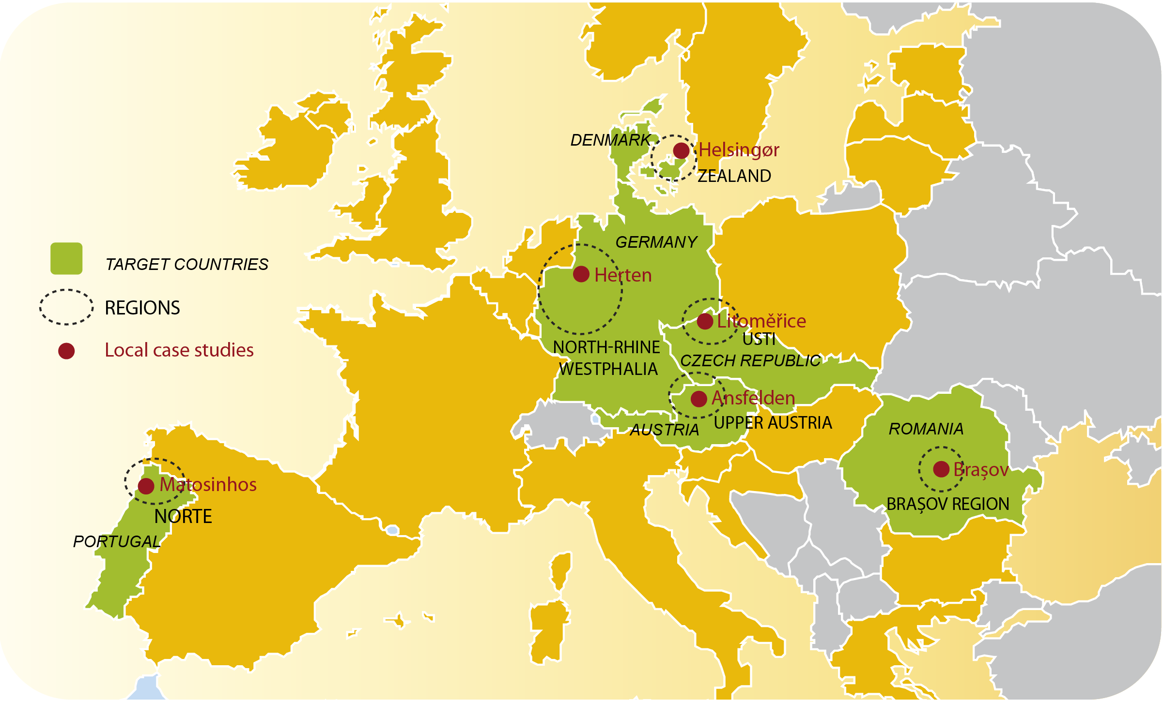
The progRESsHEAT project
Six case studies across Europe on local and national level

Slide 5
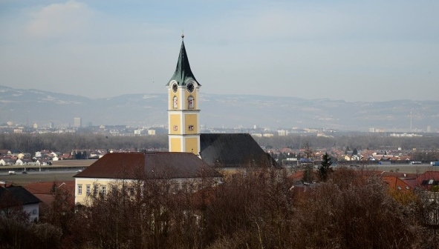
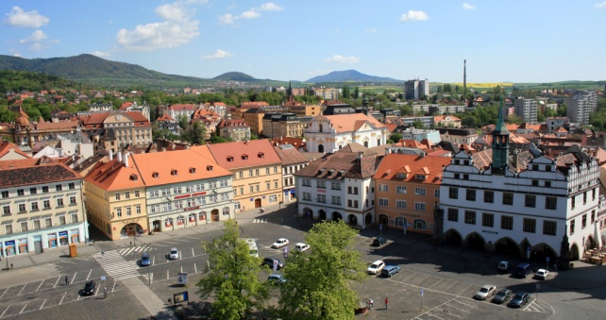
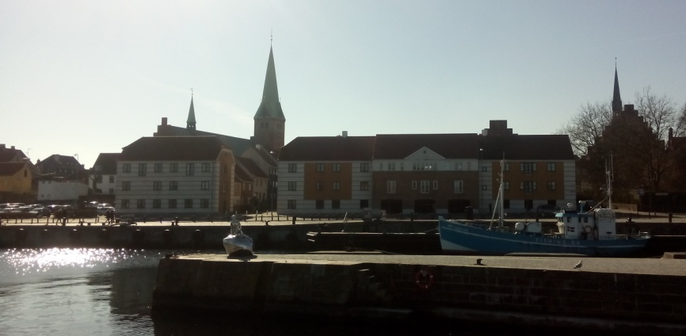
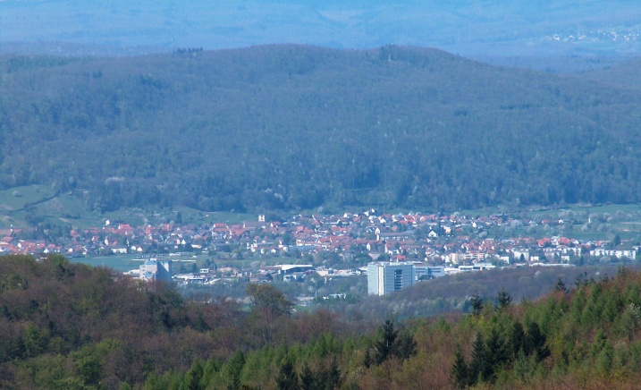
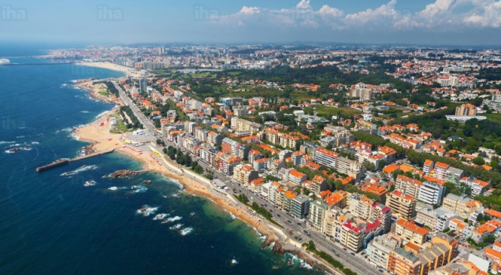
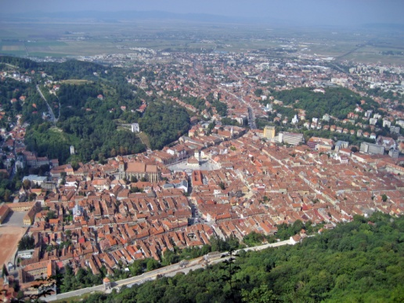
The Case Studies
AT
Ansfelden
CZ
Litomerice
DK
Helsingor
DE
Herten
PT
Matosinhos
RO
Brasov
15 822
24 101
61 613
62 400
175 000
274 491
inhabitants
289 m AMSL
136 m AMSL
at the sea
75 m AMSL
at the sea
625 m AMSL
elevation
character
Notes:
Background information about case studies.
AMSL above mean sea level
Litomerice: characterized by historical building
Herten: characteristic buildings: former dwellings of the miners
Matosinhos: situated right by the Atlantic Coast in the northern part of Portugal

Slide 6
Key messages
Energy efficient and green heating and cooling systems consist of:
Energy savings
Individual and central energy from renewable energy sources
Efficient district energy
How can energy systems be transformed to meet this criteria?
What hinders transformation?
Which success stories can be told?
IAEE European Conference, 5th September 2017
Notes:
Therse criteria are the initial position for the barriers and drivers analysis.

Slide 7





Methodology
Evaluation method for each case study
        project documents and information material from the municipalities
        interviews with local stakeholders
        surveys with different stakeholder groups
IAEE European Conference, 5th September 2017
Notes:
Empirical analysis was conducted by IREES GmbH from Karlsruhe (Germany). The empirical results were complemented by modelling and policy analysis (TU Wien/EEG, DTU, Fraunhofer ISI)

Slide 8
Barriers
financial-economic
development costs, initial costs, operating costs
institutional-structural and market oriented
infrastructure, regulations, policy framework, technology issues, multi-stakeholder issues
perceptual-behavioural
(un)trained workmen, uncertainties, knowledge/awareness gaps, risk and loan aversion
IAEE European Conference, 5th September 2017
Notes:
Report 3.2 Progressheat
Based on Dolman et al. 2011, IEA 2009, Andrews et al. 2012

Slide 9
Stakeholders
supply side
implementation of renewable heating and cooling (RES-H/C) technologies.
Main actors: energy suppliers + authorities/municipality
Additional actors: local professionals, producer of technologies, finance corporations, research and development institutes
IAEE European Conference, 5th September 2017
Notes:
Report 3.2 Progressheat

Slide 10
Stakeholders
demand side
use of renewable heating and cooling (RES-H/C) technologies offered by the supply side
Main actors: end users from all sectors
Additional actors: NGOs, media, energy agencies and energy advisors
IAEE European Conference, 5th September 2017
Notes:
Report 3.2 Progressheat

Slide 11
Policy Instruments
command-and-control
incentive regulation
knowledge building
direct investment support
information campaigns
obligations on heat generation
obligations on consumers
obligation on buildings
operating support
soft loans
fiscal incentives
support for research
knowledge institutions
training
IAEE European Conference, 5th September 2017
Notes:
Stimulate demand <=> support supply => policy packages
Use a mix of policy measures!

Slide 12

Main barriers financial-economic
Investment decisions
Upfront investment in technology
Investment in grid
Long-term planning vs. election periods
Investor-user-dilemma and split incentives
Success factor financial support
Small, but quickly available local subsidy for home owners (Litoměřice)
Introduction of new business models (Helsingør)
Energy performance contracting (Ansfelden, Litoměřice)
IAEE European Conference, 5th September 2017
Notes:
Upfront investment: most RES technologies are expensive and have a long payback time. These differs of course for central and decentral solutions.
Investment in grid: see following slide.
Long-term planning: subsidy programmes with long-term perspective are missing in most cases & decision processes usually take place at municipal level.
Investor-user-dilemma: Discrepancy between owner and user of the building (tenant) => one provides energy system and has to pay investment costs, the other consumes energy and has to pay energy tariff.
Detailed description of success factors on following slides.

Slide 13
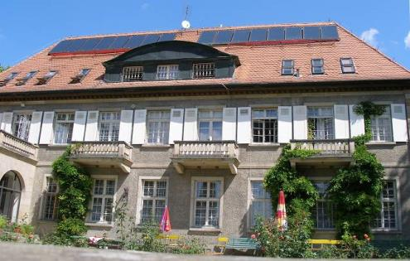
Success factor financial support
Subsidy for RES (Litoměřice)
Subsidy for solar thermal collectors installations from the city budget
‘Who gives quickly gives twice’
Local subsidy of 40.000 CZK/installation (about 1,500 Euro
Replacement of coal boilers with solar water heaters (min. 3 m²)
small, but quickly available (within 14 days after approval of request)
can be combined it with state grants

Slide 14
Success factor financial subsidy
Introduction of new business models (Helsingør, Ansfelden, Litoměřice)
Energy performance contracting
Replacement of oil boilers with biomass boiler or district heating.
Energy supplier implement and maintains the technical equipment.
Consumer only pays for energy units.
Overcomes the challenge of high upfront investments of RES-H installations.
Avoids investor-user dilemma.

Slide 15

Main barriers institutional-structural
Inadequate grid
  Density
    Conflicting aims: higher density vs. refurbishments
Temperature level of heat supply
  Inefficiently high in most cases
  Often not suitable to combine RES/DH/excess heat
High investment and operating costs
  Owner structure of energy supply
Success factor stakeholder involvement:
Regularly meetings of all stakeholders related to energy (Brașov, Litoměřice)
Close cooperation with neighbouring cities (Litoměřice)
IAEE European Conference, 5th September 2017
Notes:
Density:
-density=number of connected people per meter of pipe
-efficient green energy solutions are cheapest in many cases WHEN a high connection rate can be assured. Also double infrastructure (costs) should be avoided => zoning of energy supply systems.
-low density means: increased heat losses: high investment costs per customer, high costs of distribution per delivered energy unit, increased resource depletion for pipes and components
Temperature level:
-”traditional” temperature: 120°C
-Helsingor lowered temperature of DH grid to less than 65°C to save energy and costs
-DH works more efficient when used for low temperature demand
-special case of Brasov: temperature of DH is not constant and therefore unreliable (old system)
-combination with excess heat: heat supply and demand must match
High investment/operating costs:
-owner structure of production and infrastructure public vs. private (see next slide for further information) => has an impact on decision making processes

Slide 16
Owner structure of energy supply
Case study | Owner structure
Ansfelden (AT) | Energy suppliers mainly private, municipal share: 35%
Litomerice (DZ) | Two private energy suppliers => plans of the city to buy the district heating company
Helsingor (DK) | Two municipal co-owned companies (uncommon in Denmark) DH system 100% owned by an independent energy supplier
Herten (DE) | Energy supplier is a subsidiary company of the municipality
Matosinhos (PT) | Energy suppliers are private but infrastructure is municipal
Brasov (RO) | Part of the energy supply is private, the rest as well as transport and distribution is public.
progRESsHEAT barriers and drivers
Notes:
Supply and return temperatures are central parameters for the performance of a DH system and also effect the efficiency of using renewable energy supply in the system

Slide 17

Main barriers perceptual-behavioural
Lack of awareness and information
Consumers about supply options
Consumers about funding possibilities
Consumers about best practice examples
Professionals about RES technologies
Other key stakeholders about planning
Success factor awareness raising & capacity building:
“Energy academy”: various courses for energy advisers, professionals and representatives of municipalities (Ansfelden)
Provision of 10 mini-guidelines going through the 10 Solutions for Energy Efficiency (Matosinhos)
“Alley of Change” and “demonstration districts” (Herten)
IAEE European Conference, 5th September 2017
Notes:
Professionals could be: craftsmen, chimney sweepers, trade and repair business, installer, designer, architectures, planer
Other stakeholders could be: municipal decision maker, citizen movements, etc.
=> These slides are provided in order to overcome exactly these barriers

Slide 18
Success factor capacity building
Various courses for professionals (Ansfelden)
Energy Academy
provided by Upper Austrian Energy Agency (OÖ Energiesparverband)
Various courses about energy topics
New courses are regularly developed and existing ones adapted
Run one or more days
Target groups: energy managers of companies, municipalities and institutions, energy advisors, in-house technicians, architects, site managers, designers and planers

Slide 19
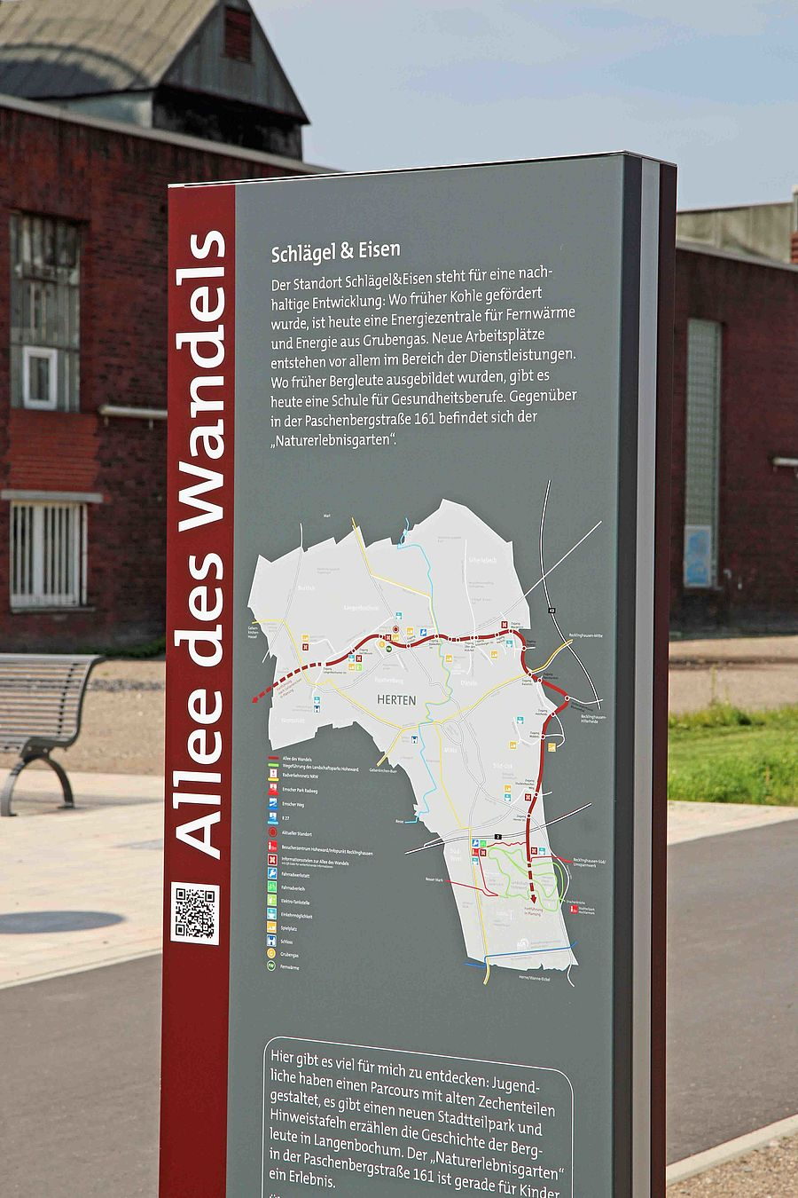
Success factor capacity building
Alley with energy related information signs (Herten)
Alley of Change
funded by ERDF (European Regional Development Fund)
former railway track => transformed into a 10 km pedestrian and biking trail
information system with an integrated app for mobile phones along the trail
Stops explain for example demonstration sites for RES technologies
“Sustainable bicycle tours” have been organised
Source: www.herten-erleben.de
Notes:
Foto: https://www.herten-erleben.de/erleben/detail/die-allee-des-wandels-ist-preisverdaechtig-692.html

Slide 20
Other barriers
Concerns due to cultural or historical issues
Trust in energy security and energy supply / Dependence on one energy supplier
Lack of legislation and standards
Unfavourable tax regime and restrictive regulations
Barriers to apply for funding
It is necessary to have a mix of policy instruments (sticks, carrots and tambourines) for the successful deployment of renewable energy for heating and cooling.
IAEE European Conference, 5th September 2017
Notes:
Cultural concerns: This is mainly a problem in Brasov (RO) and Matosinhos (PT) where a culture of individual/decentralised energy supply is predominant. Also in Brasov there is a high resentment agains district heating because it is associated with the former communist regime.
Trust in energy supply:
Irregular availability of RES energy due to seasonal conditions (amount of sun, wind etc.)
-fear of being dependent of one single energy supplier / system => fear of being disconnected
-fear of long-term commitments (e.g. provision of excess heat)
-municipal ownership could maybe enhance trust in energy supplier
Lack of legislation:
For certain technologies (e.g. heat pumps) standards are missing, making knowledge base of professionals as well as installation difficult
on Brasov there is a wish that obligation to use a certain energy system should be introduced in order to have a chance to renew the whole energy system
Unfavourable Tax regime: especially in Denmark experts complain about the tax regime that favours some „green“ technologies while others are discriminated. This makes new ideas/solutions difficult to be developed and implemented
Applying for funding: There are too many funding possibilities or it is complicated and time-consuming to apply for funding.

Slide 21
Main sources
Chassein, Edith; Hummel, Marcus; Kranzl, Lukas; Maurer, Christiane, Cappelletti, Floriane; Münster, Marie; Ben Amer-Allam, Sara et al. (2017a): Boosting renewable energy in heating and cooling. Fact sheet for six case studies. progRESsHEAT fact sheet of best practices and success factors and recommendations on actions and policies based on empirical results. Unter Mitarbeit von Michael Rex, Ignacio Bedoya, Megan Lauringer, Anja Gahleitner, Jaroslav Klusák, Hugo Santos et al. Hg. v. European Commission (Horizon2020). Online verfügbar unter http://www.progressheat.eu/Reports-publications-69.html.
Chassein, Edith; Roser, Annette; John, Franziska; Kranzl, Lukas; Fleiter, Tobias; Schilken, Peter (2017b): Using Renewable Energy for Heating and Cooling: Barriers and Drivers at Local Level. An analysis based on a literature review and empirical results from local case studies. Unter Mitarbeit von Michael Rex, Megan Lauringer, Anja Gahleitner, Jaroslav Klusák, Hugo Santos, Thomas Wiene et al. Hg. v. European Commission (Horizon2020). Online verfügbar unter http://www.progressheat.eu/Reports-publications-69.html.
Doble, Caroline; Bullard, Mike (2008a): Barriers to Renewable Heat Part 1: Supply Side. Enviros Consulting Limited (London).
Doble, Caroline; Bullard, Mike (2008b): Barriers to Renewable Heat Part 2: Demand Side. Enviros Consulting Limited (London).
Holländer, Edith; Roser, Annette; Banon, Fabrice; Kitzing, Lena; Islam, Marco; Büchele, Richard (2016): Heating & cooling: Policy frameworks in six European cities, their regions and countries. progRESsHEAT Report on current regulations, support policies, and other related framework conditions on EU level, national, regional and local level for the target countries, and assessment of specific characteristics of successful regulations and policies from a local perspective. Unter Mitarbeit von Ali Aydemir, Jan Steinbach, Ignacio Bedoya, Megan Gignac, Jaroslav Klusák, Vitor Leal et al. Client: European Commission (Horizon2020). Online verfügbar unter http://www.progressheat.eu/Reports-publications-69.html.
Reddy, B. Sudhakar (2013): Barriers and drivers to energy efficiency – A new taxonomical approach. In: Energy Conversion and Management 74, S. 403–416. DOI: 10.1016/j.enconman.2013.06.040.
progRESsHEAT barriers and drivers
Notes:
This slide is meant as backgournd information for the presenter, not for presenting.

Slide 22
See our website for more information
www.progressheat.eu

