Slide 1


15th IAEE European Conference 2017
“Heading Towards Sustainable Energy Systems: Evolution or Revolution?”
3rd to 6th September 2017, Hofburg Congress Center, Vienna, Austria
Innovation in the Energy Sector:
Which Technologies do we need after 2030 and which policies do we need now?
Innovation from the perspective of the Developing World
Ricardo Raineri Bernain rraineri@ricardoraineri.com
Vienna
September 2017

Slide 2

Most Pressing Priorities in Developing World
Poverty and Energy Access
Economic Development, job creation and expectations for rising salaries
Improving living conditions, rise of the middle class and the demand for a safety nest
Increase productivity: low income countries - low hanging fruit and middle income countries - high hanging fruit
Increasing Environmental and Social Constraints

Slide 3
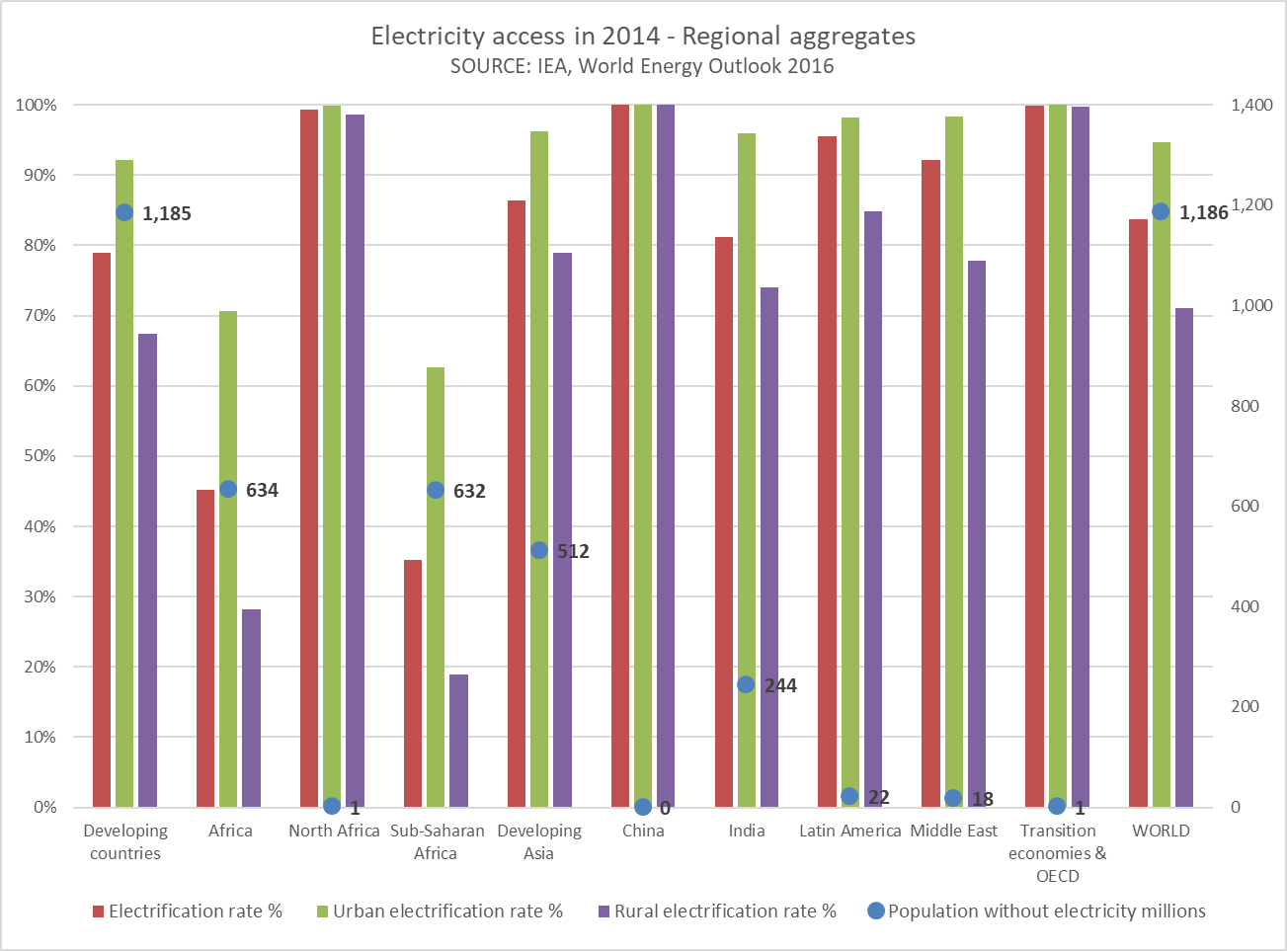
Poverty and energy access

Slide 4
Economic Development, job creation and expectations for rising salaries
Africa Population 2016: 1.216 Billion UN
The world needs to wake up to “the ticking timebomb” of youth unemployment in developing countries and treat the issue as seriously as humanitarian disasters and global efforts to eradicate disease, a group of British MPs has warned.
In its latest report, the Commons International Development Committee (IDC) says population increases – especially in Africa – are making it harder for people to earn a livelihood, let alone find full-time employment.
With 600 million young people competing for a predicted 200 million jobs over the next decade, the committee says there is a danger of widespread social and political unrest.
Notes:
https://www.populationpyramid.net/africa/2016/

Slide 5
Economic Development, job creation and expectations for rising salaries
Europe Population 2016: 739 Million UN
The world needs to wake up to “the ticking timebomb” of youth unemployment in developing countries and treat the issue as seriously as humanitarian disasters and global efforts to eradicate disease, a group of British MPs has warned.
In its latest report, the Commons International Development Committee (IDC) says population increases – especially in Africa – are making it harder for people to earn a livelihood, let alone find full-time employment.
With 600 million young people competing for a predicted 200 million jobs over the next decade, the committee says there is a danger of widespread social and political unrest.
Notes:
https://www.populationpyramid.net/Europe/2016/

Slide 6
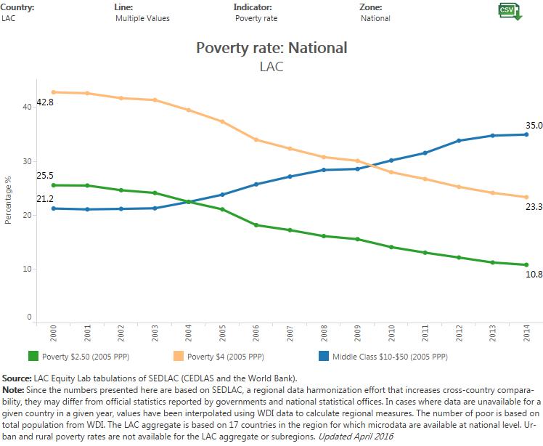
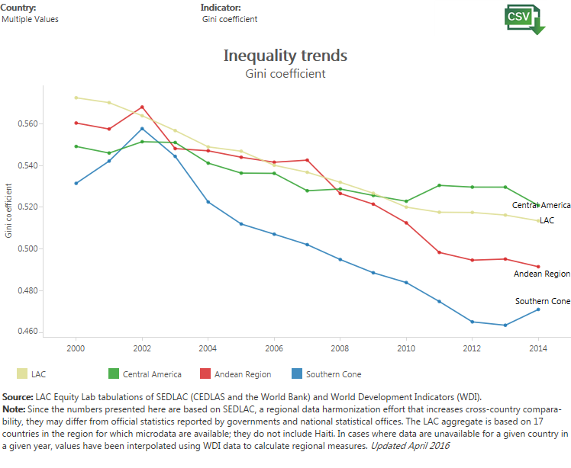
Improving living conditions, rise of the middle class and the demand for a safety nest
Notes:
Lac Poverty 0-4; 4-10;10+

Slide 7
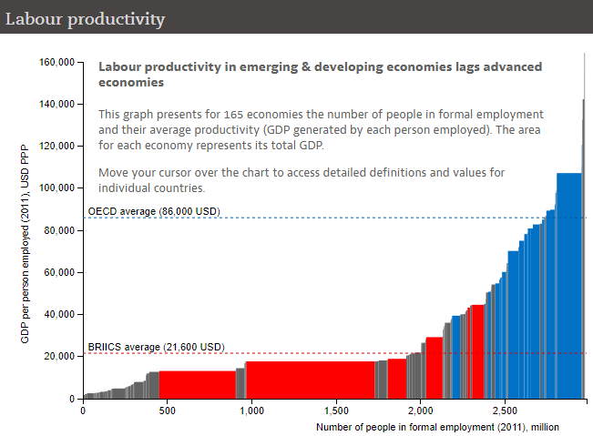
Increase productivity: low income countries - low hanging fruit and middle income countries - high hanging fruit
On the dynamics of economic growth: Malthus, Solow and Romer
Boosting productivity key for developing economies to close income gap with advanced countries
With few exceptions, hard to expect contributions in frontier edge innovation and technology

Slide 8
Increase productivity: low income countries - low hanging fruit and middle income countries - high hanging fruit
On the dynamics of economic growth: Malthus, Solow and Romer
Boosting productivity key for developing economies to close income gap with advanced countries
With few exceptions, hard to expect contributions in frontier edge innovation and technology
And… Extractives

Slide 9
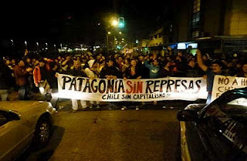
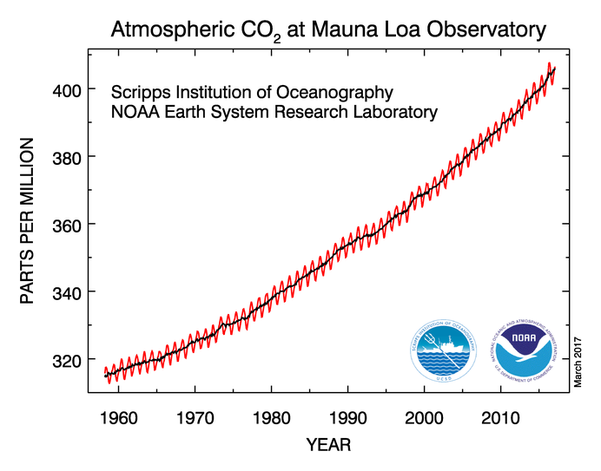
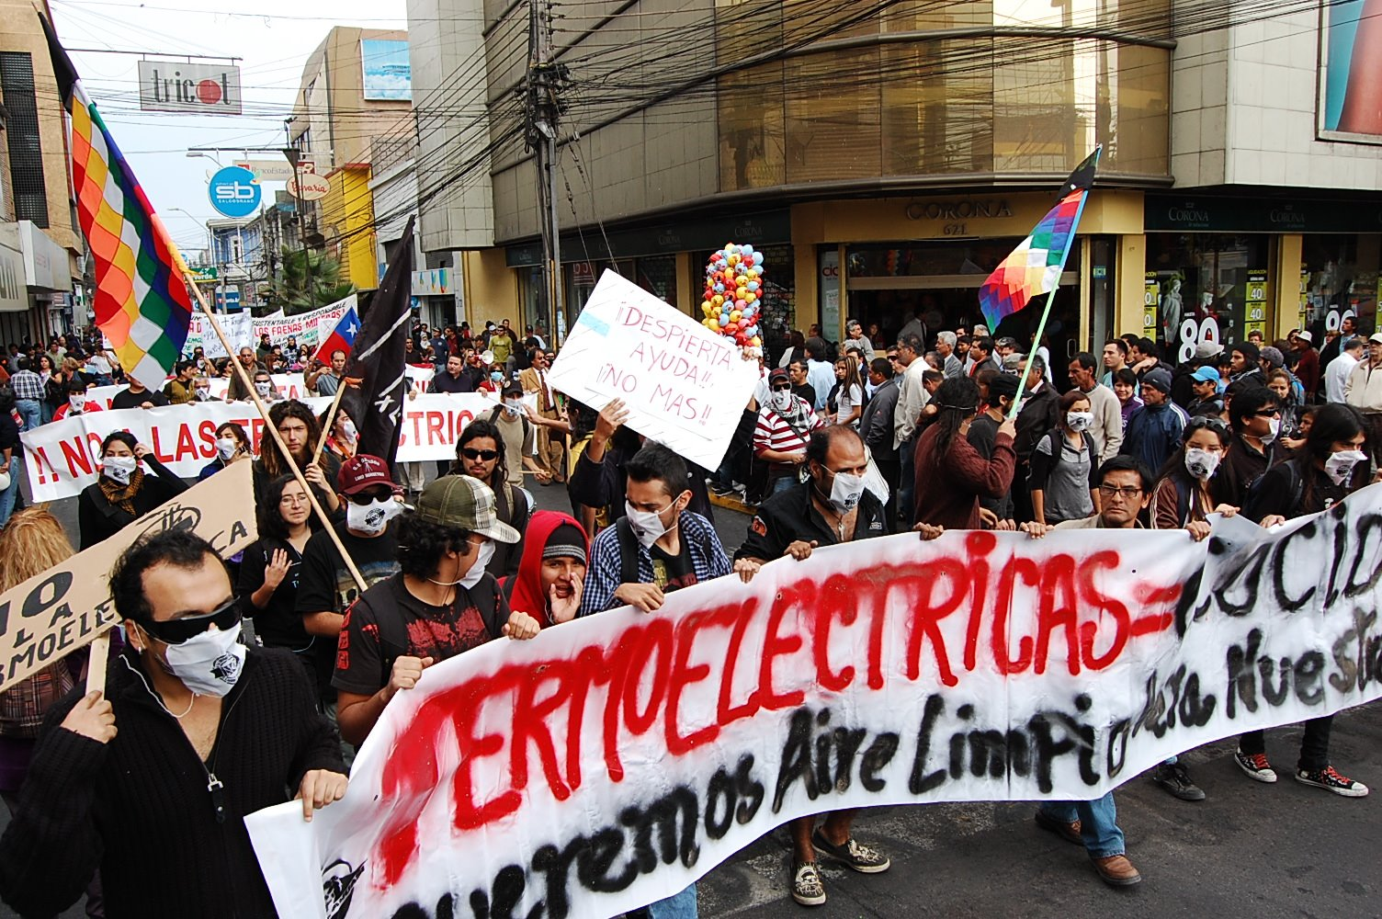
Increasing Environmental and Social Constraints
Change in the Civil Society and Change in Power
  We are more
  More educated
  And more empowered
NIMBY – Not In My Back Yard.
LULU – Locally Unwanted Land Use.
NOPE – Not On Planet Earth (!).
BANANA – Build Absolutely Nothing Anywhere Near Anything.
CAVE – Citizens Against Virtually Everything
But, caring for the environment can be seen as a luxury public good

Slide 10
Key Challenges for Energy Sector
Growth in energy demand: pop. growth and econ. development
Affordability
Enabling institutional and business environment
  Informal economy
  Red tape an corruption
  Access to finance
  Lack of infrastructure
  Lack of qualified labor
  Limited or no resources for innovation
    Restricted access to R&D networks
    Property rights
  Political and cultural constraints
Social and environmental licenses and climate change

Slide 11
Opportunity
Easy/more democratic access to technology, lower costs
Softer lock-in, path dependency, with greater flexibility to build sustainable infrastructure, energy systems
Large potential of untapped energy resources and EE
Emerging economies are escalating in global rankings…
As the developing world and large energy consumers and polluters commits with sustainable development, the Paris Agreement opens the chance to build sustainable energy systems and a global market for CO₂ emissions

Slide 12
Which policies do we need now?
  Enabling business environment
    Rule of law, strong institutions and absence of corruption
    Well functioning energy markets where private sector is key
    International community/organizations (SE4ALL) is Key
  Energy Access
    Affordability
    Adequacy of infrastructure
    Sustainability and EE
  Innovation and technology transfer, enable new energy sources and access to additional resources
  A need for a clear leadership on where investments should go.

Slide 13
Which Technologies do we need after 2030?
New technologies are reshaping the energy sector, from a centralized structure to a decentralized one
The advancement of drilling and other energy technologies has allowed the access to new subsurface resources, of non-conventional energy sources, and the harness of energy from the wind, sun, and oceans, among others.
New challenges such as communications, smarter metering and the management of larger data, where demand side management and storage can become a key contributor for energy systems.

Slide 14
The way ahead
Great opportunity in developing world
  The need for proper institutions and an enabling business environment
  Access and energy for development should be the focus for energy policy
  The levels of commitment of an economy to a low carbon economy need clarity and stable long-lasting rules from governments and international community.
Governments, international community, industry, researchers have a key role in the understanding and promotion of the proper policies, technologies and business models to manage the most pressing issues of developing world.

Slide 15
15th IAEE European Conference 2017
“Heading Towards Sustainable Energy Systems: Evolution or Revolution?”
3rd to 6th September 2017, Hofburg Congress Center, Vienna, Austria
Innovation in the Energy Sector:
Which Technologies do we need after 2030 and which policies do we need now?
Innovation from the perspective of the Developing World
Ricardo Raineri Bernain rraineri@ricardoraineri.com
Vienna
September 2017

