Slide 1
Unilateral Policy Design against Carbon Leakage
(w/ Professor Knut Einar Rosendahl )
Kevin R. Kaushal
PhD candidate in Energy and Environmental Economics
Norwegian University of Life Sciences
School of Economics and Business
Norwegian University of Life Sciences
1

Slide 2
What is carbon leakage?
Climate policy in one (group of) country may lead to increased emissions in other countries = Leakage
Leakage rate:
How much??
Reduced climate benefit of climate policy
Two main channels for leakage
Energy Market
Emission Intensive and Trade Exposed (EITE)
Norwegian University of Life Sciences
2

Slide 3
Focusing on the Emission Intensive and Trade Exposed
Unilateral action -> carbon leakage(a result of other countries soft climate regulations)
How to mitigate the carbon leakage in EITE sector?
Output-based allocation (OBA) -> (Allocation of free quotas linked to output)
A quota market with Output-Based Allocation (OBA)
(Böhringer and Lange, 2005): OBA reduces leakage, but stimulates domestic production and acts as an implicit production subsidy
EU ETS: practicing free allocation of emission allowances for several years
Norwegian University of Life Sciences
3

Slide 4
Quota Market with Output-Based Allocation(OBA)
In this paper:
A subset of countries involved in this quota system may want to increase their effort to reduce carbon emissions
examine the welfare effects of introducing a consumption tax on all use of EITE goods in a situation where a quota system has already been implemented, together with OBA on the EITE goods.
There are papers examining consumption tax in environmental regulation
However, we look at multiple goods in an multi-sector and multi-region economy, with a subset of countries involved in the quota market
Paper builds on the basic model and findings in Böhringer et al. (2017)
The motivation: current situation in Europe
Where the EU/EEA countries have set quite ambitious climate targets
EU institutions have responded enthusiastically to the Paris Climate Agreement outcome
However, significant political tension and different interests among the member states
Norwegian University of Life Sciences
4

Slide 5
NOR
EU
Model
Regions NOR, EU and ROW:
Producers of same goods across regions are homogenous:
emission-free and tradable
emission-intensive and trade-exposed, the sectors where OBA is considered (e.g. metal and other mineral production)
emission-intensive and non-tradable, where leakage is not of concern (e.g. electricity production and transport)
WIOD data (base-year 2009)
Emission reduction target at 20 percent of base-year emission for NOR and EU
Consumption tax introduced in NOR, a more stringent target
We use the standard calibration procedure in numerical simulation analysis, where base-year data information defines the fixed parameter values.
ROW
Norwegian University of Life Sciences
5

Slide 6
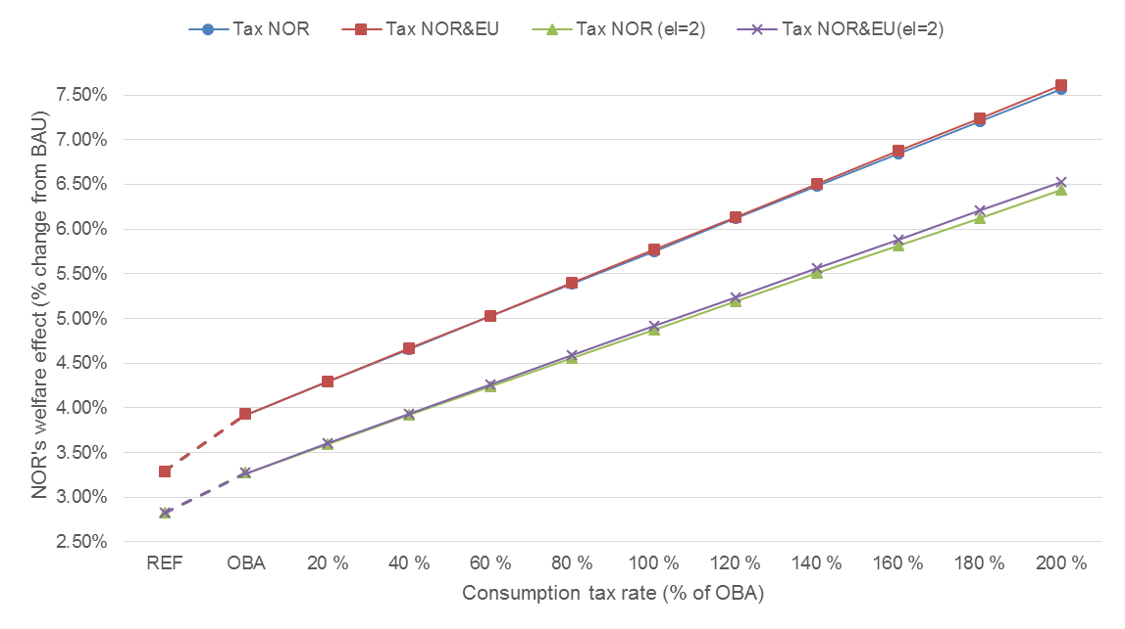
Welfare Effect in NOR
The consumption tax w.r.t. subglobal welfare effect is unambiguously positive if:
the region is a net-importer of the Emission-Intensive and Trade-Exposed good.
joint emissions from sector y and z in region i are unchanged or increases
If either of these breaks, then it is unclear what that the regional welfare effect might be for region i
Norwegian University of Life Sciences
6

Slide 7
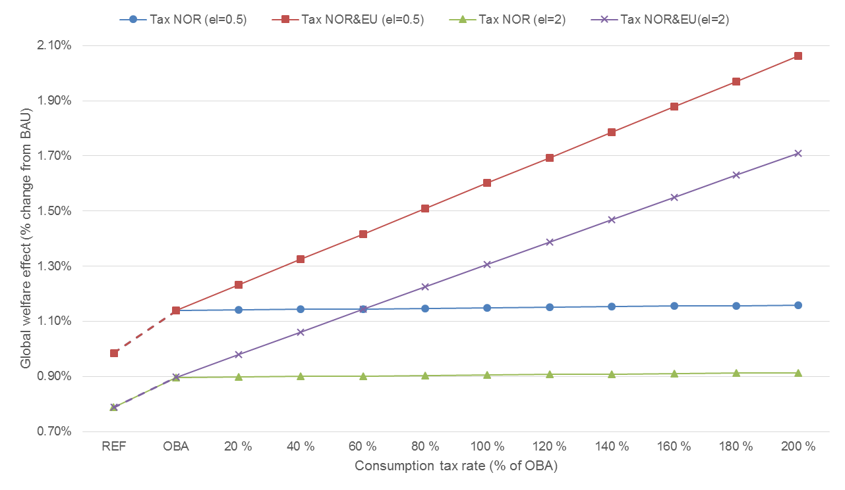
Global Welfare Effect
The consumption tax in region i w.r.t to global welfare would be welfare improving when both region i and j have introduced an OBA-policy, and are part of the joint tradable emission market.
We also find this when only region i has undertaken an environmental policy with OBA and introduces a consumption tax.
Norwegian University of Life Sciences
7

Slide 8
Numerical Simulation – Leakage Rate
Norwegian University of Life Sciences
8

Slide 9
Numerical Simulation – Welfare in other countries (Europe)
Country | Regional Welfare
 | REF | OBA | OBA & 100% consumption tax
Austria | 3 % | 3 % | 5 %
Belgium | 3 % | 4 % | 5 %
Bulgaria | 18 % | 23 % | 26 %
Cyprus | 36 % | 42 % | 44 %
Czech Republic | 8 % | 9 % | 11 %
Germany | 2 % | 3 % | 5 %
Denmark | 7 % | 8 % | 10 %
Spain | 2 % | 2 % | 4 %
Estonia | 49 % | 56 % | 58 %
Finland | 6 % | 7 % | 8 %
France | 1 % | 1 % | 3 %
United Kingdom | 3 % | 3 % | 5 %
Greece | 7 % | 9 % | 11 %
Hungary | 9 % | 11 % | 13 %
Ireland | 4 % | 5 % | 6 %
Italy | 2 % | 2% | 4%
Lithuania | 25 % | 29 % | 32 %
Luxembourg | 10 % | 12 % | 13 %
Latvia | 30 % | 35 % | 37 %
Malta | 66 % | 76 % | 77 %
Netherland | 3 % | 4 % | 5 %
Norway | 3 % | 4 % | 6 %
Poland | 9 % | 10 % | 12 %
Portugal | 5 % | 6 % | 8 %
Romania | 11 % | 13 % | 16 %
Slovakia | 8 % | 10 % | 11 %
Slovenia | 19 % | 22 % | 24 %
Sweden | 3 % | 4 % | 5 %
Norwegian University of Life Sciences
9

Slide 10
Concluding Remarks
Theoretical analysis
Regional welfare improving effect under certain conditions
Global welfare effect is unambiguously positive
Numerical simulation results
Positive welfare effect in Norway when introducing a consumption tax
Also if other EU/EEA countries introduce a consumption tax
Positive global welfare effect by introducing a consumption tax in EU/EEA countries
Reduced leakage rate and global emission
If the tax is set equal to the output-based allocation factors (“benchmarks”), the administrative cost of adding such a consumption tax will likely be limited (Neuhoff et al., 2016a; Ismer and Haussner, 2016). Böhringer et al. (2017) shows that the outcome of this combined policy will be equivalent to a certain variant of border carbon adjustments. Thus, combining output-based allocation with a consumption tax seems like a powerful policy strategy to mitigate carbon leakage, also for individual countries involved in a more extensive emission trading system
Norwegian University of Life Sciences
10

Slide 11
References
Böhringer, C., Lange, A., (2005). On the design of optimal grandfathering schemes for emission allowances, European Economic Review. 49, 2041-2055.
Böhringer, C., Rosendahl, K. E., Storrøsten, H. B. (2017). Robust policies to mitigate carbon leakage, Journal of Public Economics 149: 35–46.
Ismer, R., Haussner, M. (2016). Inclusion of Consumption into the EU ETS: The Legal Basis under European Union Law. Review of European Community & International Environmental Law, 25 (1): 69-80.
Neuhoff, K., Ismer, R., Acworth, W., Ancygier, A., Fischer, C., Haussner, M., Kangas, H., Kim, Y., Munnings, C., Owen, A., Pauliuk, S., Sartor, O., Sato, M., Stede, J., Sterner, T., Tervooren, M., Tusveld, R., Wood, R., Xiliang, Z., Zetterberg, L., Zipperer, V. (2016a). Inclusion of Consumption of carbon intensive materials in emissions trading – An option for carbon pricing post-2020. Climate Strategies: report may 2016.
Norwegian University of Life Sciences
11

