Slide 1
Innovation in the Energy Sector: Technologies after 2030 and Necessary Policies Today Prof. Dr. Georg Erdmann, TU Berlin President, GEE e.V., Former President IAEE Independent Expert Group "Energie der Zukunft" Steering Committee Member, ICEF Tokyo 10th European IAEE Conference Vienna, 6 September 2017

Slide 2
Germany: Will the 2020 Targets be Reached? [Assessment Report of the Independent Expert Commission 2016]
 | 2015 |  | 2020 | 2050
Greenhouse gas emissions (base year 1990) | -27,2% |  | - 40% | -80-95%
Primary energy consumption (base year 2008) | -7,6% |  | - 20% | -50%
Gross electricity consumption (base year 2008) | -4,0% |  | -10% | -25%
Heat demand in buildings (base year 2008) | -11,1% |  | -20%
Final energy in transportation (base year 2005) | +1,3% |  | -10% | -40%
Renewable share of primary energy | 14,9% |  | 18% | 60%
Renewable share of electricity consumption | 31,6% |  | 35% | ≥80%
Renewable share of heat demand | 13,2% |  | 14%
Renewable share in transportation | 5,2% |  | 10%
Consequence: Public debate focuses on short term aspects of ta rather long term project
while neglecting long term requirements and needs

Slide 3
Agenda: Towards Net Zero GHG Emissions
Status today
Innovations in the short run: Promotion of technologies that are market ready
Innovations in the long run: Don’t neglect technologies that may only be needed after 2035
Present approach is short term focused, in spite of the long term GHG ambitions

Slide 4
REN Capacity Additions in Germany
Net capacity additions [MW]
10000
Biomass
DKG
8000
PV
Wind offshore
Wind onshore
6000
Hydro
4000
2000
0
2000
2002
2004
2006
2008
2010
2012
2014

Slide 5
High Unit Payments for Renewable Electricity [Source: Own calculations based on EEG 2014]
Unit payments for REN electricity [Euro/MWh]
160
120
Average payments for renewable electricity
80
40
Baseload day-ahead price (2% price increase scenario from 2014 on)
0
1990
2000
2010
2020
2030

Slide 6
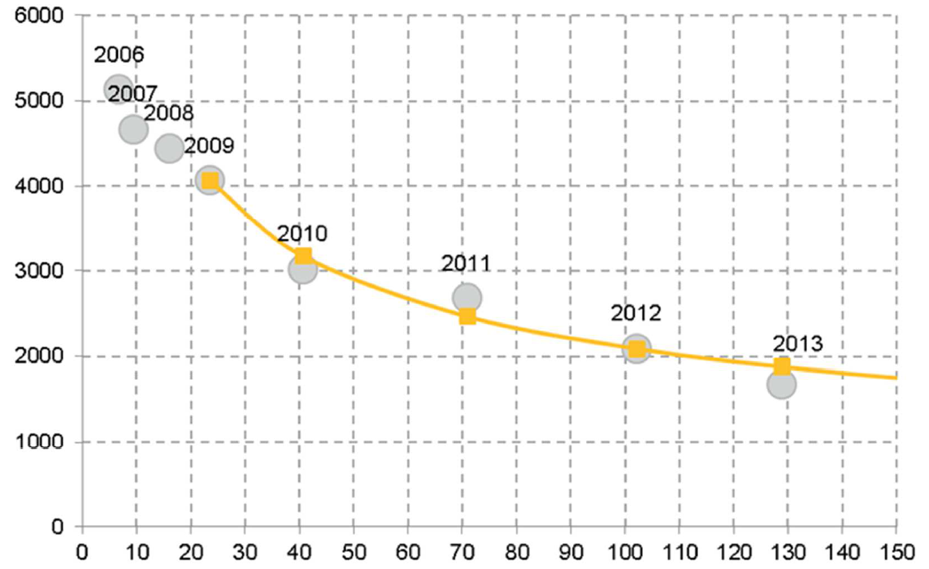
PV Cost Reduction due to Learning Effects [Source: Prognos/EWI/GWS 2014, p. 119]
Investment expenditures [global average, Euro/kW]
14.3% progress ratio for PV since 2006
Global PV capacity installed [GW]

Slide 7
Global Performance of German PV Support
Without the German PV support
Average costs of PV investments in 2012 would have been 2600 Euro/kW_{el} instead of 2000 Euro/kW_{el} (70 GW_{el} cumulated PV capacities outside)
the global PV investments would have cost 40 billion Euros more in 2012. This represents 5 times the German REN levy used to finance PV
Conclusion
Technologies that are (nearly) market ready need a strong but short political impulse
Subsidies are easier to implement than emission taxes or bans but the abolishment of subsidies some day in the future is politically rather challenging

Slide 8
Agenda: Towards Net Zero GHG Emissions
Status today
Innovations in the short run: Promotion of technologies that are market ready
Innovations in the long run: Don’t neglect technologies that may only be needed after 2035
Present approach is short term focused, in spite of the long term GHG ambitions

Slide 9
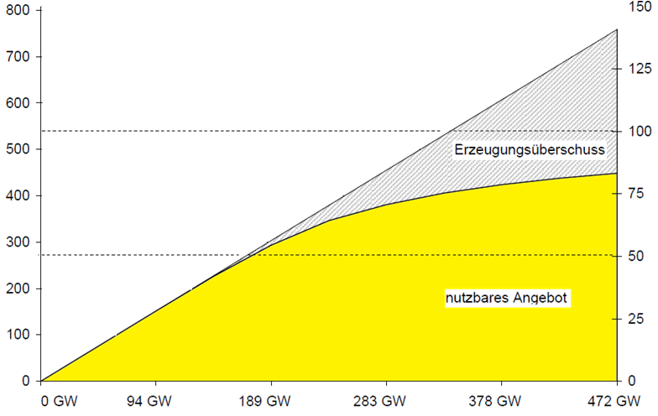
Electricity Generation from Wind and PV [Source: from Grosse Böckmann 2010]
Renewable generation [TWh]
% of generation
Annual load in Germany
Surplus power potential
2016
Usable REN generation
Assumed wind and PV capacity in Germany [GW]

Slide 10
Some Major Problems to be Solved after 2035
Electricity: 100% renewables needs long term (seasonal) storage capacities: Chemical storage or something else (such as HVDC)? Capital intensive technologies (such as electrolysis) may cause economic pressure towards base-load electricity supply (new nuclear?)
Heat: Second generation biofuels, electrical heat pumps or something else?
Transportation, in particular over long distances: 2nd generation fuels from renewables or something else?
Fossil fuel owners may have an economic incentive to continue extracting and using their wealth in the ground: Can Carbon Capture and Use (CCU) become the answer?

Slide 11
Disruptive Innovations are Needed
Most research focuses on contemporary problems and is going to solve them in a more or less effective way
But for meeting the Paris Agreement, research should include a larger variety of ideas that may become interesting / market ready after 2035:
Understanding catalysis (electrolysis, fuel cells, …)
In-situ gasification of coal deposits
Carbon-free steel works
Super High Voltage DC power transmission
CO₂-free air traffic
CCS, CCU, …
…

Slide 12
Agenda: Towards Net Zero GHG Emissions
Status today
Innovations in the short run: Promotion of promising technologies that are ready for market entry
Innovations in the long run: Don’t neglect technologies that may only be needed after 2035
Present approach is short term focused, in spite of the long term GHG ambitions

Slide 13
Necessary Innovation Policies Today
Today most possible long-term innovations are still outside the mainstream research agenda and receive insufficient grants from governments and international institutions
“Innovation for a Cool/Clean Earth Forum” (ICEF), Tokyo

Slide 14
Muchas Gracias

