Slide 1

Role of Technology in Reducing CO₂ to Zero
Nebojsa Nakicenovic
Deputy Director General
International Institute for Applied Systems Analysis
Former Professor of Energy Economics
Vienna University of Technology
15th IAEE European Conference 2017, Heading Towards Sustainable Energy Systems, Evolution or Revolution, Vienna – 3-6 September 2017

Slide 2
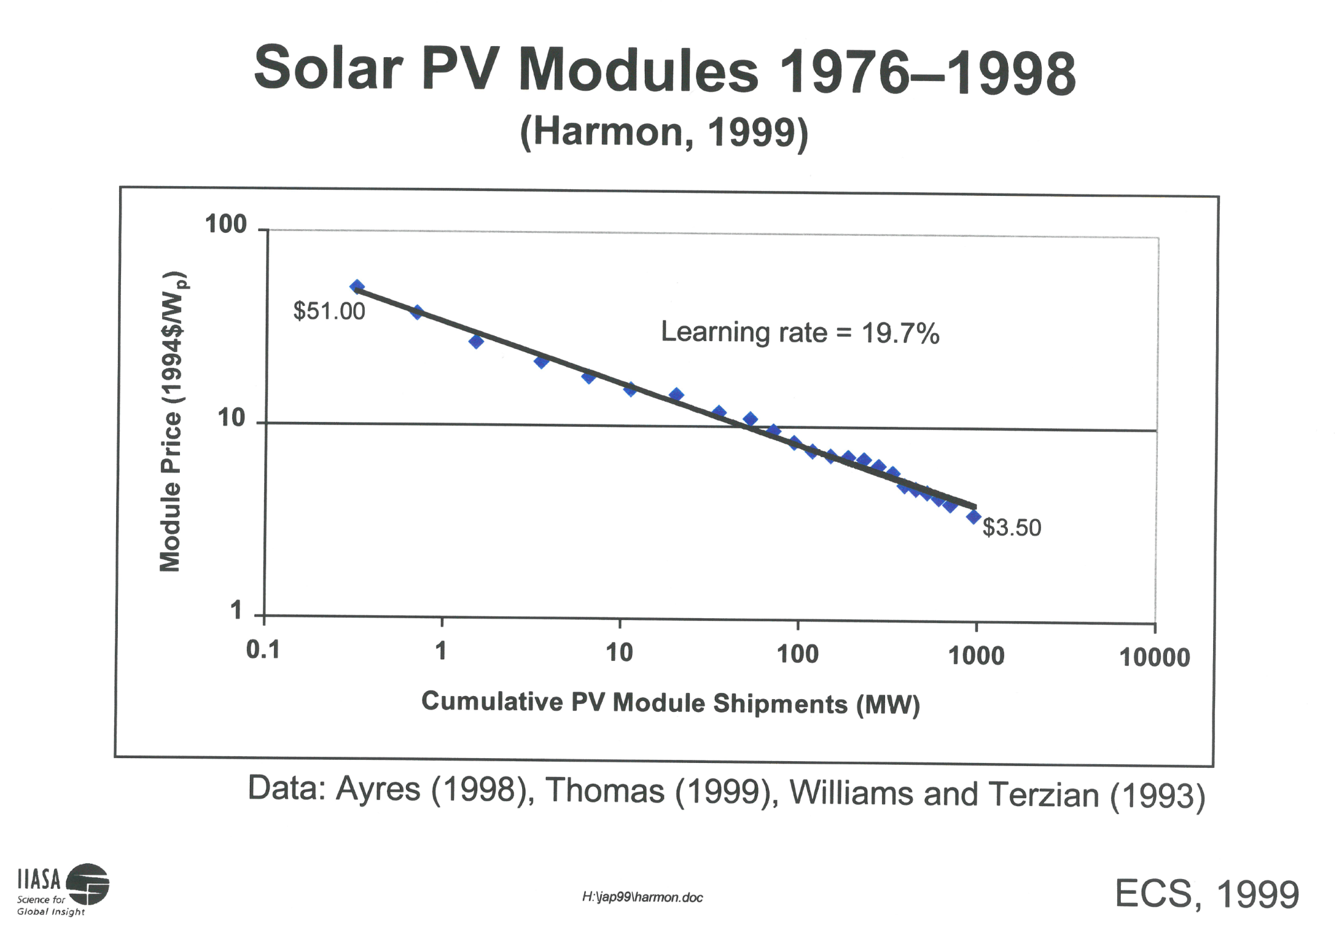

Slide 3
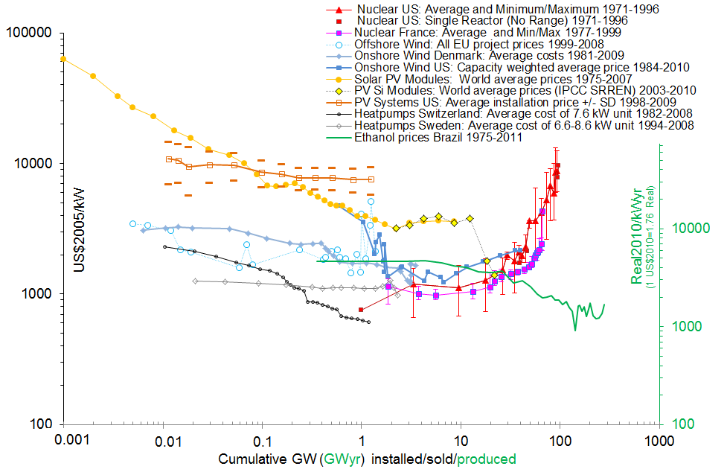

Supply Technologies Cost Trends
230GW @ $0.8/W
Source: Grubler et al, 2012
Notes:
3

Slide 4
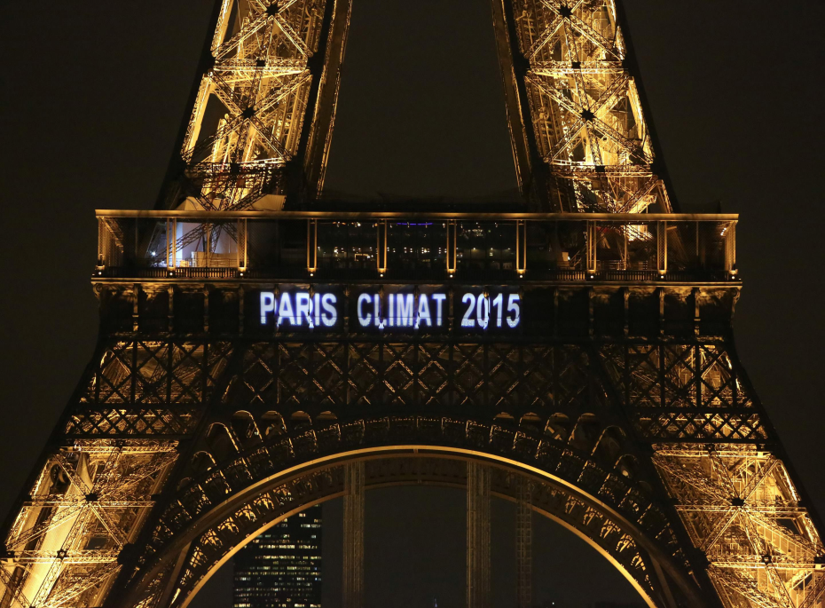

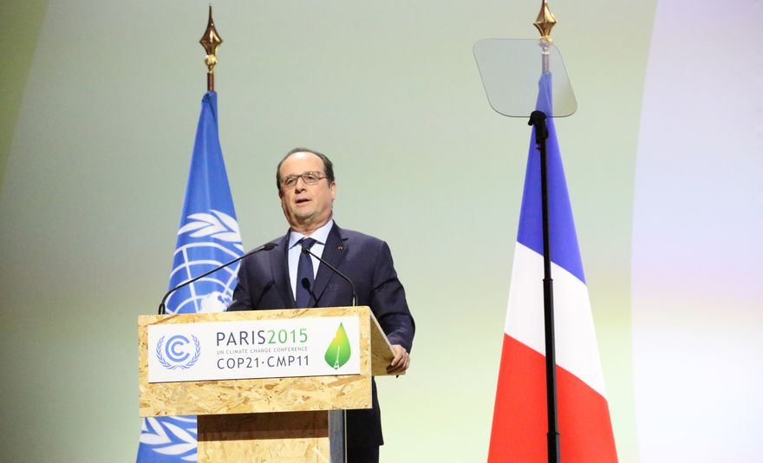
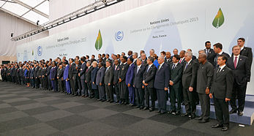

The Paris Agreement
Bildquelle: https://www.wmo.int/media/
Limiting global warming to
“well below”
2 degrees celsius
Achieving net-zero
GHG emissions by mid of the 21st century
Regular review and improvement of nationally determined contributions
Mobilizing $100 billion a year in support by 2020 through 2025
Source: Schellnhuber, 2016
Notes:
https://www.wmo.int/media/sites/default/files/cop21.jpg

Slide 5
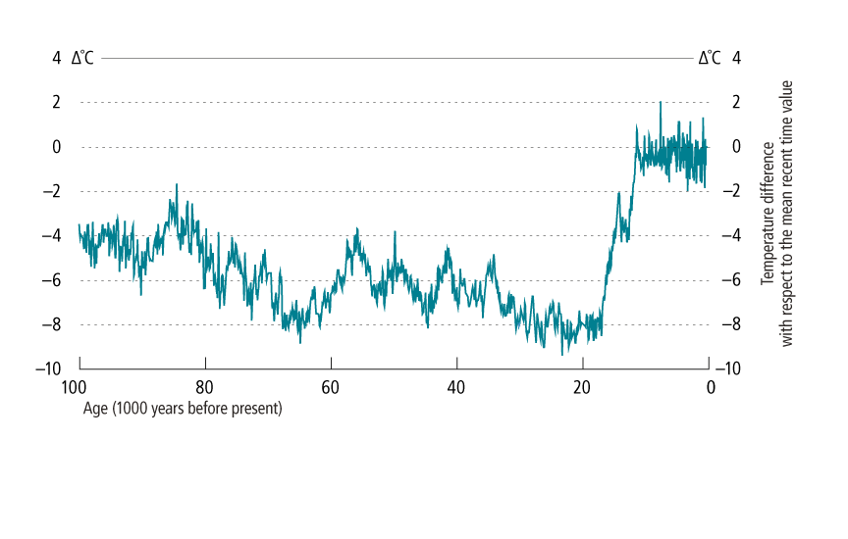

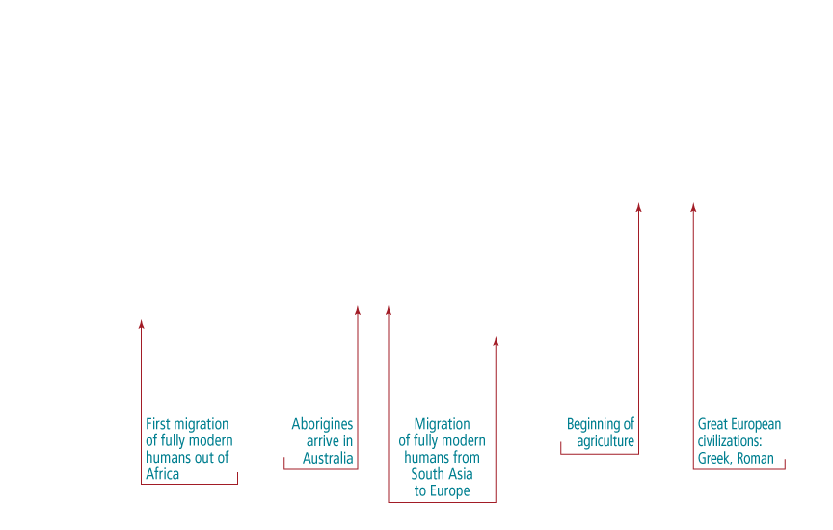

100,000-year ice-core record
Source: Data from Petit et al. 1999, labeled as in Young and Steffen 2009.

Slide 6
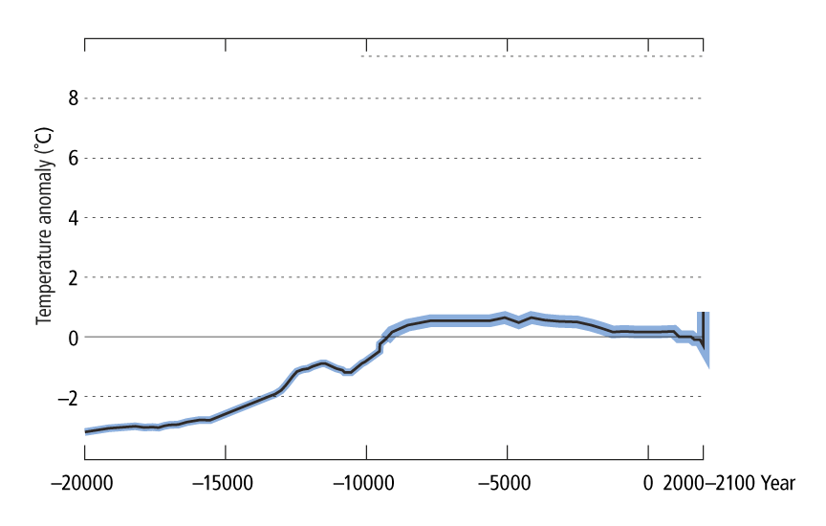


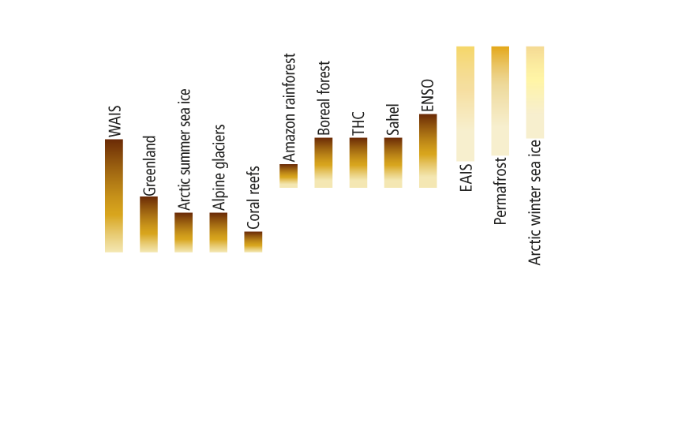

Tipping Elements & Paris
Adapted from Schellnhuber et al. 2016

Slide 7
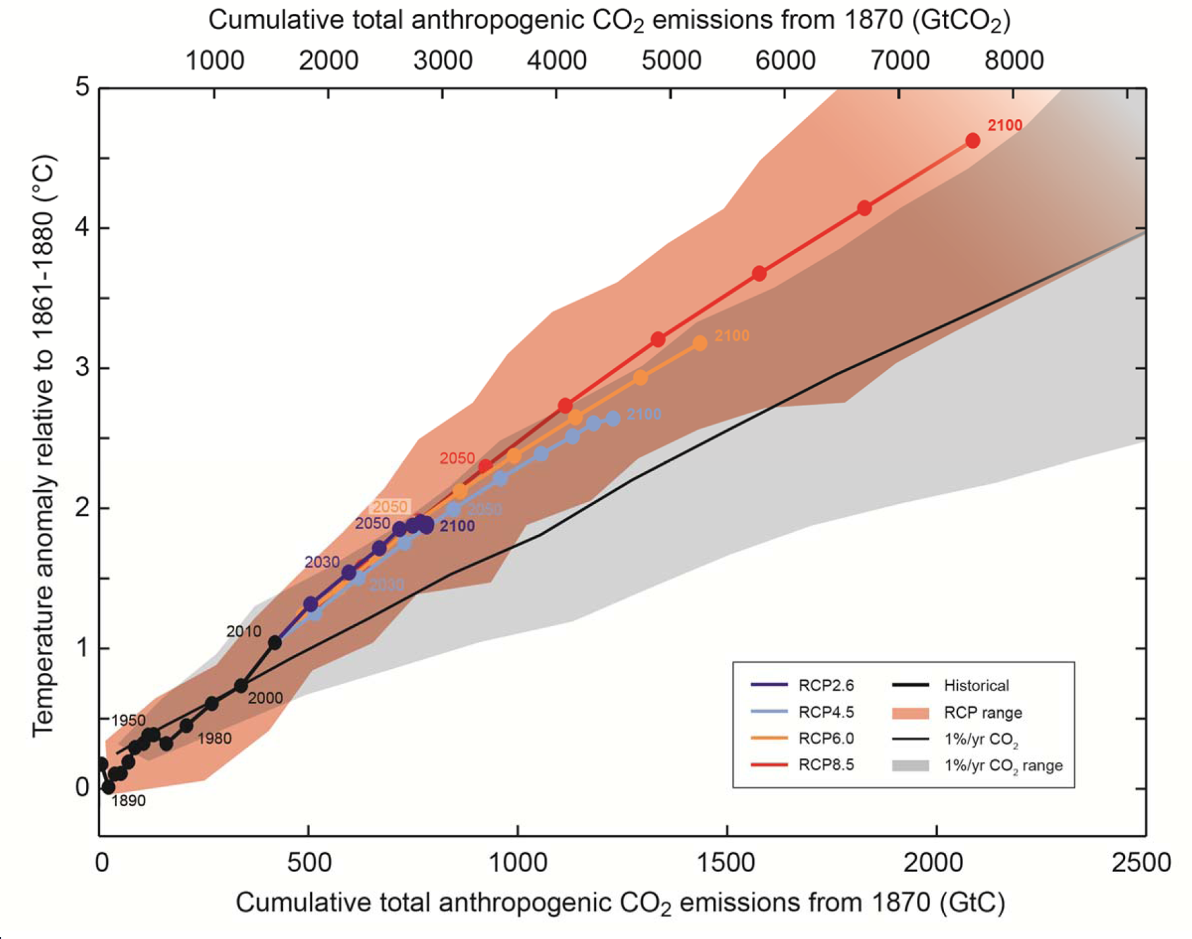

Cumulative Emissions & Temperature
Source: IPCC WGI, 2013

Slide 8
Net-Negative CO₂ Emissions
Max. temperature change in 21th century
Net carbon emission (in year 2100)
net negative carbon emissions
NO Scenarios with net negative Emissions above ~ 2.8 degree
NO Scenarios without net negative Emissions below ~ 1.5 degree

Slide 9









Global Primary Energy
Historical Evolution
1200
Other renewables
Nuclear
1000
Gas
Oil
Coal
Biomass
800
Mikrochip
Kommerzielle Luftfahrt
Nuklear-
energie
EJ
600
Renewables
Fernseher
Nuclear
400
Vakuumröhre
Ottomotor
Gas
Dampf-maschine
Elektrischer Motor
200
Oil
Coal
0
Biomass
1850
1900
1950
2000
2050
Notes:
9
9

Slide 10
Global Primary Energy
A Transformational Pathway
1200
Energy savings (efficiency, conservation, and behavior)
Savings
Other renewables
~40% improvement by 2030
1000
Nuclear
Gas
Oil
~30% renewables by 2030
Coal
800
Biomass
EJ
600
Nat-gas-CCS
Coal-CCS
Renewables
Nuclear
400
Gas
200
Bio-CCS – negative CO₂
Oil
Coal
0
Biomass
1850
1900
1950
2000
2050
Source: Riahi et al, 2012
Notes:
WEU + EEU – 31% (other RE + bio); 26% other RE, 5.5 % biomass
10

Slide 11
Global Primary Energy
no CCS, no Nuclear
1200
Energy savings (efficiency, conservation, and behavior)
Einsparungen
Savings
Andere E
Other renewables
~40% improvement by 2030
Nuklear
1000
Nuclear
Gas
Gas
Öl
Oil
~55% renewables by 2030
Kohle
Coal
800
Biomasse
Biomass
Nuclear phase-out (policy)
EJ
600
Renewables
Nuclear
400
Gas
200
Oil
Coal
0
Biomass
1850
1900
1950
2000
2050
Source: Riahi et al, 2012
Notes:
11

Slide 12
Globale Primärenergie
1200
Savings
Energie Einsparungen (Effizienz, Umwandlung und Verhalten)
Other renewables
1000
Nuclear
~50% Verbesserung bis 2030
Gas
Oil
Coal
~50% EE bis 2030
800
Biomass
≈ 1.5ºC
→ immediate Peak
EJ
600
Renewables
Gas
400
Nuclear
Oil
200
Coal
Biomass
0
1850
1900
1950
2000
2050

Slide 13
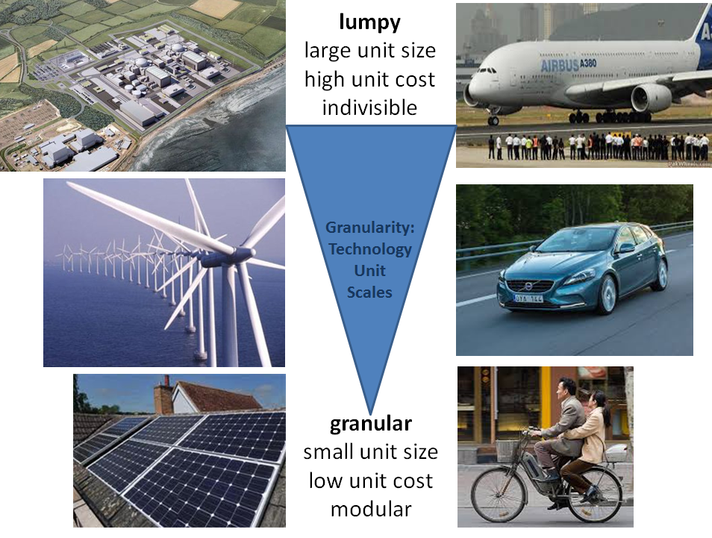
Pictures: Courtesy of Charlie Wilson

Slide 14
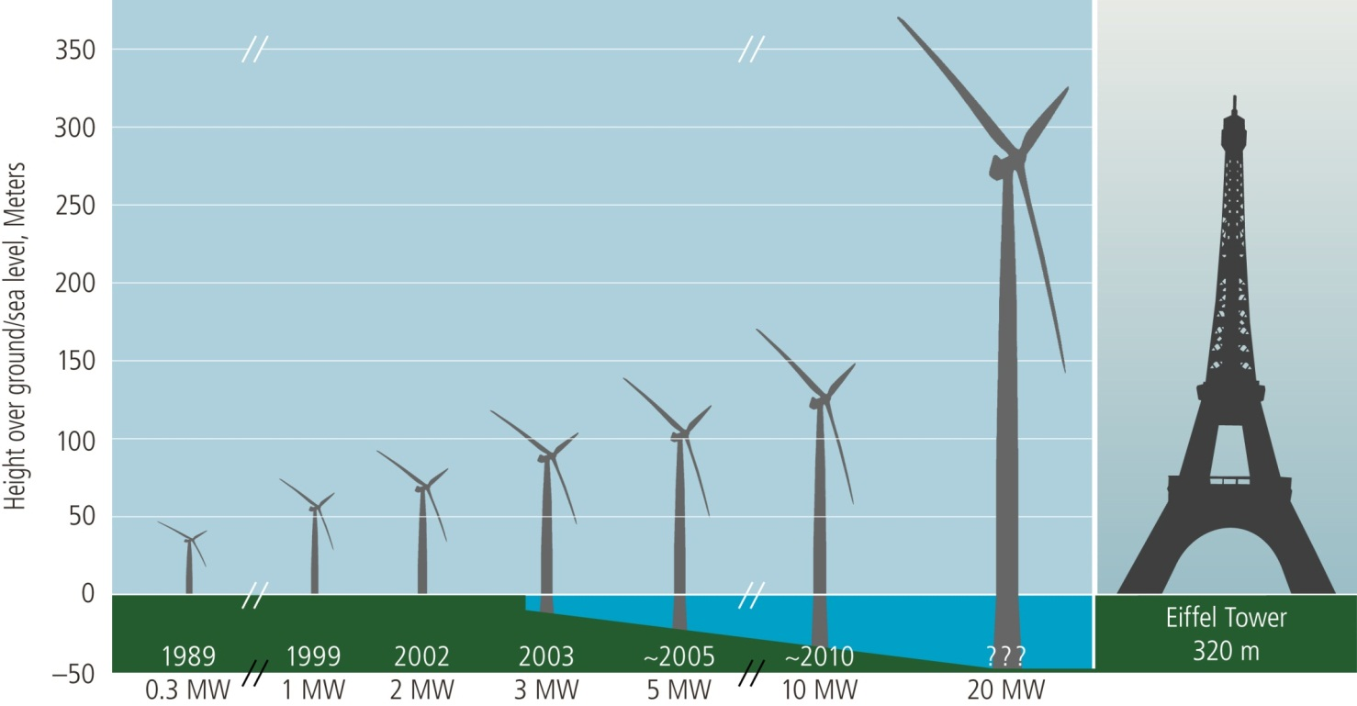
“Learning” Through Scale
Economies of scale, US wind turbines
Source: Grubler et al. ALPS-2012t
Notes:
14

Slide 15
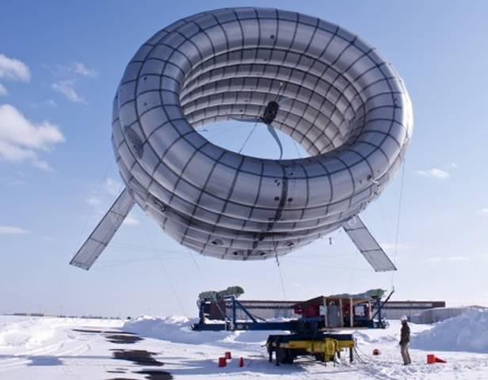



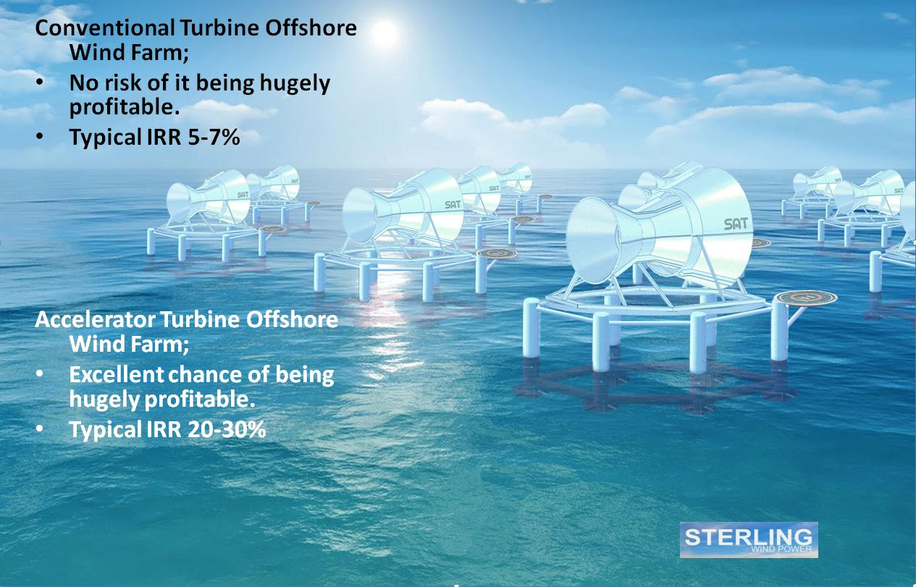
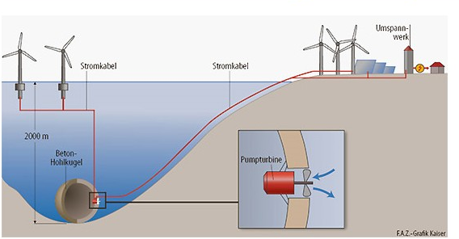
Possible transformational technologies

Slide 16

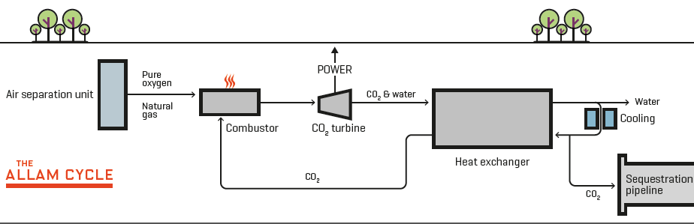
NET Power Breaks Ground on Demonstration Plant for Oxyfuel, Nantural Gas ZEP, La Porte, Texas

Slide 17
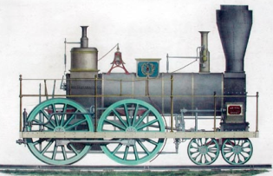
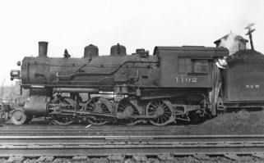
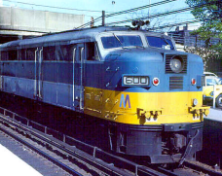
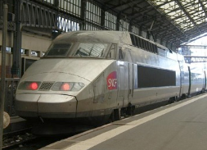
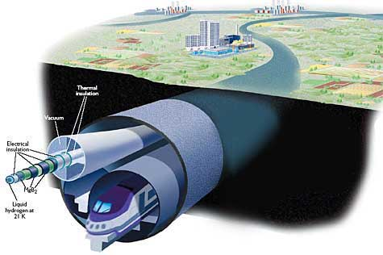
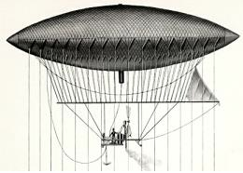
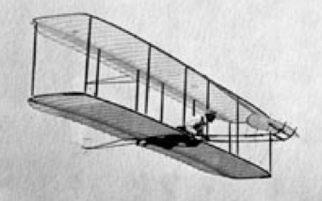


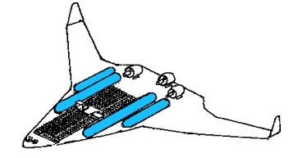
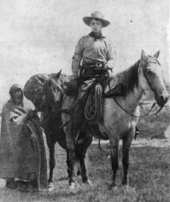

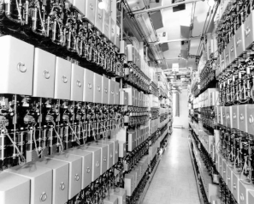


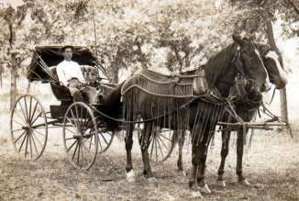
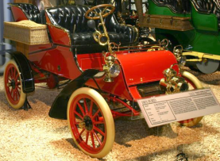

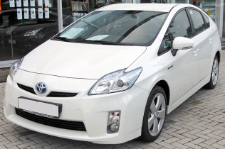

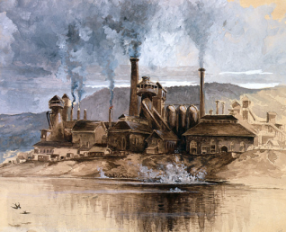
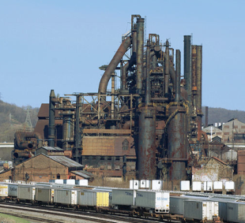
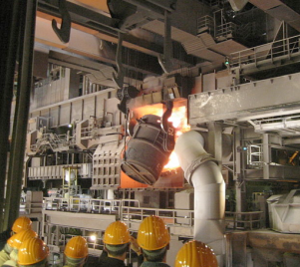

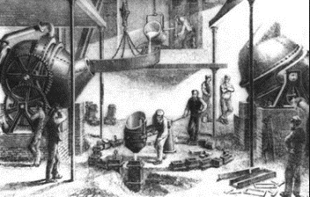
Transformational Change
1850
1900
1950
2000
2050
Source: After Granger Morgan, 2013

Slide 18
Disruptive Change
Darum geht zu allen Völkern […] und lehrt sie alles zu befolgen was ich Euch geboten habe.
Seid gewiss: Ich bin bei euch alle Tage bis ans Ende der Welt.
Source: Campanale, Carobntracker

Slide 19

THANK YOU
naki@iiasa.ac.at

